Slide 1
Learning
The process by which experience or practice results in a relatively permanent change in behavior or potential behavior
Classical
Conditioning
When a natural response to one stimulus is altered to occur with a different, neutral stimulus
Operant
Conditioning
behaviors are learned to earn rewards or avoid punishments
Social Cognitive Learning Theory
Behaviors are learned by observing a model
Pavlov and Watson
B.F. Skinner
Albert Bandura
UCS, UCR, NS, CS, CR
Reinforcement and Punishment
Modeling and Vicarious Learning

Slide 2
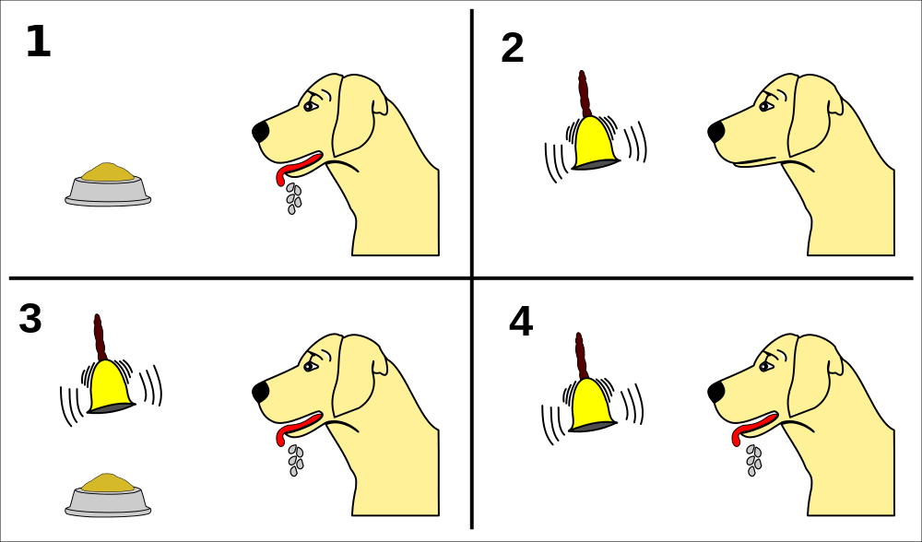
Classical Conditioning
Learn by association
Associate involuntary response with a new stimulus
Previously the stimulus meant nothing.
Now it means something IS ABOUT TO HAPPEN.

Slide 3
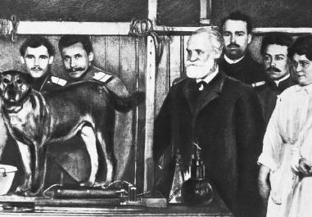
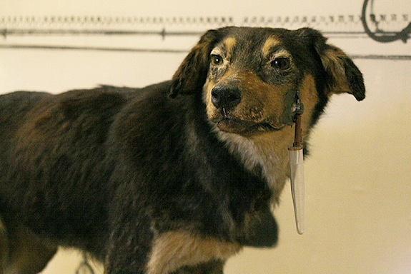
Ivan Pavlov
Russian physiologist known for his work in classical conditioning.
(Pavolv’s Dogs)

Slide 4
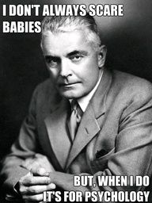
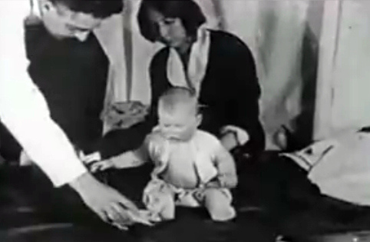
John B. Watson
American psychologist who established school of behaviorism.
He did the “Little Albert” experiment.

Slide 5
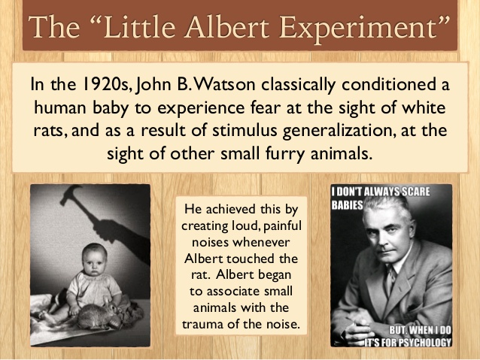

Slide 6
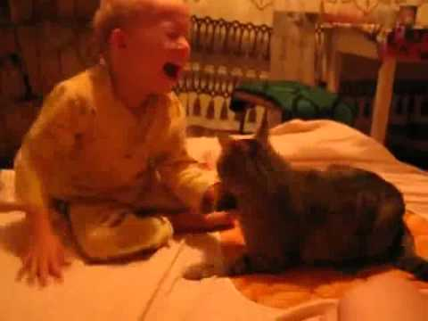
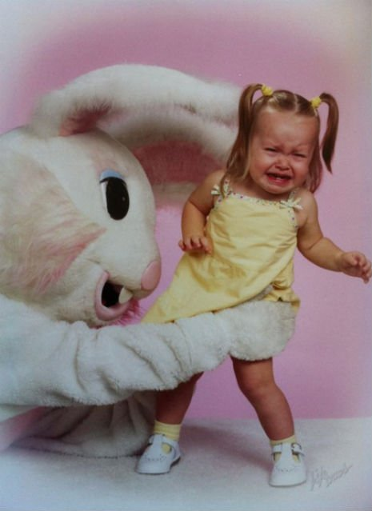
Classical Conditioning Examples
After the attacks, cats become a conditioned stimulus (CS) for pain causing fear when the child sees cats.
After this botched photo, 6 ft bunny becomes CS for someone trying to capture you.

Slide 7
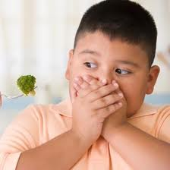
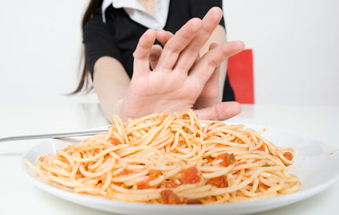
Classical Conditioning Examples
Taste Aversion
If you get sick after eating, you associate the food with getting sick. You may not try that food again.

Slide 8
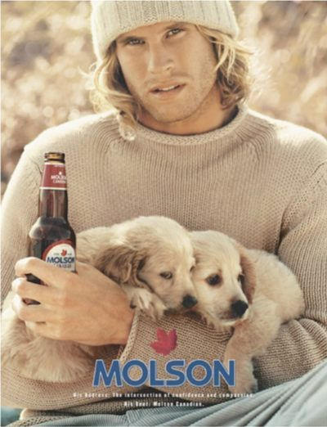
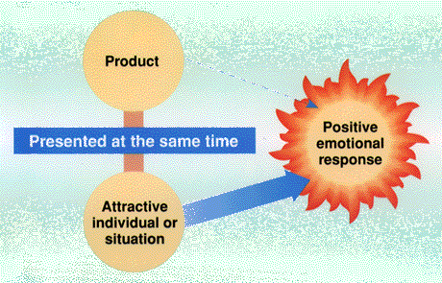

Classical Conditioning Examples
Show products with sexual imagery to elicit positive response for product alone.
Using sex to sell

Slide 9

Classical Conditioning: Key Terms
Unconditioned Stimulus (US) – A stimulus that causes an organism to respond in a specific way (ex. food)
Unconditioned Response (UR) – A response that takes place in an organism whenever a UCS occurs (ex. salivate)
Neutral Stimulus (NS) – Something that normally elicits no response (ex. bell sound)
Conditioned Stimulus (CS) – A previously neutral stimulus (NS) that is paired with an unconditioned stimulus and eventually produces the desired response when presented alone. (ex. bell sound)
Conditioned Response (CR) – The learned response to a previously neutral stimulus. (ex. salivate from bell sound)

Slide 10
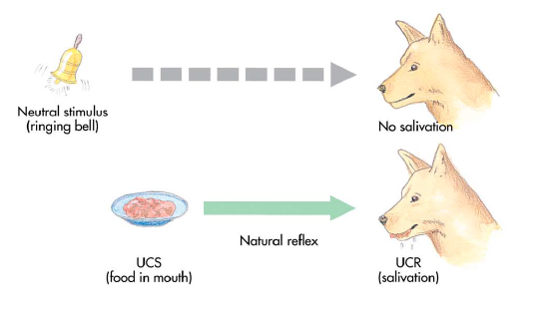
Neutral Stimulus
A stimulus that does not naturally cause a response.
It will become the CS.

Slide 11
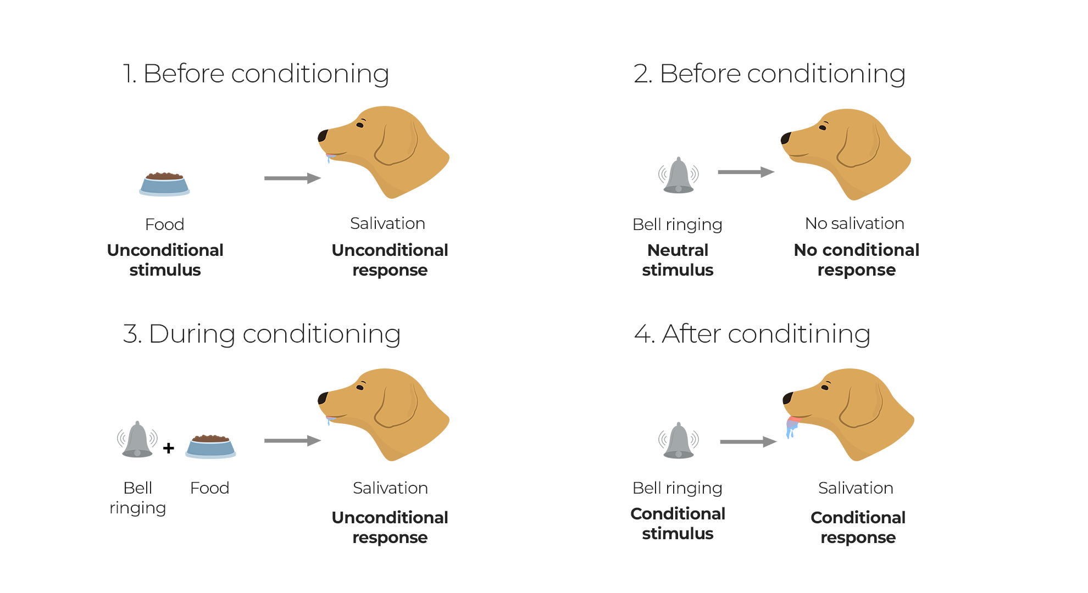
Pairing
Presenting the NS and the US together multiple times.
When acquisition occurs, the NS becomes the CS.
Most effective when NS is presented shortly before US

Slide 12
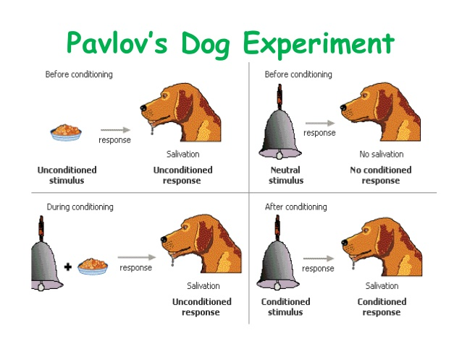

Slide 13
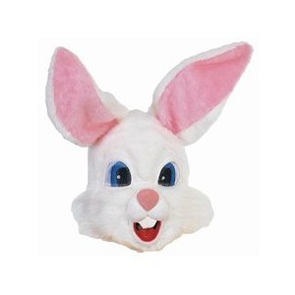
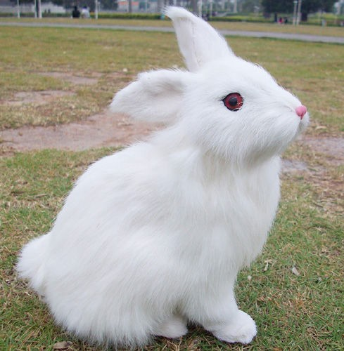
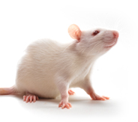
Generalization
The transfer of a learned response to different but similar stimulus.

Slide 14
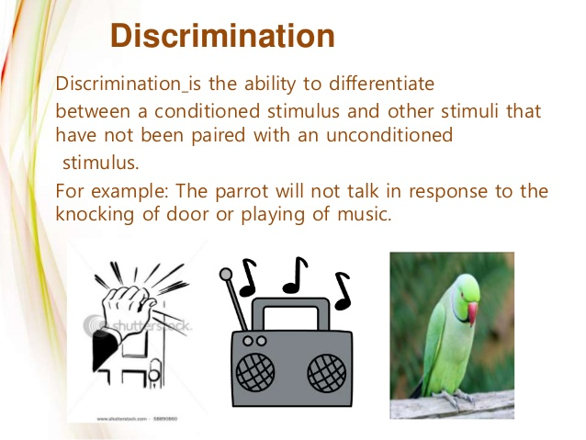

Slide 15
