Slide 1
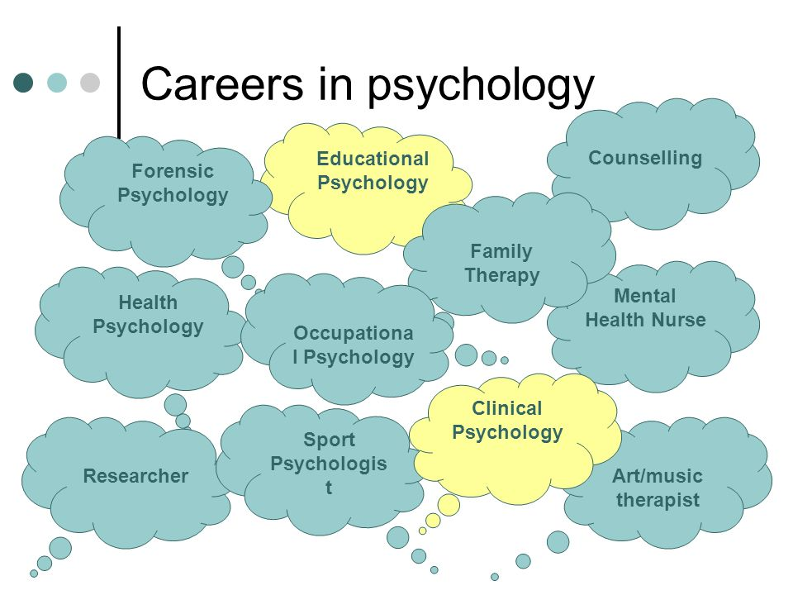
Psychology’s Subfields
Psychology is made up of many different disciplines. Here are some:
Clinical
Counseling
Cognitive
Developmental
Educational
Experimental
Psychometric
Social
Industrial-Organizational

Slide 2
Clinical vs. Counseling
About 50% of all psychologists
Counseling psychologists = deal with “normal” problems, like stress caused
by career change or marital problems.
Clinical psychologists = deal with more serious problems or mental illness
Career options include:
  Licensed social workers
  Counseling psychologists
  Clinical psychologists
  Psychiatrists
  Psychoanalysts

Slide 3
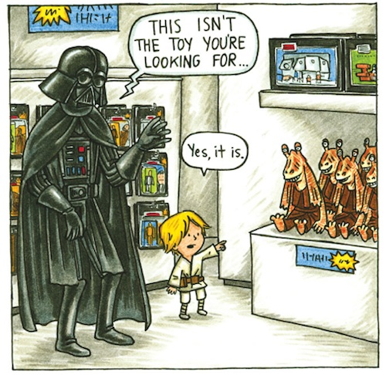
Developmental
Study of physical and mental growth from birth to old age
Study of changing abilities from womb to tomb
Subfields:
  Child psychology
  Adolescent psychology
  Life-span psychology

Slide 4
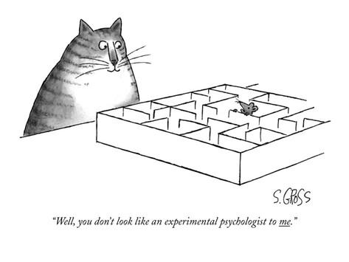
Experimental
Design research experiments
May or may not have a direct impact on the treatment of patients
Animal subjects
Drug trials

Slide 5
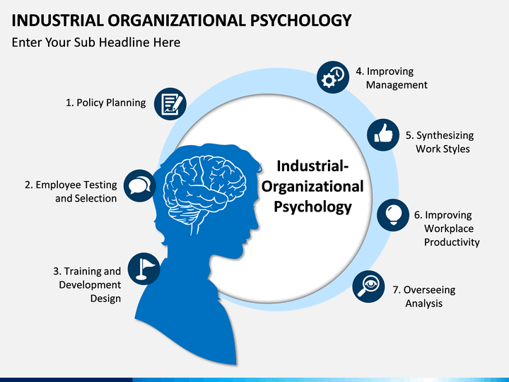
Industrial - Organizational
Study of psychological principles in industry and business
Examples:
Selecting and training personnel
Productivity improvement
Optimizing working conditions
Managing the impact of automation on workers

Slide 6

Psychometric
The theory and technique of psychological measurement.
Create psychological tests that are reliable and valid.

Slide 7
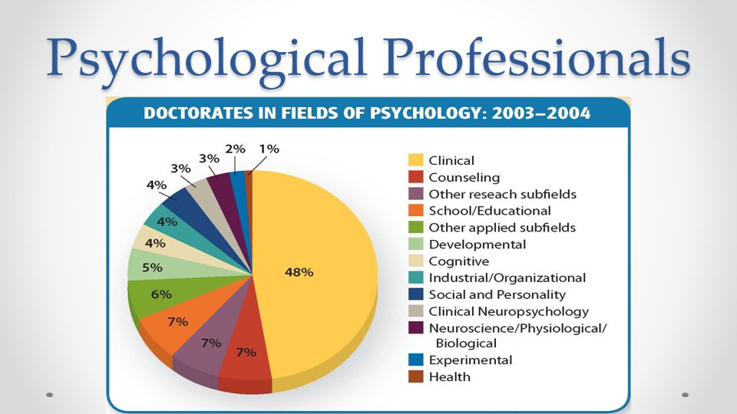

Slide 8
