Slide 1
Black Holes
A region in space-time from which nothing, not even light, can escape. General relativity predicts this.
Two types:
Stellar: The end point of stars 20x mass of sun. Relatively small (5-30 km)
Supermassive: Found in center of galaxies. Very large (up to 10 AU).

Slide 2
Stellar Black Holes
Large star collapses to point of zero volume and infinite mass; a singularity.
Event Horizon: surface or edge of black hole (point of no return).
Accretion Disk: BH can’t swallow matter fast enough… a clogged drain.

Slide 3
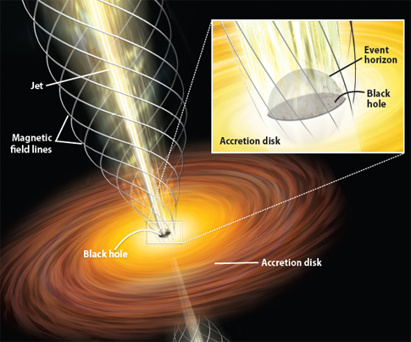

Slide 4
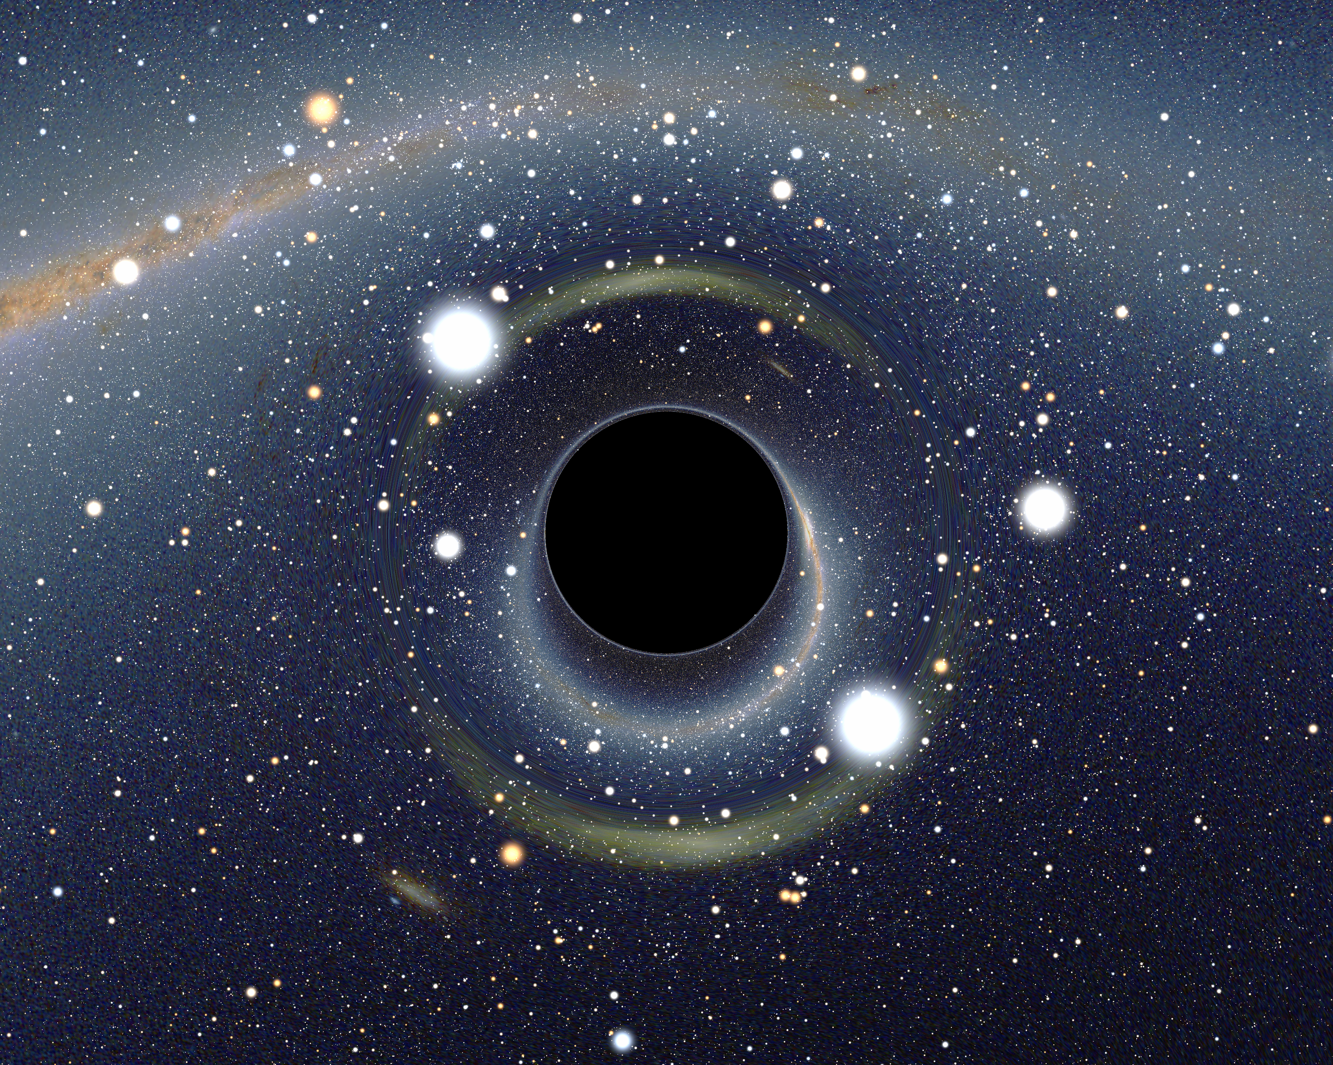

Slide 5
How Do We See Them
We infer them by observing how matter and EMR react.
1. X-ray emissions: matter in accretion disk heats up… if hot enough, matter produces X-ray emissions before it falls into BH.

Slide 6
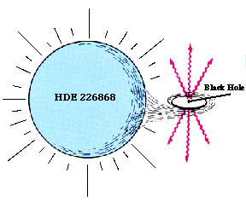
Cygnus X-1 (closest BH) emits X-rays.

Slide 7
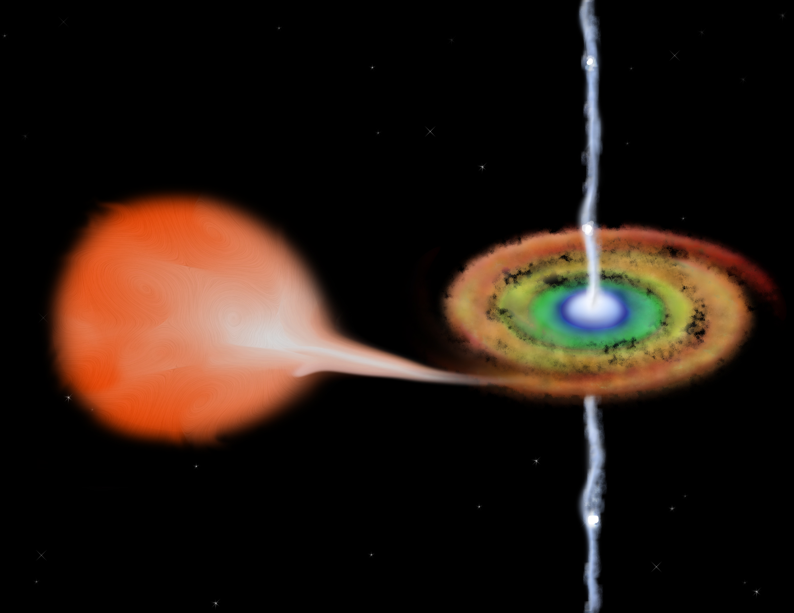

Slide 8
How Do We See Them
2. Gravitational Lensing - as black hole passes in front of matter, gravity bends/distorts light behind the black hole.
Neutron stars can only be so big… if limit is reached, must be black hole.

Slide 9
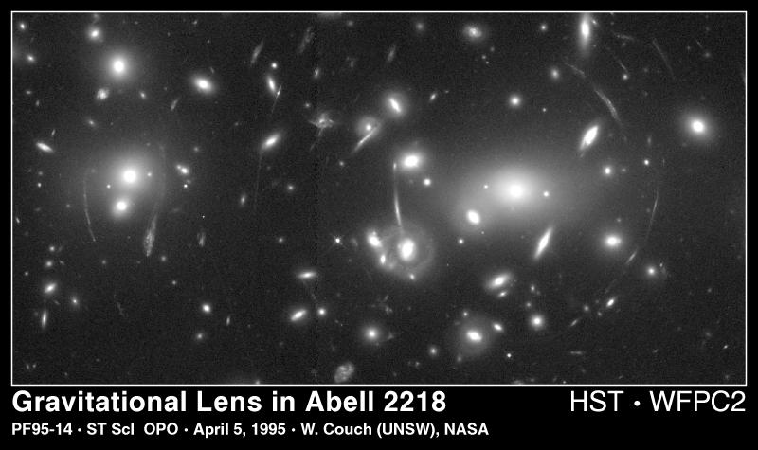

Slide 10
Supermassive BHs
Likely formed by stellar black hole that swallows more and more matter… maybe merges with other black holes.
Found at center of most (if not all) galaxies… including the Milky Way.
Largest so far… 10x bigger than solar system (swallowed billions of stars).

Slide 11
What Happens at Event Horizon?
If looking at a spaceship at horizon, the spaceship would apparently never enter the hole.
On the spaceship at the horizon, time would move normally.
Spaghettification? or Fire? for humans.

Slide 12
