Slide 1
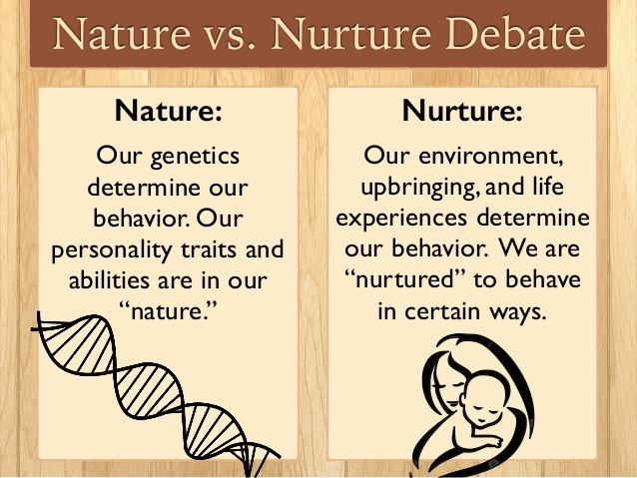
Behavioral Genetics
Notes:
OBJECTIVE 6-2| Describe the type of questions that interest behavior geneticists.

Slide 2
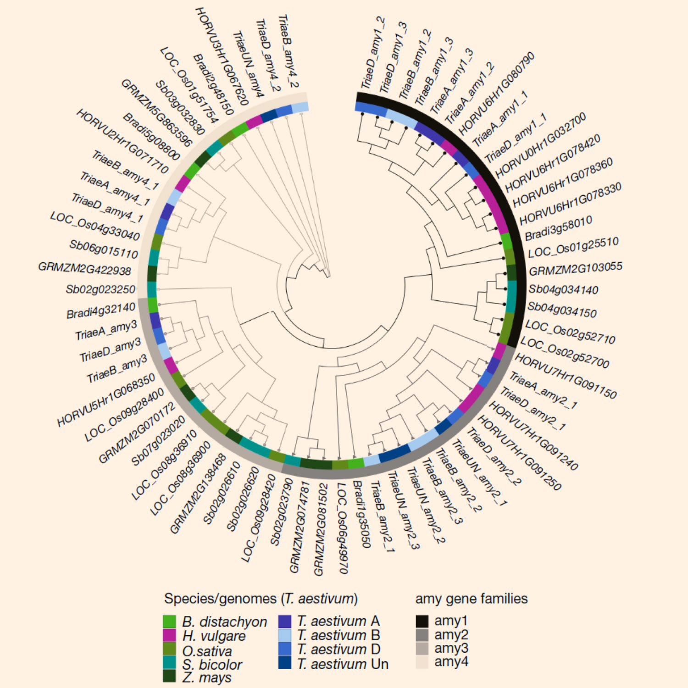
Genome
set of complete instructions for making an organism…
contains all the genes in that organism.

Slide 3
Heritability
Heritability = genetics explains variation (ex. intelligence) among groups of people.
Can never say what percentage of individual variation (ex. intelligence) is due to genetics.
Differences in weight and height are heritable, and yet nutrition has made us heavier and taller than our ancestors a century ago.
Notes:
OBJECTIVE 6-7| Explain heritability's application on individuals and groups, and explain what we mean when we say genes are self-regulating.

Slide 4
How do similar environments impact heritability?
If all schools were of uniform quality,
all families equally loving, and
all neighborhoods equally healthy,
then
heritability would increase
(because differences due to environment
would decrease).
So, any difference we noticed between two students would be due more to their genes than their environment.

Slide 5
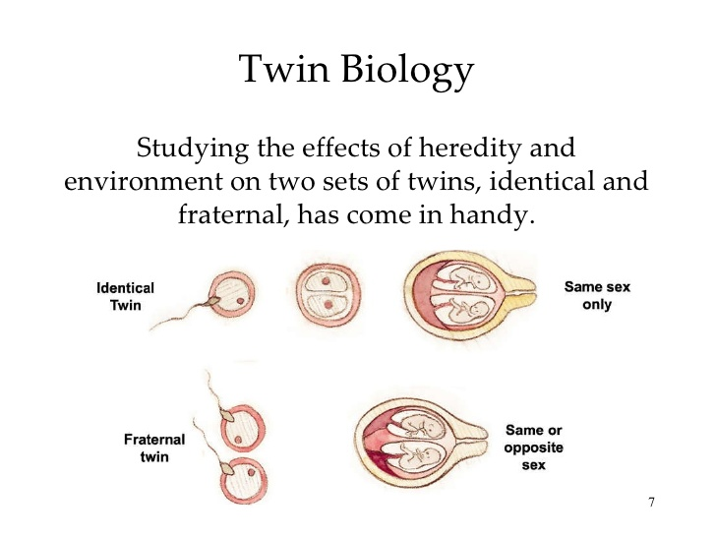

Slide 6
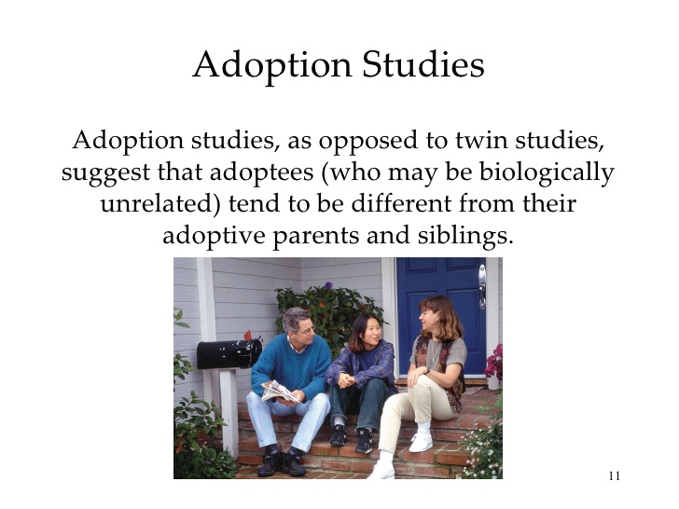

Slide 7
Separate Twins
Temperament = a person’s stable emotional reactivity and intensity.
Identical twins have similar:
Temperaments, suggesting genetic influence; and
I.Q., where ~67 percent is heritable (variation among groups), with 33 percent influenced by the environment.
Notes:
OBJECTIVE 6-6| Discuss how the relative stability of our temperament illustrates the influence of heredity on development.

Slide 8
Separated Twins
Identical twins raised separately from birth have similarities.
Separated Twins
Intelligence, Abilities
Brain Waves, Heart Rate

Slide 9
Parenting (Nurture)
Parenting effects biologically related and unrelated children.
Parenting Influence
Attitudes, Values, Politics
Manners, Beliefs

Slide 10
Gene-Environment Interaction
Genes can influence traits, and environment can affect gene activity.
A genetic predisposition that makes a child restless and hyperactive, evokes angry responses from his parents.
A stressful environment can trigger genes to manufacture neurotransmitters leading to depression.
Notes:
OBJECTIVE 6-8| Give and example of a genetically influenced trait that can evoke responses in others, and give another example of an environment that can trigger gene activity.

Slide 11
Evolution
A number of human traits have been identified as a result of pressures afforded by natural selection.
Why do infants fear strangers when they become mobile?
Why are most parents so passionately devoted to their children?
Why do people fear spiders and snakes and not electricity and guns?

Slide 12
Human Sexuality
Gender differences are mostly in reproductive pressures.
Due to the reproductive reality, it would seem most adaptive for women to find a mate that gives the best genes, resources, and long-term parental care.
Males can pass on as many genes as they can find willing partners.
Notes:
OBJECTIVE 12| Identify gender differences in sexuality.

Slide 13
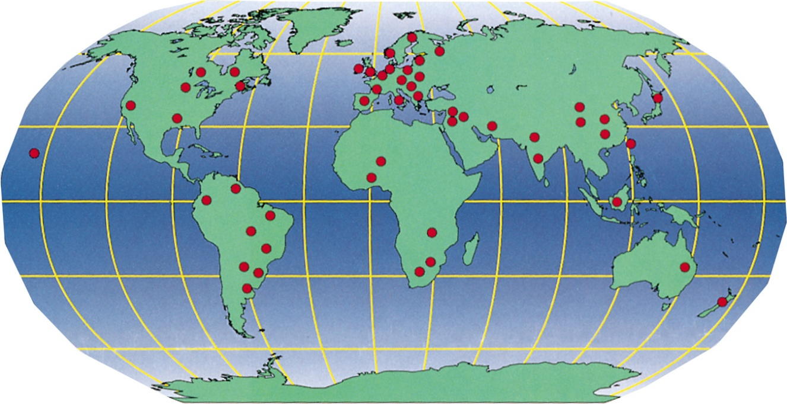
Mating Preferences
Men look for youthful appearance, and chastity
Women look for maturity, dominance, affluence and boldness.
Data based on 37 cultures.

Slide 14
Sigh . . . .
Average-looking student research assistants asked random people the following:
“I have been noticing you around campus and I find you to be very attractive. Would you go to bed with me tonight?
Russell Clark and Elaine Hatfield (1978)
Women = 0%
Men = 75%
Some men replied “Why do we have to wait until tonight”.
Repeated in 1982 and in the late 1980s with the same results. (50-75% of the men said yes.)

Slide 15
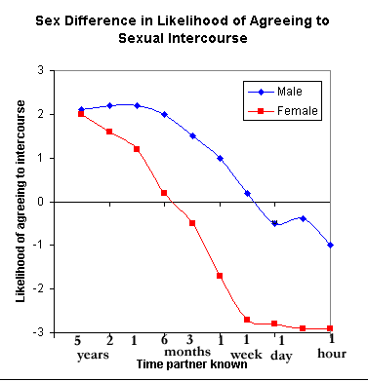

Slide 16
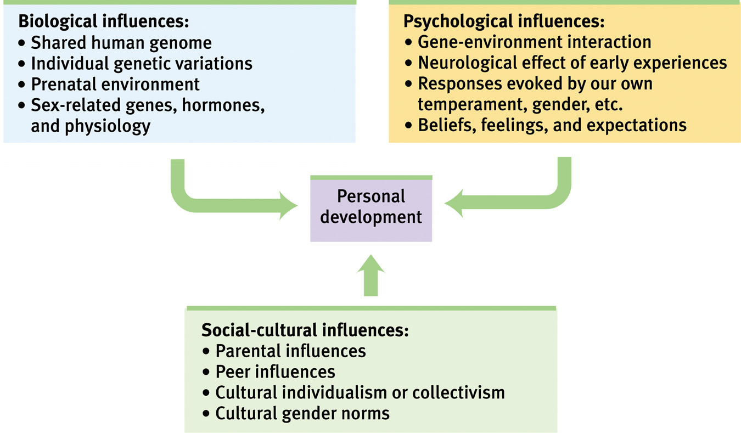
Reflections on Nature and Nurture
Notes:
OBJECTIVE 7-17| Describe the biopsychosocial perspective on development.

