Slide 1
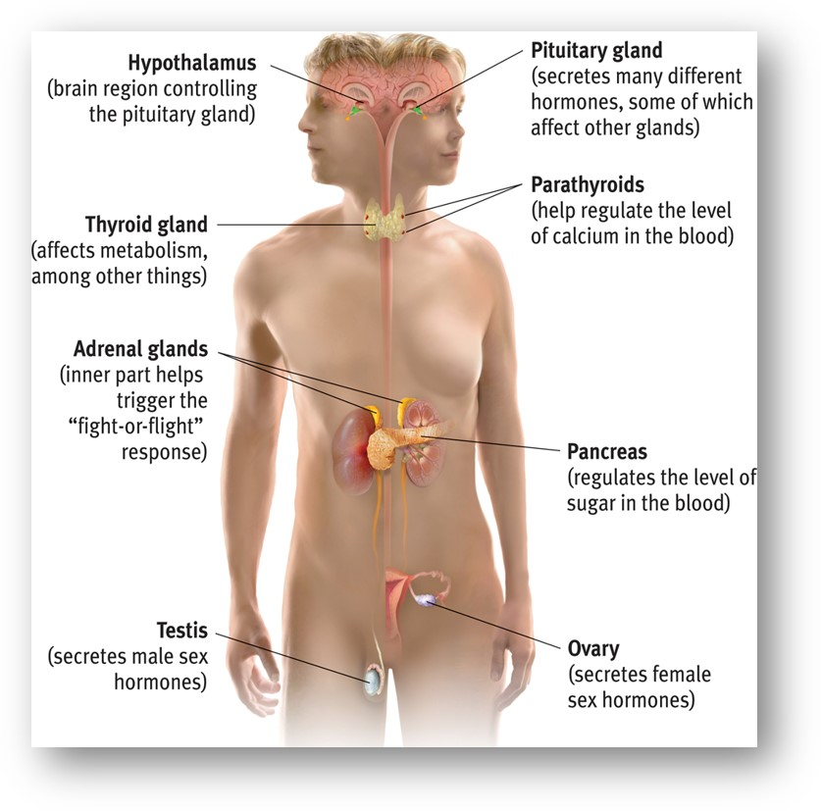
Endocrine System
the body’s “slow” chemical communication system, using hormones made by glands.
Compares to “fast” nervous system.
Notes:
OBJECTIVE 4-10| Describe the nature and functions of the endocrine system and its interaction with the nervous system.

Slide 2
Endocrine System
The endocrine system sends messages (hormones) through the bloodstream.
Hormones are produced in various glands around the body.
Controlled by the Hypothalamus
Notes:
Click to reveal bullets.
“Slow but sure” endocrine system messages take longer to get to their location, but then the molecules hang around for a bit, so the effect of the “message” lasts longer. In neural communication, reuptake of the neurotransmitters sometimes prevents effective communication. (This is the real “chemical imbalance” treated by some medication: slowing reuptake.)

Slide 3
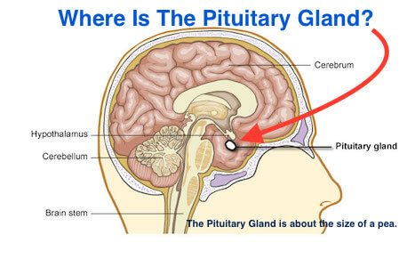
Pituitary Gland
The “master gland” of the endocrine system.
Controlled through the hypothalamus.
Regulates other glands.
Notes:
Click to reveal bullets.

Slide 4
Pituitary Gland
Influences blood pressure, thirst, contractions of the uterus during childbirth, sexual behavior and interest, body growth etc.
Produces growth hormone (especially during sleep) and oxytocin, the “bonding” hormone.

Slide 5
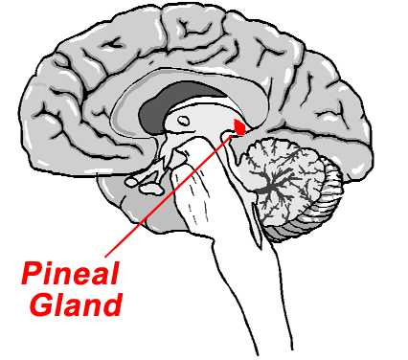
Pineal Gland
Secretes melatonin = influences sleep/wake cycle.

Slide 6
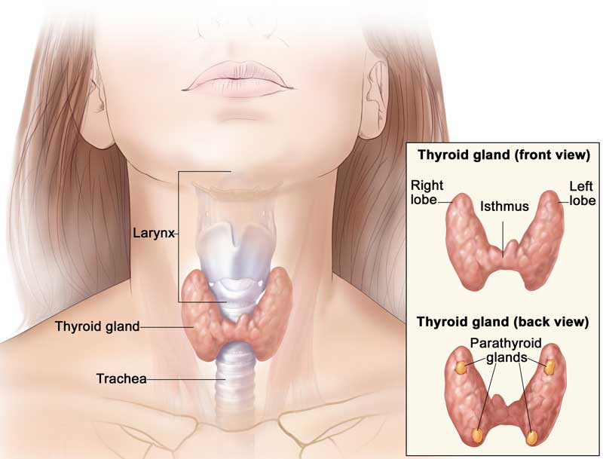
Thyroid Gland
Controls metabolism
Overactive thyroid = insomnia
Underactive thyroid = constantly tired

Slide 7
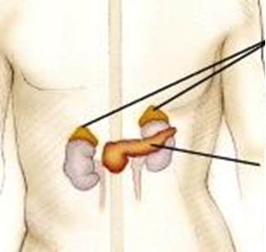
Adrenal Glands
Produce adrenaline/epinephrine, noradrenaline/norepinephrine, and cortisol.
Adrenal Glands
The sympathetic “fight or flight” nervous system sends a message to adrenal glands.
Effect: increased heart rate, blood pressure, and blood sugar.
Pancreas
Notes:
Click to reveal bullets.
The adrenal glands also produce cortisol; more about this when we talk about stress and health.

Slide 8
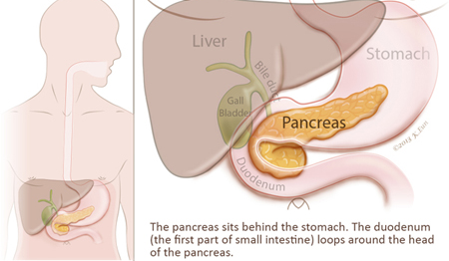
Pancreas
Regulates blood-sugar levels
Secretes insulin (to lower) and glucagon (to add)
Husbands and wives reported being most unhappy with their spouses when their blood-sugar levels were lowest, usually at night

Slide 9
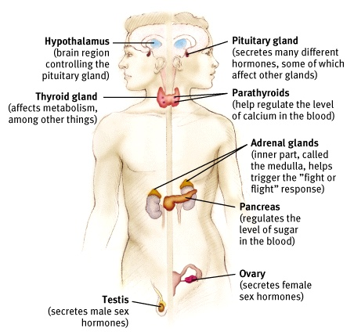
Gonads
Sex glands regulate bodily development and maintain reproductive organs.
Ovaries and testes secrete estrogen and testosterone

Slide 10
