Slide 1
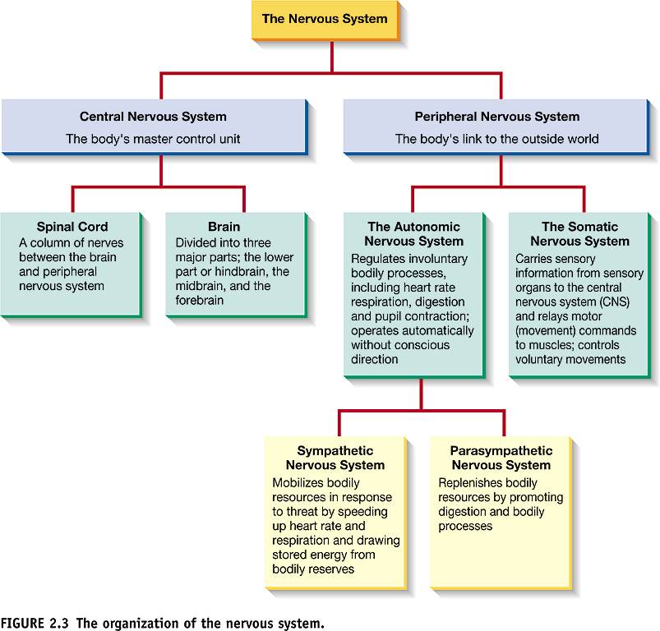

Slide 2
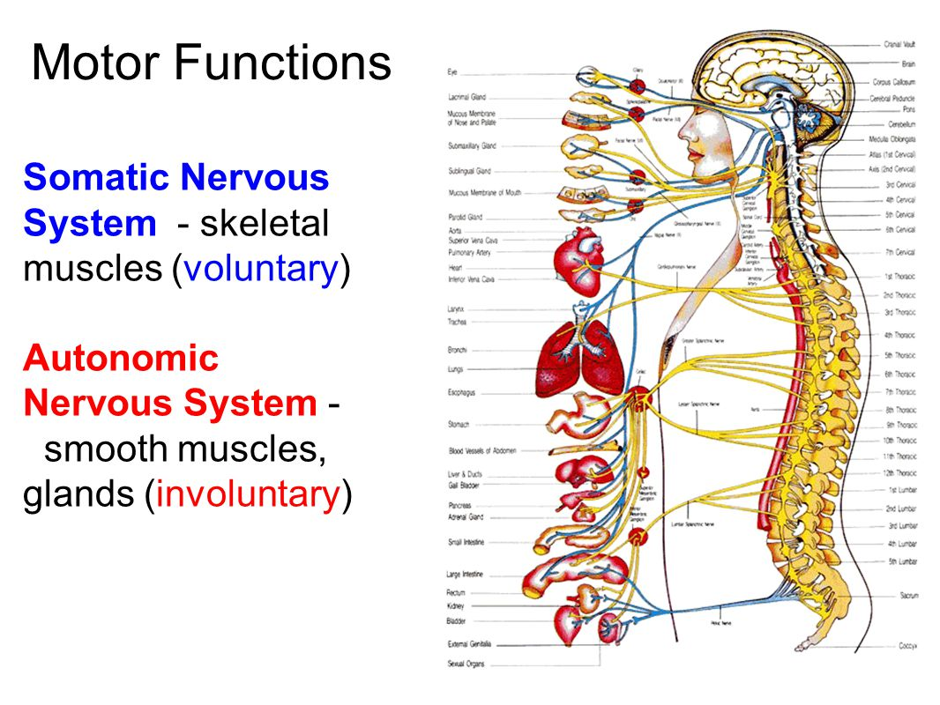

Slide 3
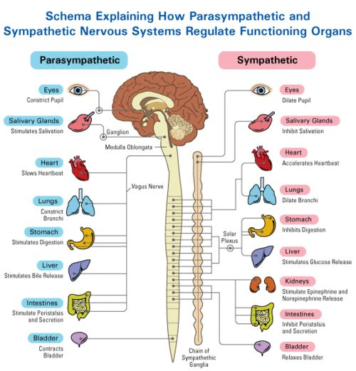
The Autonomic Nervous System (ANS)
Sympathetic:
arouses the body, mobilizing energy in stressful situations. Gets you ready for “fight or flight”.
Parasympathetic Nervous System:
calms the body, conserving energy. Brings you back down after the threat is over.

Slide 4
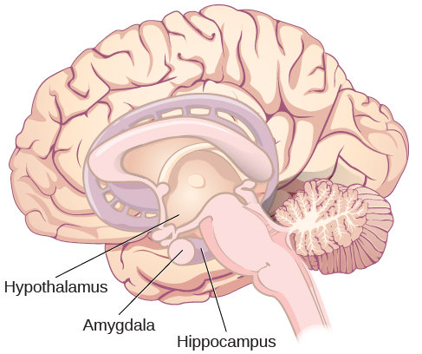
The Hypothalamus
The hypothalamus coordinates ANS responses.
During a stressful event, the amygdala sends a distress signal to the hypothalamus that communicates fight or flight to the rest of the body.

