Slide 1
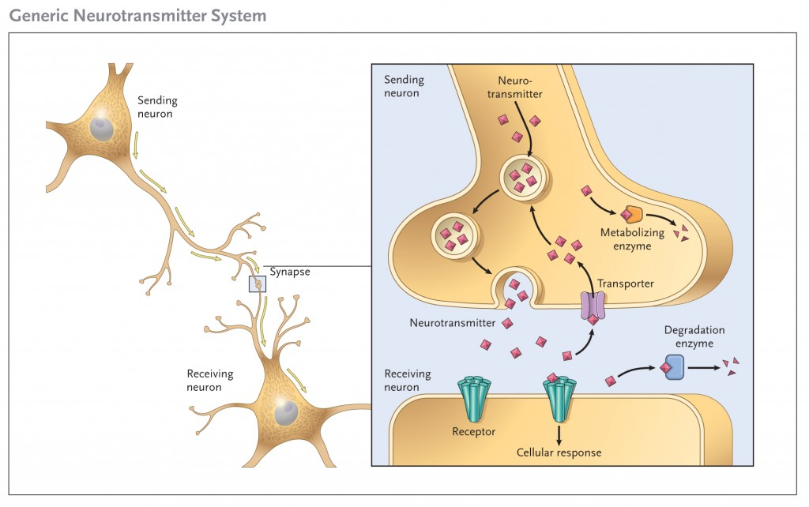
Neural Communication

Slide 2
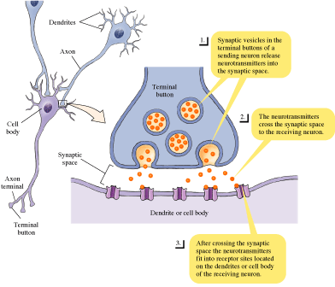
Synapse
The synapse
Includes the terminal button, the synaptic space, and dendrites
Terminal button
Enlarged area at the end of an axon
Synaptic space (synaptic cleft)
Tiny gap between neurons
Receptor Sites
Sites on the dendrite where neurotransmitters fit like keys.

Slide 3
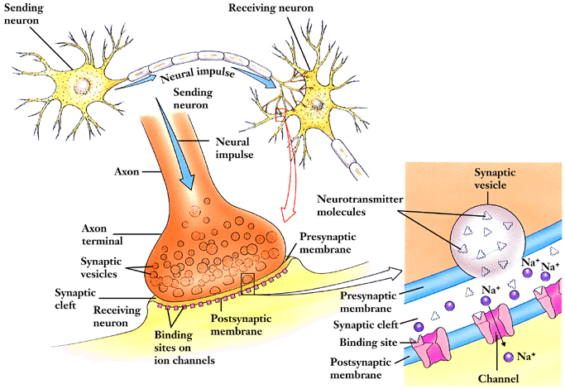
Chemical Communication
-- Synaptic vesicles release neurotransmitters that bind to receptor sites.
-- Sacs in terminal button release chemicals into synaptic space.
-- Sites on the dendrite where neurotransmitters bind fitting like keys into specially designed locks.

Slide 4
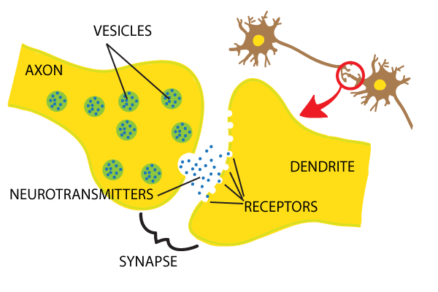
Neurotransmitters
Neurotransmitters
chemicals that travel across the synaptic gap and bind to receptor sites on the receiving neuron, thereby generating an action potential.

Slide 5
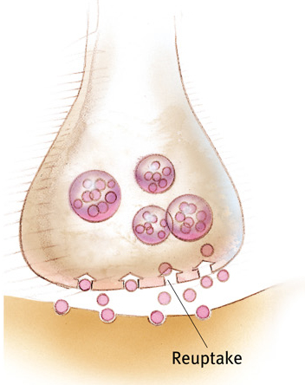
Reuptake
Reuptake = neurotransmitters in the synapse are reabsorbed into the sending neuron.
Ex:
People with depression have lower levels of serotonin. SSRI’s (anti-depressants) block reuptake, which floods the synapse with more serotonin.
Notes:
Reuptake – After NTs are puked out, it sucks back up remaining NTs and refirbs for future use.

Slide 6
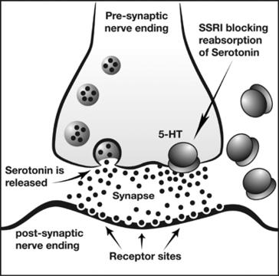
Selective Serotonin Reuptake Inhibitor (SSRI)
Citalopram (Celexa)
Escitalopram (Lexapro)
Fluoxetine (Prozac)
Paroxetine (Paxil, Pexeva)
Sertraline (Zoloft)

Slide 7
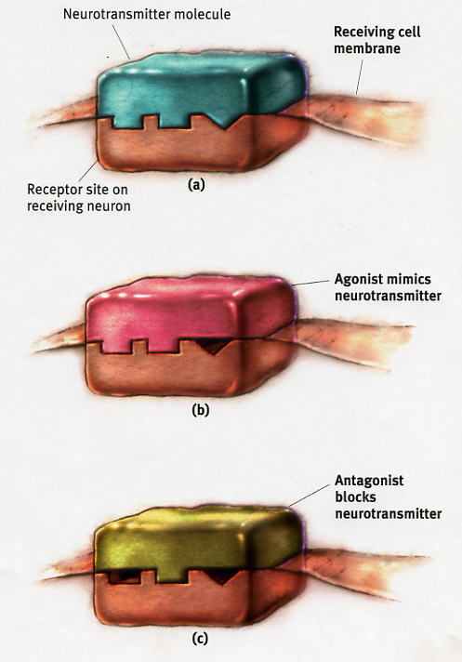
Agonist and Antagonist
Agonists - Drugs that excite a neuron.
Antagonists - Drugs that inhibit a neuron.

Slide 8
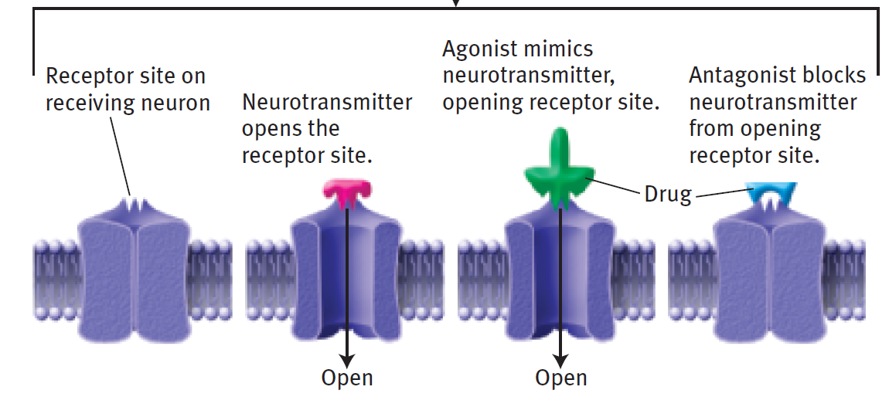
Agonist vs. Antagonists

Slide 9
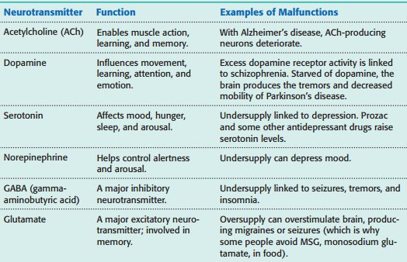
Neuro- transmitters

