Slide 1
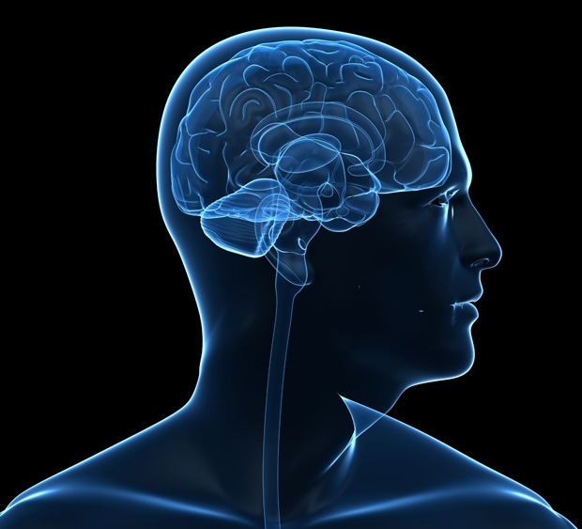
Biological Psychology
How the body influences behavior and mental processes
Biological psychologists may call themselves behavioral neuroscientists, neuropsychologists, behavior geneticists, physiological psychologists, or biopsychologists

Slide 2
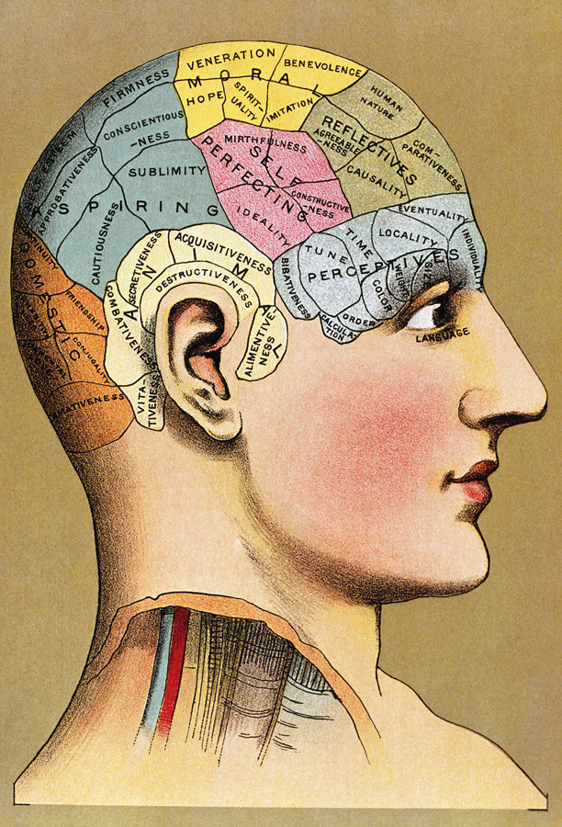
History of the Mind
Phrenology
In 1800, Franz Gall suggested, that bumps of the skull represented mental abilities.
His theory though incorrect, nevertheless proposed different mental abilities were modular.
Bettman/ Corbis
Notes:
Biological psychologists – look at link between biological activity and psychological events
Mark Twain visited Lorenzo Fowler (under a fictitious name) he was told he had no sense of humor, but on a repeat visit under his own name he had “the loftiest bump of humor” ever encountered (Twain 1959; Lopez 2002)

Slide 3


Biological Psychology
Everything psychological is simultaneously biological.
The brain is both specialized and integrated.
The nervous system is “plastic” especially at early ages of development.

Slide 4
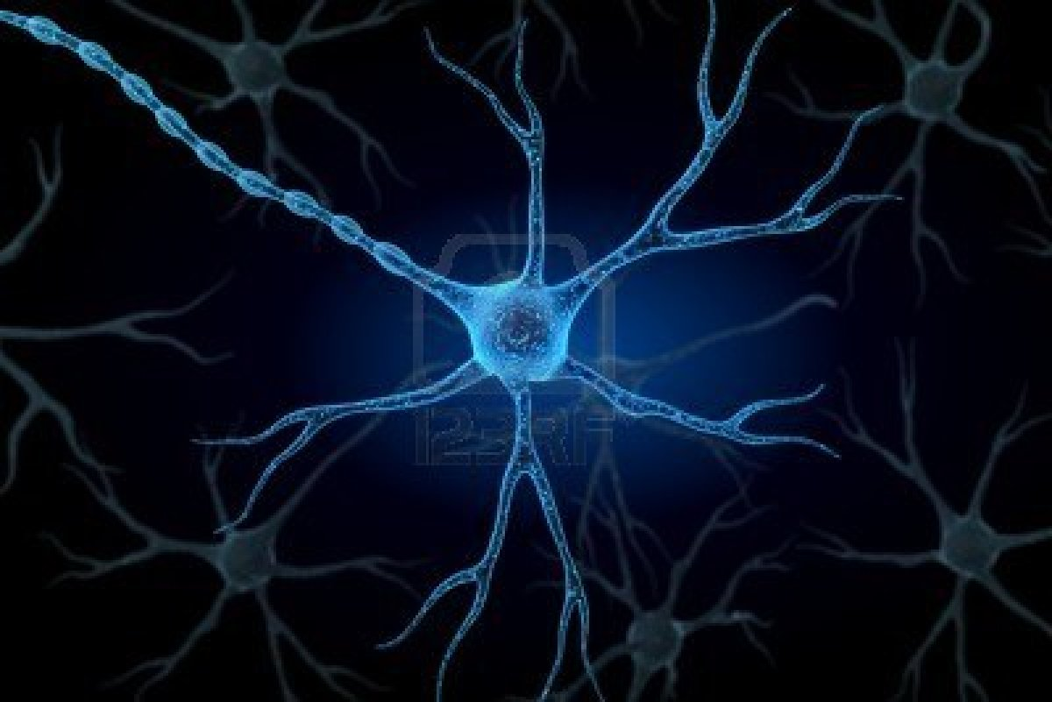
Neurons
About 100 billion neurons (nerve cells) in the human brain.
Neurons have many of the same features as other cells
  nucleus
  cytoplasm
  cell membrane
What makes neurons unique is their shape and function.

Slide 5
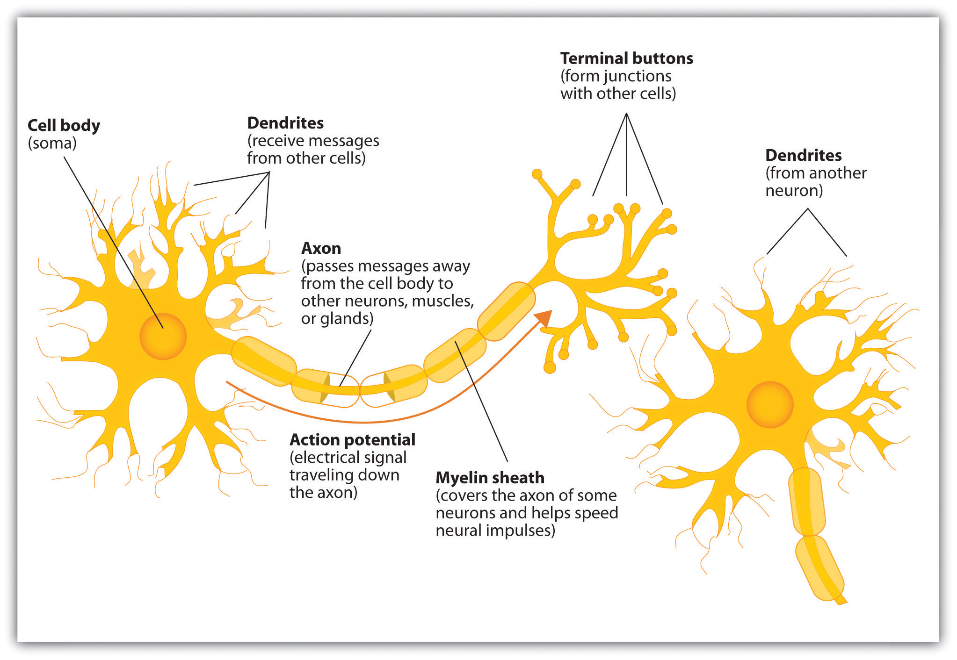
Neurons
Dendrites
  Carry information to the cell body from other neurons
Axon
  Carries information to the next cell
Myelin Sheath
  Insulates the axon and speeds up the neural impulse
Glial Cells
  Cells that protect neurons.

Slide 6
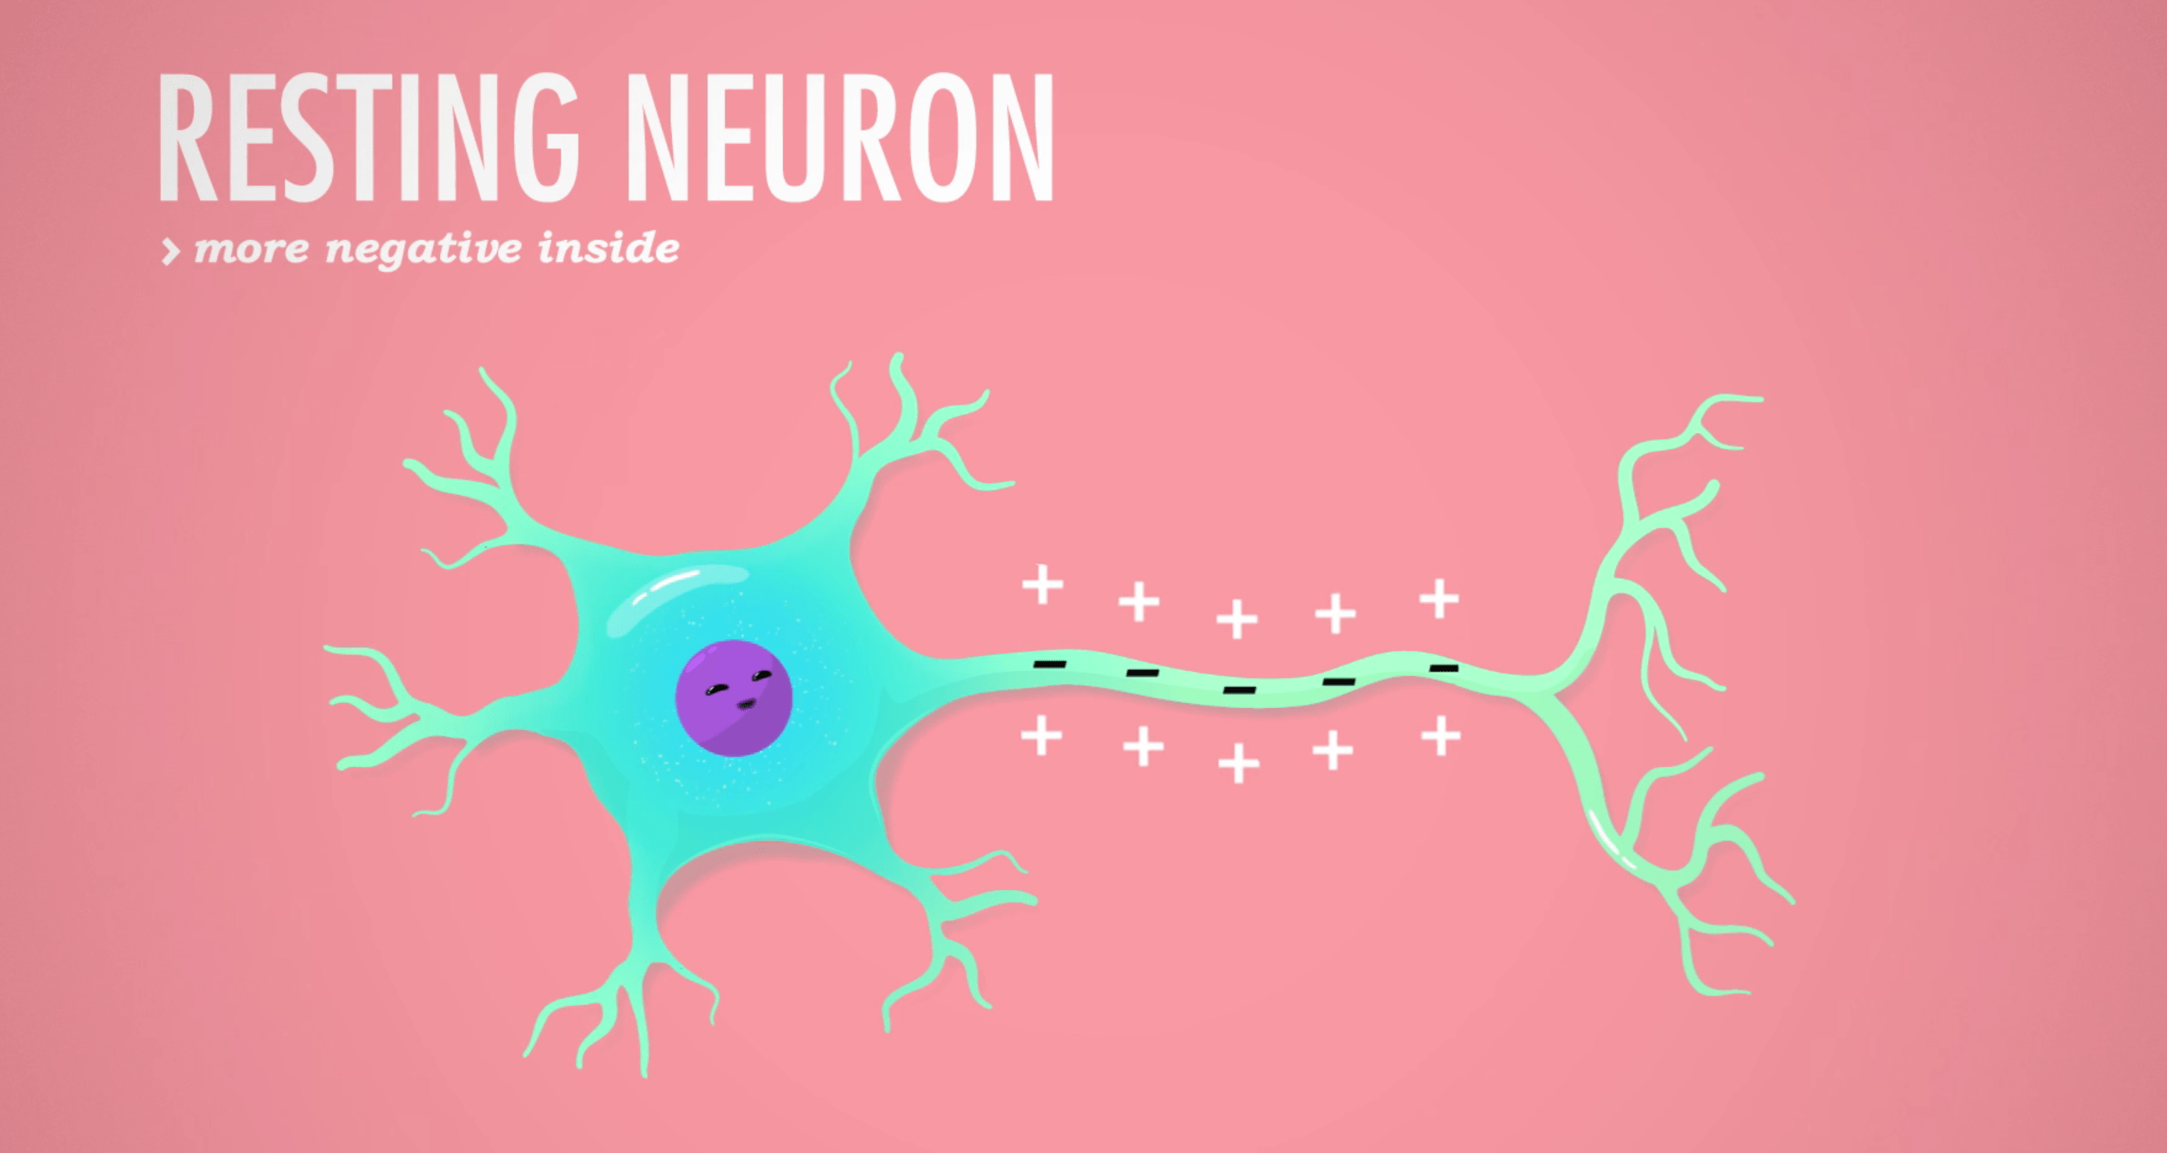
Resting Potential
Nothing is happening = Polarized
Negative ions on the inside.
Positive ions are on the outside
Negative Ions Inside the Neuron is Natural

Slide 7
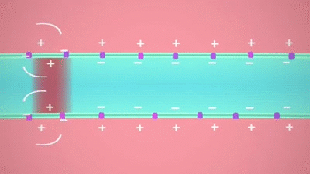
Action Potential
brief electrical charge that travels down an axon
Also called neural impulse or nerve firing or depolarization
positively charged ions move into the axon.

Slide 8
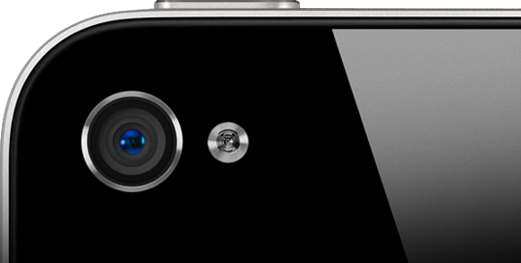
Refractory Period
Refractory Period = Every action potential is followed by a brief recharging period.
  Ex. similar to delay after taking a picture with flash before you can take another picture.

Slide 9

All or None Law
A neuron either fires or it doesn’t.
When it fires, it always produces an impulse of the same strength
Intensity of a stimulus is seen by the frequency (how many) of action potentials

Slide 10
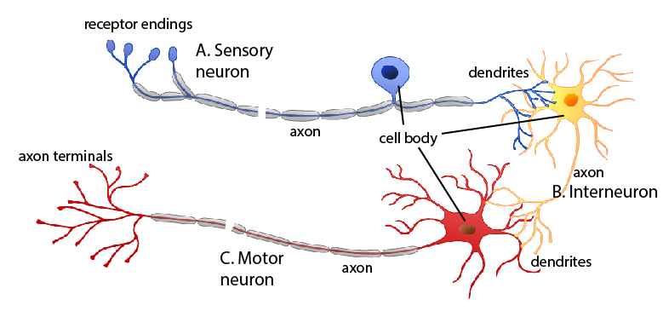
Types of Neurons
Sensory neurons (afferent)
  from senses to the brain
Motor neurons (efferent)
  from brain to muscles and glands
SAME
Sensory-Afferent
Motor-Efferent
Interneurons
  between other neurons
  mostly in the brain and spinal cord

