Slide 1
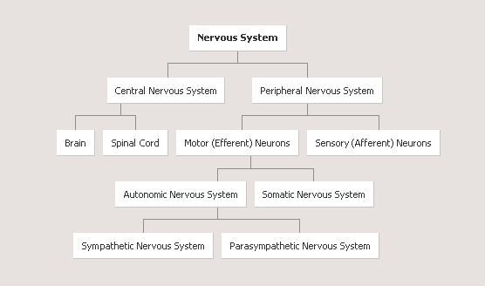

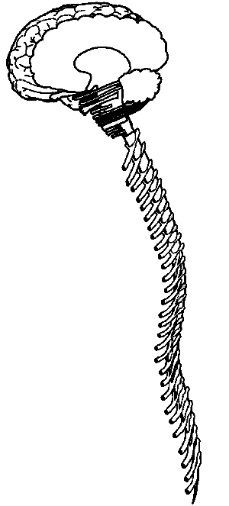
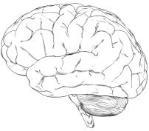
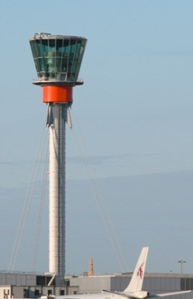
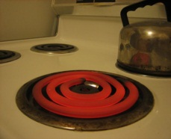
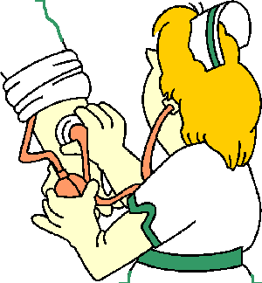
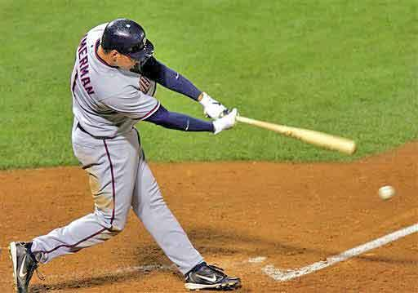


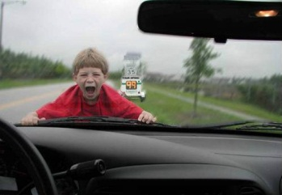

Slide 2
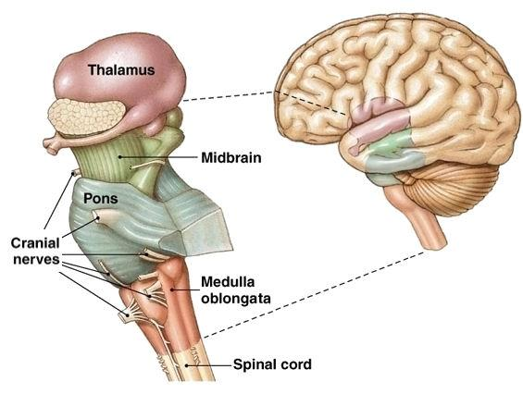
Brain Stem (Automatic Functions)
The brainstem is the oldest part of the brain (lizard brain),
where the spinal cord swells and enters the skull.
responsible for automatic survival functions.

Slide 3
The Brain Stem (Automatic Functions)
Brain Structure | Primary Function | Secondary Function
Medulla | Respiration, blood pressure, heart rate | Vomiting
Pons | Sleeping and Waking
Reticular Formation | Attention, regulates awareness
Cerebellum | Balance and coordination
Thalamus | Directs sensory information to the rest of the brain

Slide 4
Brain Stem
Medulla controls heartbeat and breathing.
Reticular Formation controls arousal.
Thalamus sends messages to the sensory areas in the cortex.
Pons play a role in sleep and arousal

Slide 5
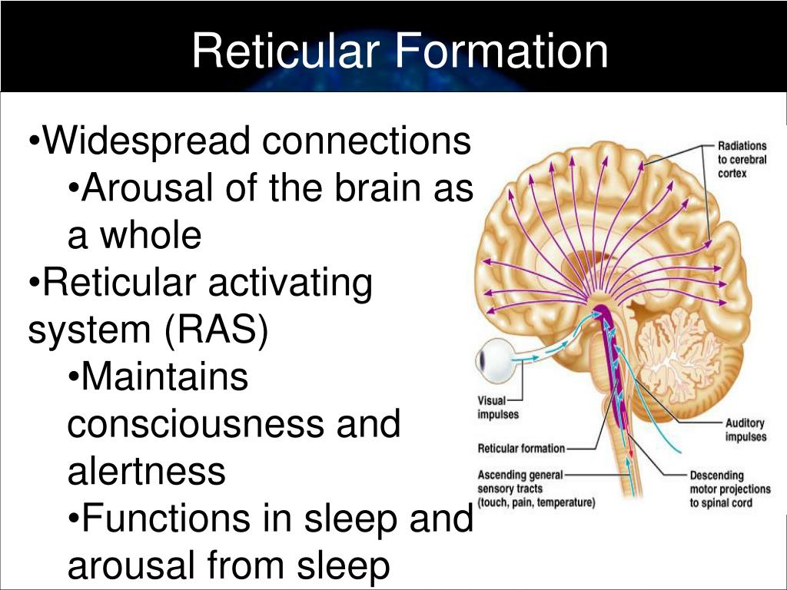

Slide 6
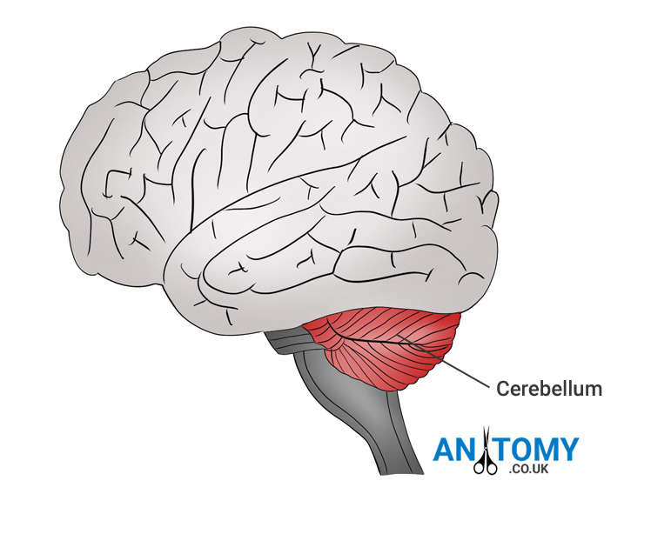
Cerebellum
The “little brain” attached to the rear of the brainstem.
It helps coordinate voluntary movements (motor) and balance.

Slide 7
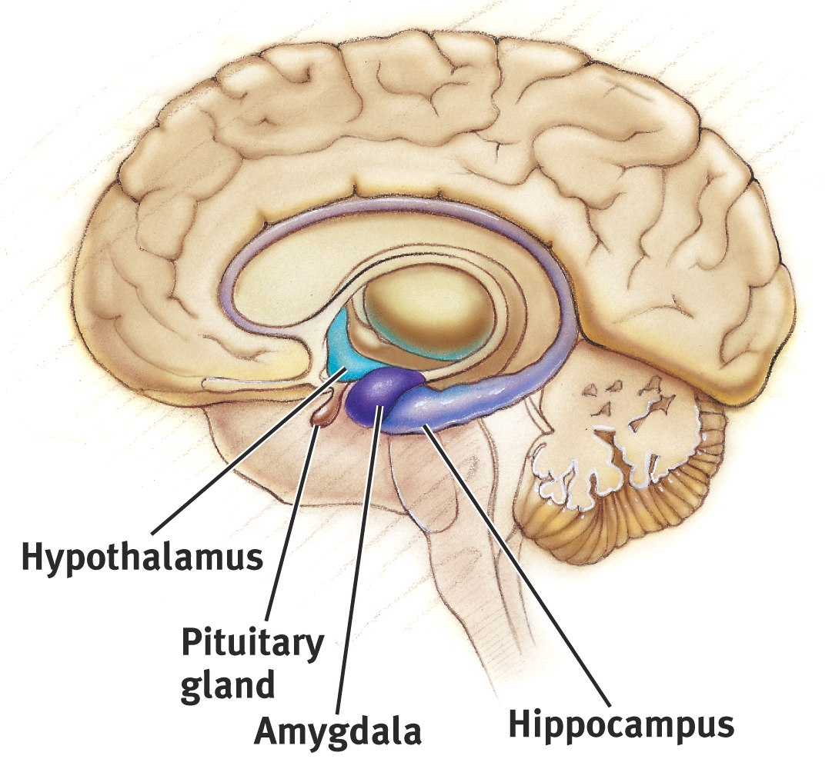
The Limbic System
neural structures between the brainstem and cerebrum.
associated with emotions including fear, aggression and drives for food and sex.
Notes:
OBJECTIVE 13| Describe the structures and functions of the limbic system, and explain how one of these structures controls the pituitary gland.

Slide 8
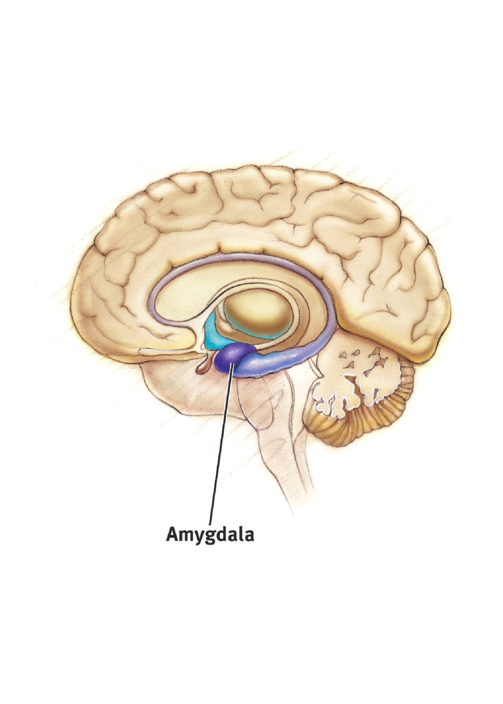
Amygdala
The Amygdala consists of two neural clusters linked to the emotions of fear and anger.

Slide 9
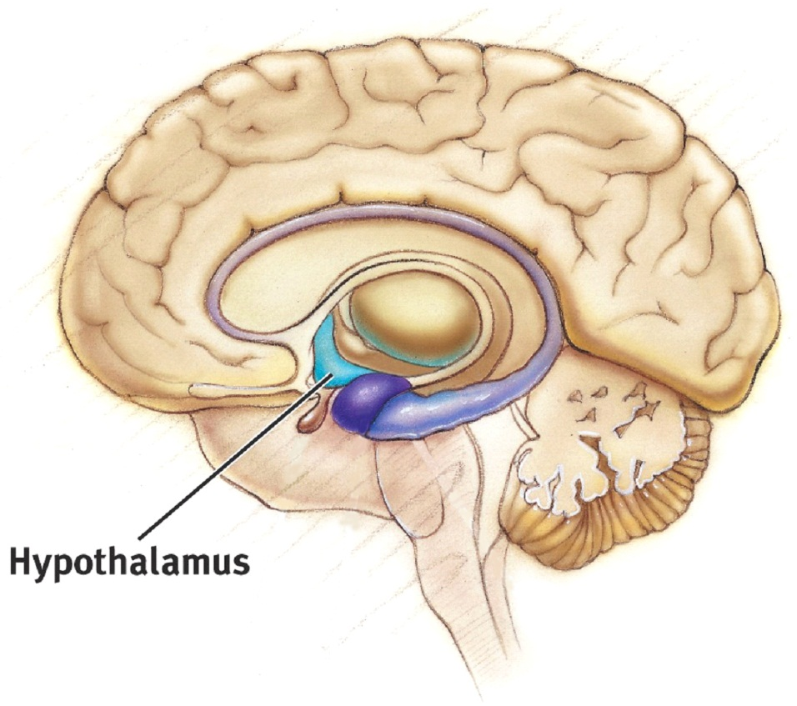
Hypothalamus
The Hypothalamus lies below (hypo) the thalamus.
It directs several maintenance activities like eating, drinking, body temperature, and emotions.
Works with pituitary gland to control the endocrine system (hormones).

Slide 10
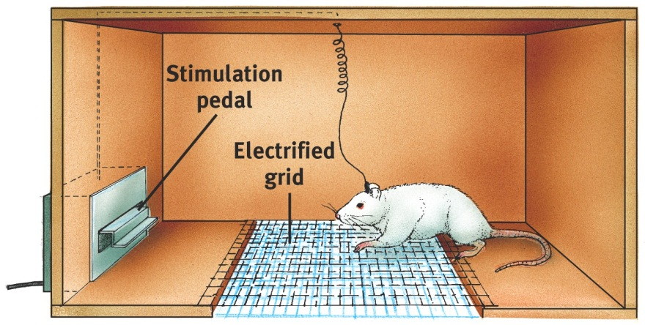
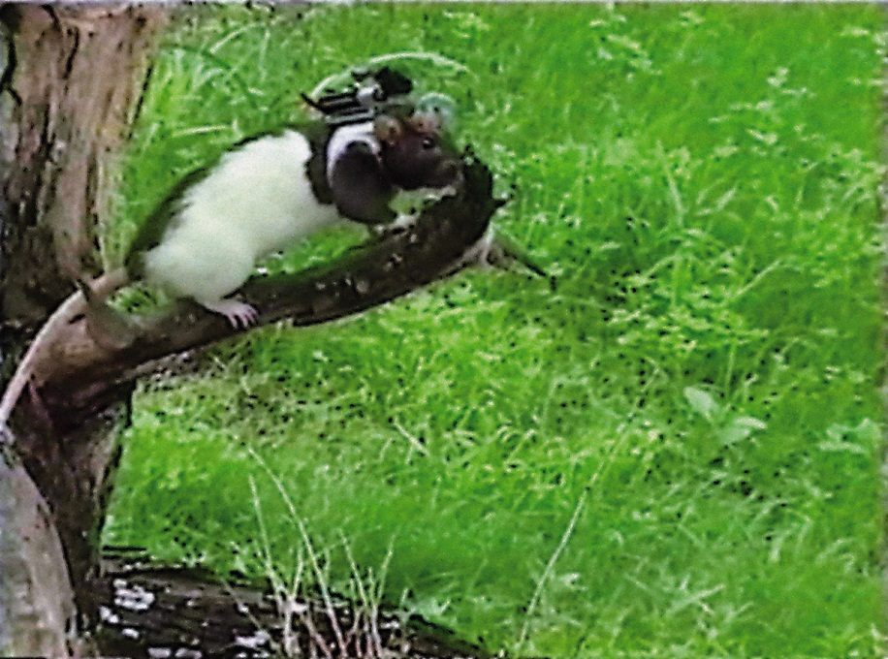
Reward Center
Pleasure Center: Four Fs – fight, flight, feeding, and sexual behavior
Rats will cross an electrified grid or climb up a tree for self-stimulation when electrodes are placed in the reward (hypothalamus) center.
Sanjiv Talwar, SUNY Downstate

Slide 11
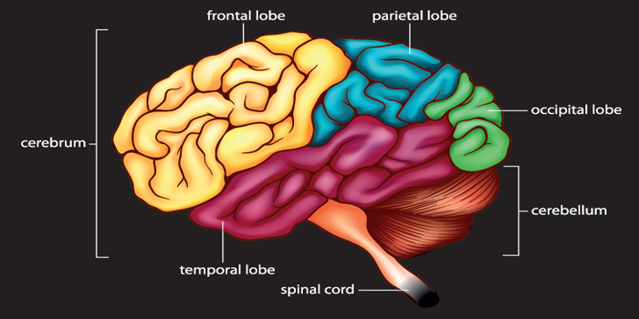
Cerebral Cortex

Slide 12
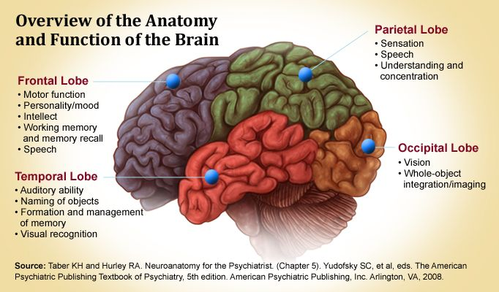
Cerebral Cortex
The ultimate control and information processing center.

Slide 13
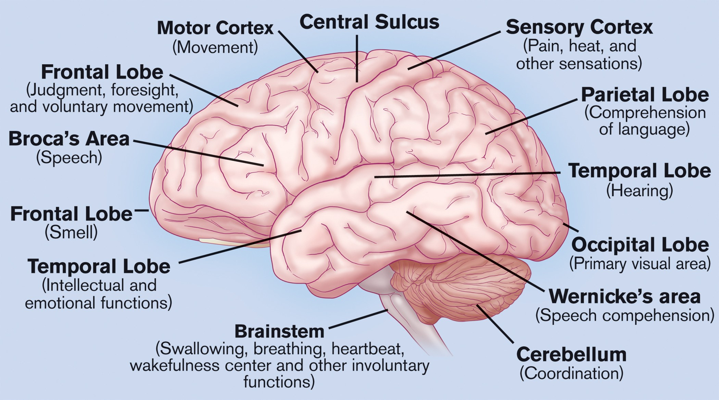
Cortex Functions
Motor Cortex
- controls voluntary movements.
Sensory Cortex (parietal cortex)
- receives information from skin surface and sense organs.

Slide 14
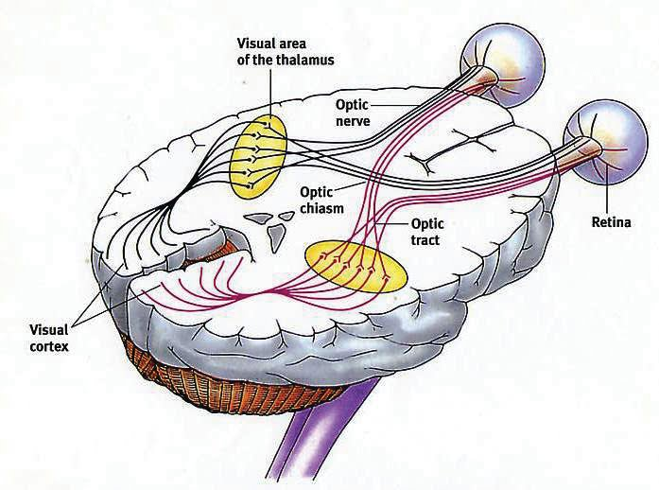
Visual Cortex
Located in the occipital (rear) lobe

Slide 15
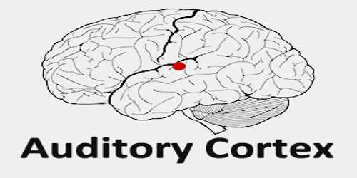
Located in the temporal (side) lobe

Slide 16
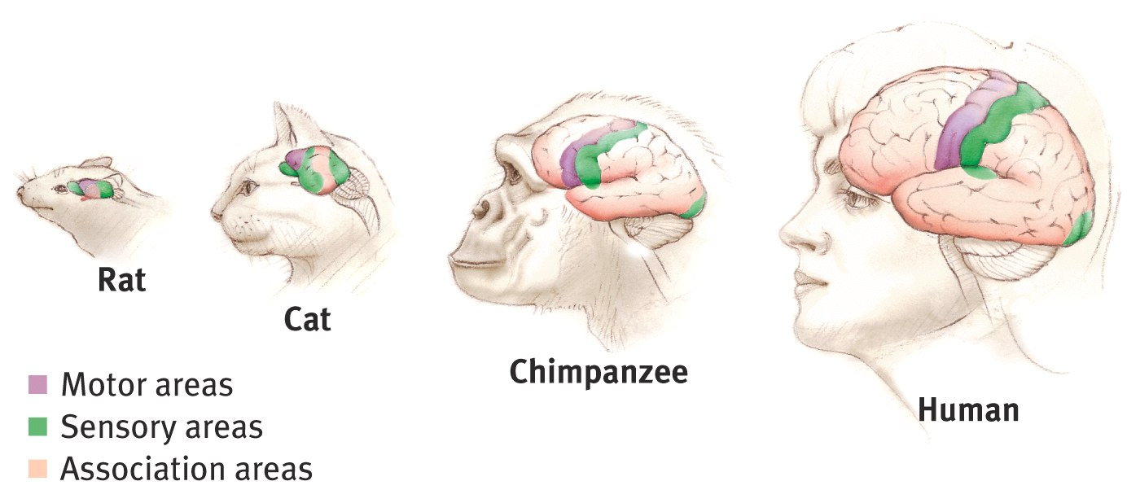
Association Areas
Intelligent animals have increased “uncommitted” or association areas of the cortex.

Slide 17
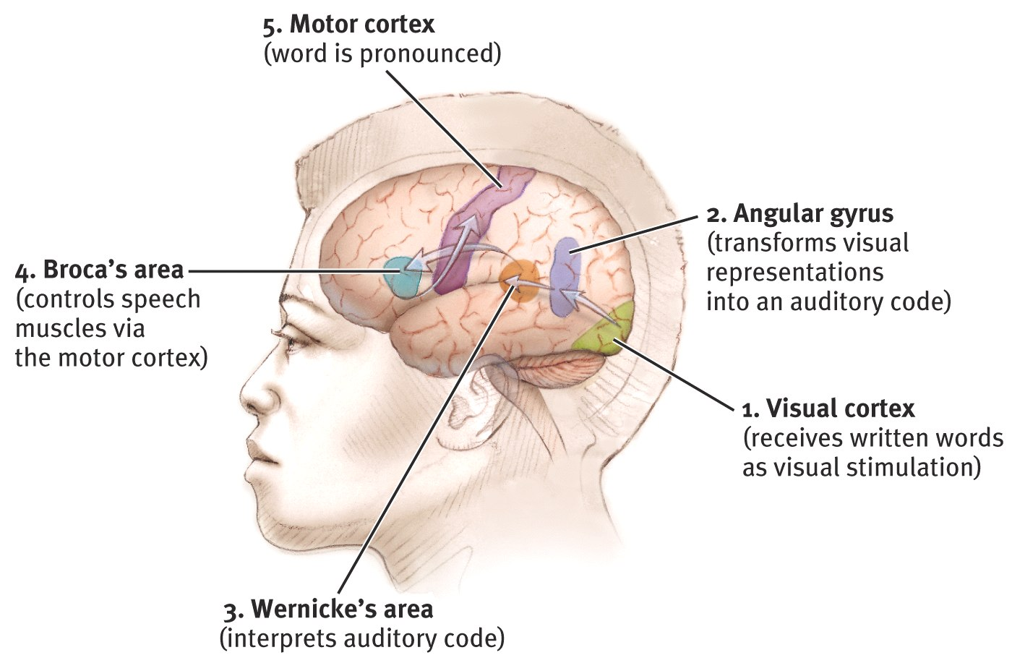
Language
Aphasia
impairment of language
usually caused by left hemisphere damage either to Broca’s area (speaking)
or to Wernicke’s area (comprehension).
Notes:
OBJECTIVE 17| Describe the five brain areas that would be involved if you read this sentence aloud.

Slide 18
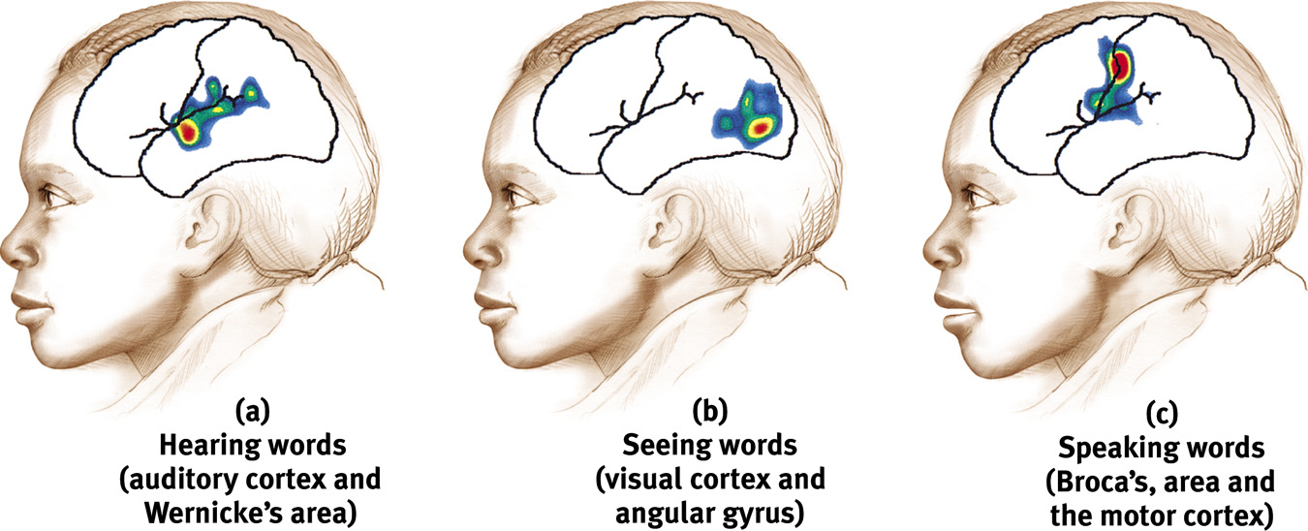
Specialization & Integration
Brain activity when hearing, seeing, and speaking words

Slide 19
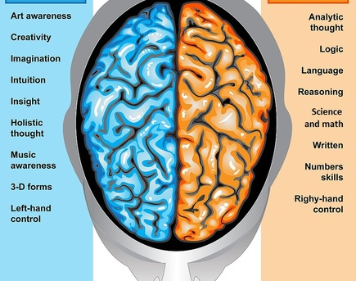
Brain Hemispheres
left-right hemispheric differences are complicated.
right brain - spatial, perceptions, music
left brain - language, logic, reasoning.

Slide 20

The Wagner Preference Inventory
(a) left, logical
(b) left, verbal
(c) right, manipulative/spatial
(d) right, creative

Slide 21
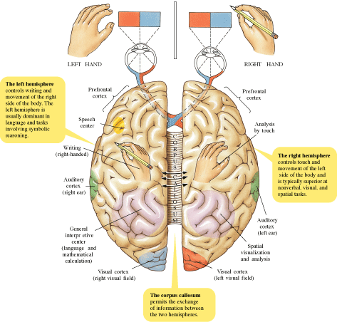
Hemispheric Specialization
Corpus Callosum
Fibers allow communication between left and right hemisphere
Each hemisphere appears to specialize in certain functions

Slide 22
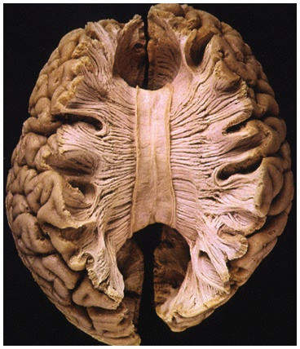
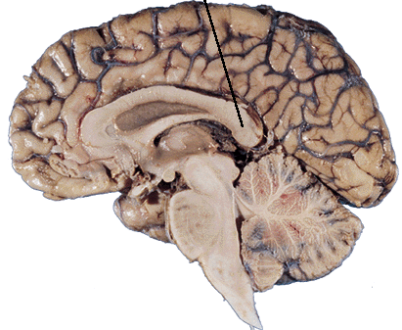
Splitting the Brain
Corpus Callosum
Isolate the hemispheres by cutting the connecting fibers (mainly those of the corpus callosum) between them.

Slide 23
Fun with your Hemispheres
Rotate your dominant hand in one direction while at the same time rotating the opposite foot in the other direction.
  No problem since controlled by different hemispheres
Now, rotate your dominant hand in one direction while at the same time rotating the foot on the same side in the other direction.
  This is hard as one hemisphere is doing all the work.

Slide 24
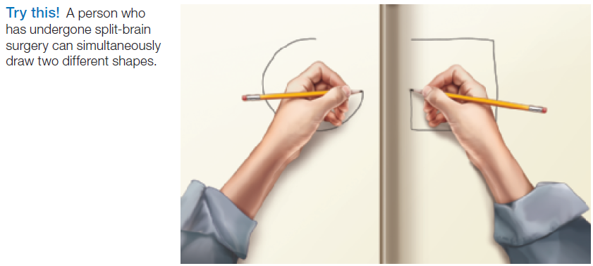
Splitting the Brain

Slide 25
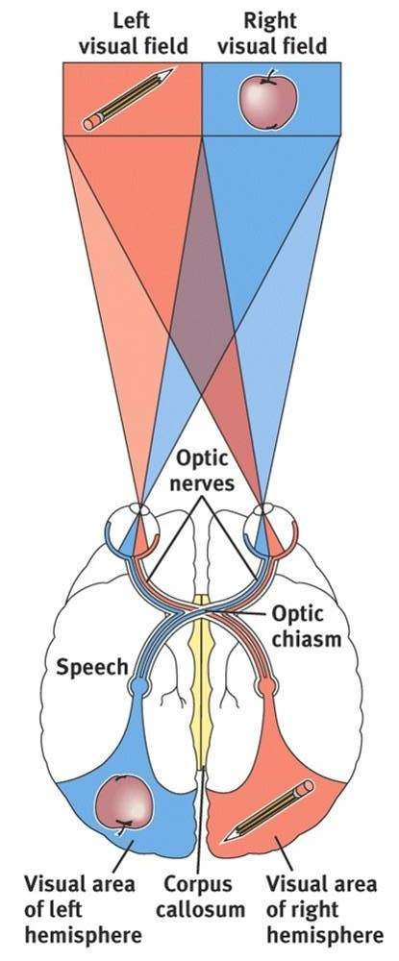
Split Brain Patients
With the corpus callosum severed, an apple presented in the right visual field can be named. Pencil in the left visual field cannot.

Slide 26
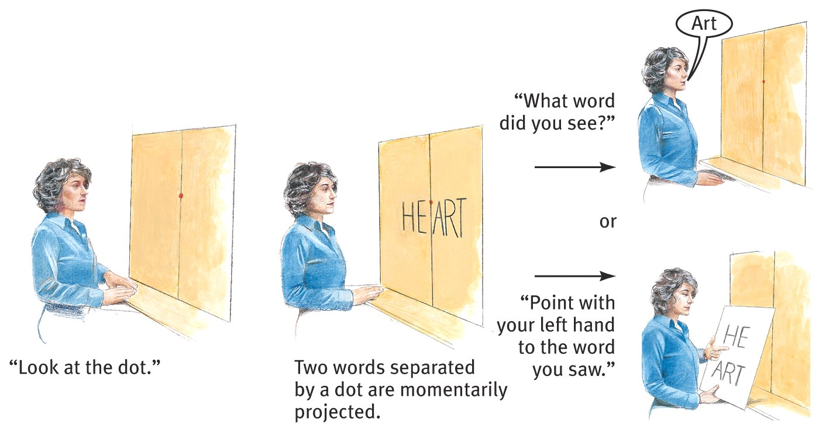
Divided Consciousness

Slide 27
Interpreter Phenomenon
One of the most fascinating insights from the split-brain studies was the way the left hemisphere made up stories to explain what the right hemisphere was up to – what Gazzaniga dubbed the “interpreter phenomenon”. For example, in one study, a patient completing a picture-matching task used their left hand (controlled by the right hemisphere) to match up a shovel with an image of a snow storm (shown only to the right hemisphere). The patient was then asked why he’d done this. But his left hemisphere (the source of speech) didn’t admit to not knowing. Instead, it confabulated, saying that he’d reached for the shovel to clear out the chicken coop (the picture shown to the left hemisphere was of a bird’s foot).
Writing an overview of the split-brain research in a 2002 article for Scientific American (pdf), Gazzaniga concluded, based on the interpreter phenomenon and other findings, that the left hemisphere is “inventive and interpreting”, whilst the right brain is “truthful and literal.”

Slide 28
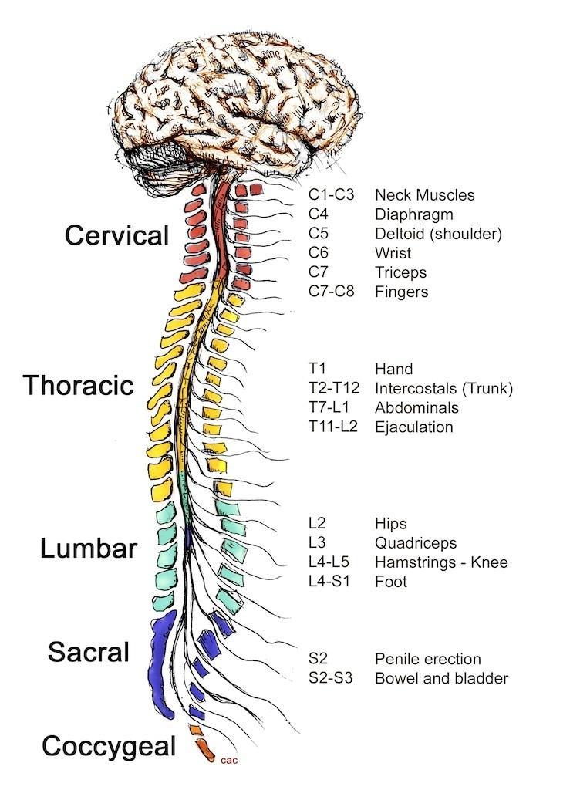
The Spinal Cord
Cable of nerves that connects brain to rest of the body
Carries motor and sensory impulses.

Slide 29
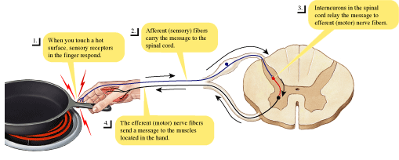
The Spinal Cord
Controls some reflex movements… without using the brain.

Slide 30
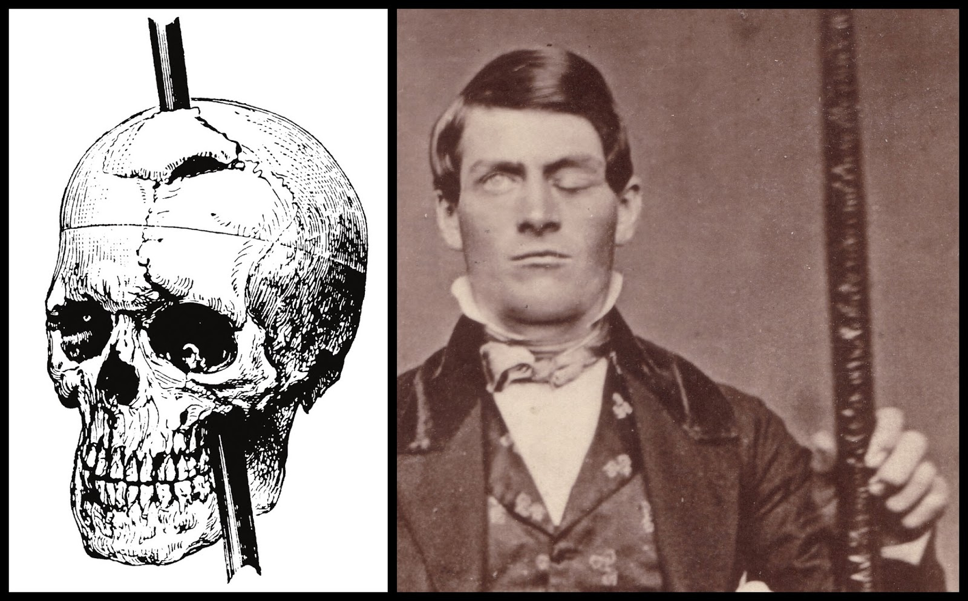
Aim: What is the relationship between our brain and our behavior?
Do Now:
In 1848 Phineas Gage was in an accident where a 43 inch long and 1.25 inch in diameter rod shot through the left side of his frontal lobe.
Would this accident cause a change in his behavior?
Claim Evidence and Reasoning.

