Slide 1

Quantum Fluctuations
(Something from Nothing)

Slide 2
Early Structure
Slight density differences get larger as the universe expands.
After 1.2 billion years, galaxy regions were twice as dense as empty regions.
Most galaxies formed by this time.

Slide 3
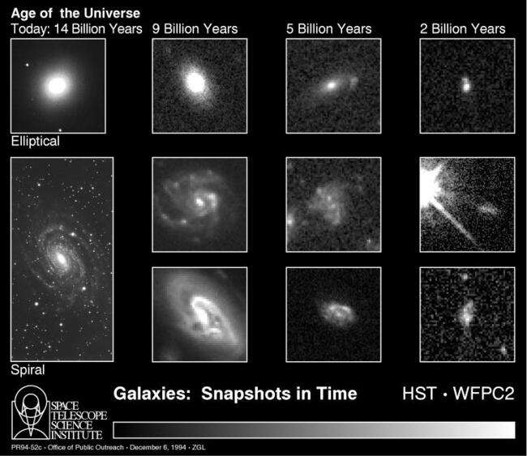
Galaxy Evolution

Slide 4
Structure
Cosmic Microwave Background radiation shows small temperature differences from Big Bang.
2.7249° K -- 2.7251° K
Temperature differences mean Density differences

Slide 5
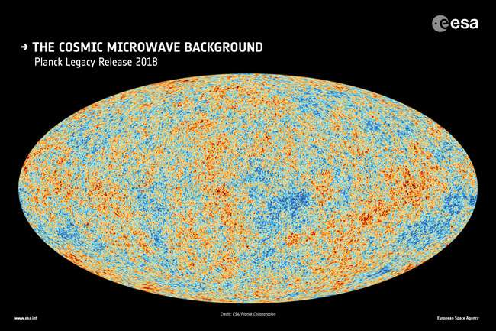

Slide 6
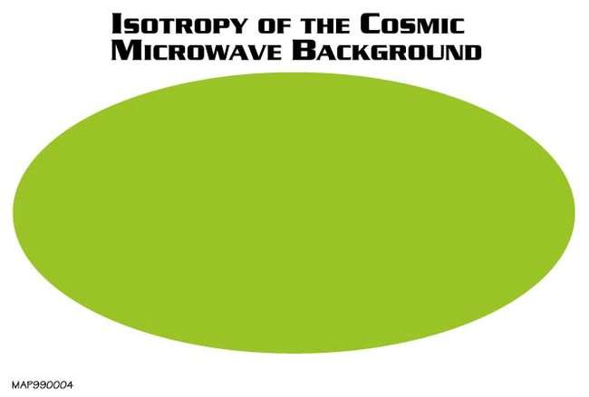

Slide 7
The Horizon Problem
Why is the universe the same temp everywhere we look?
If we look back 13.8 billion years in one direction (Point A) and then 13.8 in the opposite direction (Point B), we see the same temp. But now Point A is 28 billion years away from Point B (or too far for light/heat to travel between them)… how does heat transfer between them?
Inflation Theory holds that these regions were once close enough to transfer heat and then expanded rapidly away

Slide 8
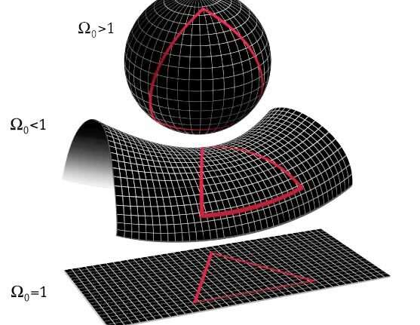
Universe Shape?
Closed (sphere)
Gravity wins (finite)
Open (saddle)
Expands forever at same rate (infinite)
Flat
Expansion slows, but never stops (infinite)

Slide 9

Is the Universe Flat?
Why haven’t minor density variations grown over time. The universe’s density has stayed the same since the beginning.
Did something flatten it out? The Inflation Theory solves this.
Like blowing up a balloon. The balloon is uneven, until inflated. Inflation causes it to flatten.

Slide 10
Inflation Theory
The early universe expanded quickly for a short time.
Explains how small density differences rapidly became galaxies.
Solves both the Horizon Problem and the flatness of universe.

Slide 11
Why Galaxies and Stars?
Why were there any density/temperature differences?
Topological Defects? Breakdown in symmetry. Cosmic strings may form… similar to cracks forming in ice when water freezes.
2. Inflation?

Slide 12

Topology
Shapes are the same if they can change without tearing gluing, or making holes

Slide 13
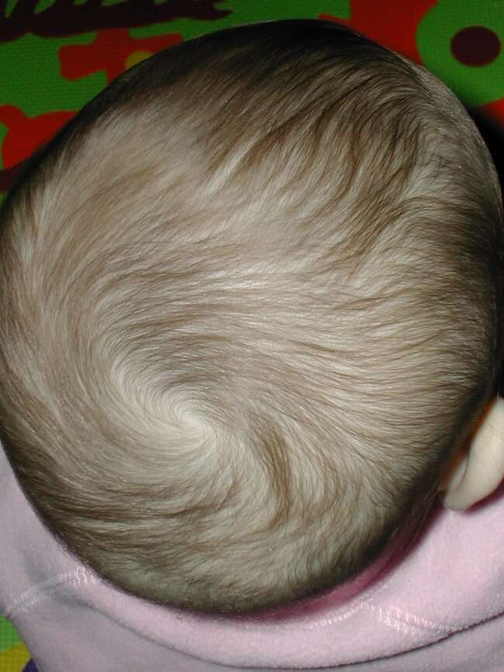
The Hairy Ball Theorem.
“one cannot comb the hair flat on a hairy ball without creating a cowlick.”

Slide 14
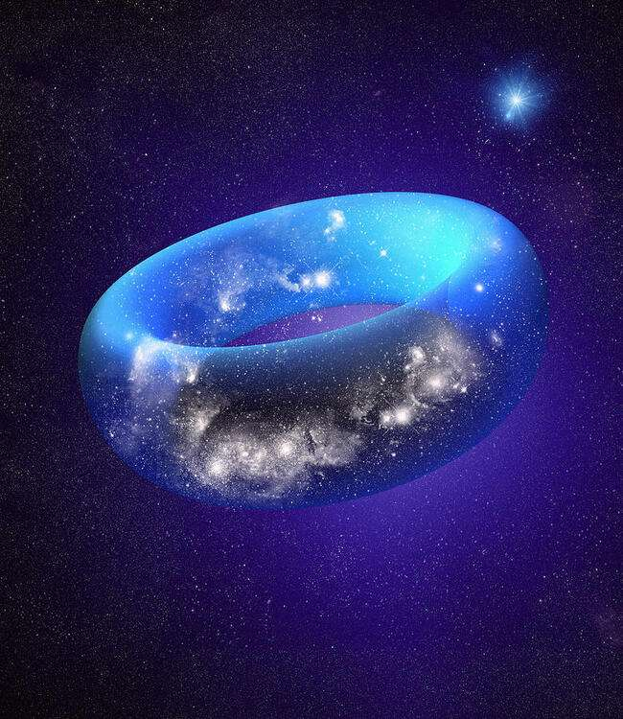
Finite, But No Edge
Like a donut (torus)
You could walk around it but never reach an edge.
So, it’s finite but has no edge

Slide 15

Mobius Strip (one edge, one surface)

Slide 16
Observable Universe
Observable Universe - farthest distance we can see (13.8 billion light years).
Actual universe may be ~94 billion light years across.
Universe distance has increased during expansion…most of universe is too far away to ever see.

Slide 17
