Slide 1

Social Psychology
Social psychology investigates how we think about, influence, and relate to one another.

Slide 2
What do Social Psychologists study?
Social psychologists focus on the situation and how others influence behavior which can explain why the same person acts differently in different situations.
Social psychologists study the effect of the home team advantage, the impact of racism, the motivation in gangs, and the explanations we give for our own and others’ behaviors.

Slide 3


Attribution:
Why did he do that?
Attribution Theory: tries to explain how people make judgments about the causes of other people’s behavior
Three criteria used to judge behavior:
  Distinctiveness: Is this how the person treats everyone or are you different?
  Consistency: Has the person always treated you this way or is this different?
  Consensus: Do other people do the same thing or is this really different?

Slide 4

Attribution: Why did he do that?
Bob walks past you without saying hi.
  Distinctiveness: Your explanation as to why Bob did this will be different if he does this to everyone in the hall or just you
  Consistency: Your explanation as to why Bob did this will be different if he always says hi to you or if you don’t really know each other.
  Consensus: Whether you’re in New York City vs. a small high school will change how you explain Bob’s behavior.
Notes:
ACTIVITY

Slide 5
Biases in Attribution
Fundamental attribution error: when explaining the behavior of others, we tend to overemphasize dispositional (personal) causes and underemphasize situational causes
Actor-Observer Bias: When we explain our own behavior, we overemphasize situational causes and downplay disposition (personality).
Defensive attribution
  Self-Serving Bias: Tendency to attribute our successes to our own efforts and our failures to external factors
  Just-world hypothesis: Assume bad things happen to bad people and good things happen to good people
Attribution across cultures varies dramatically

Slide 6
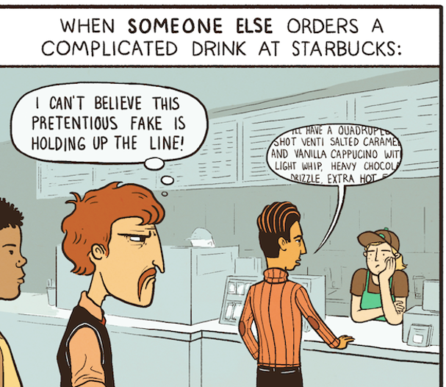

Slide 7
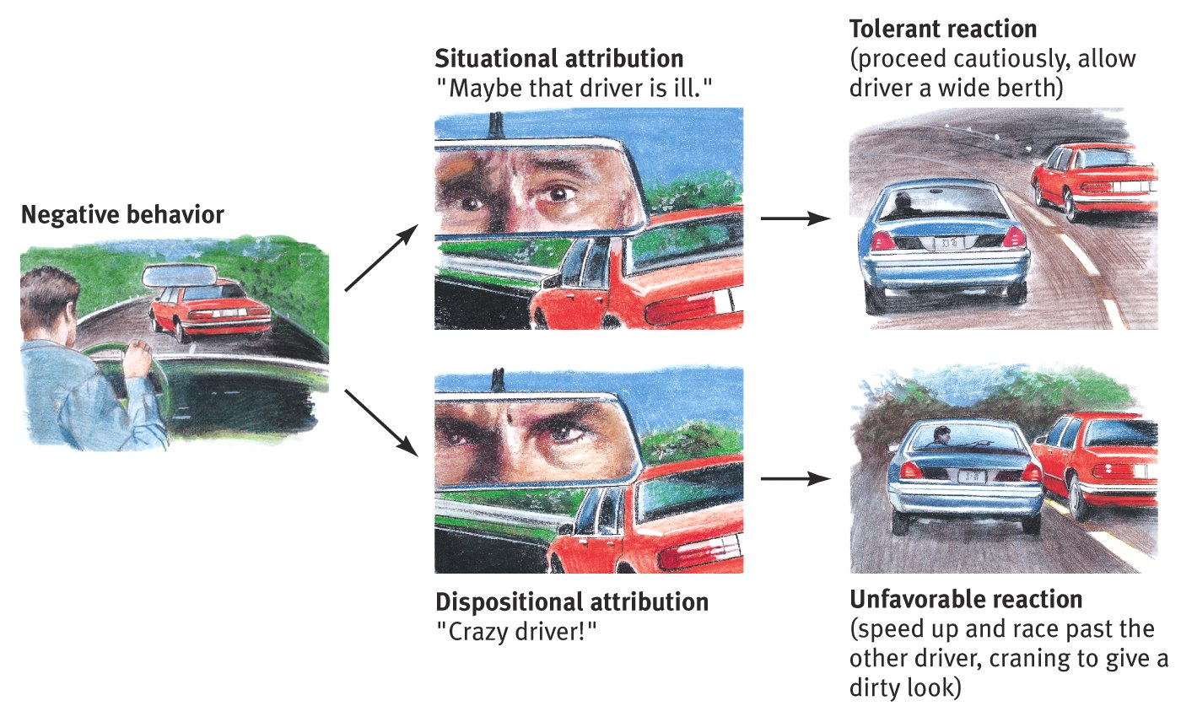
Effects of Attribution

Slide 8
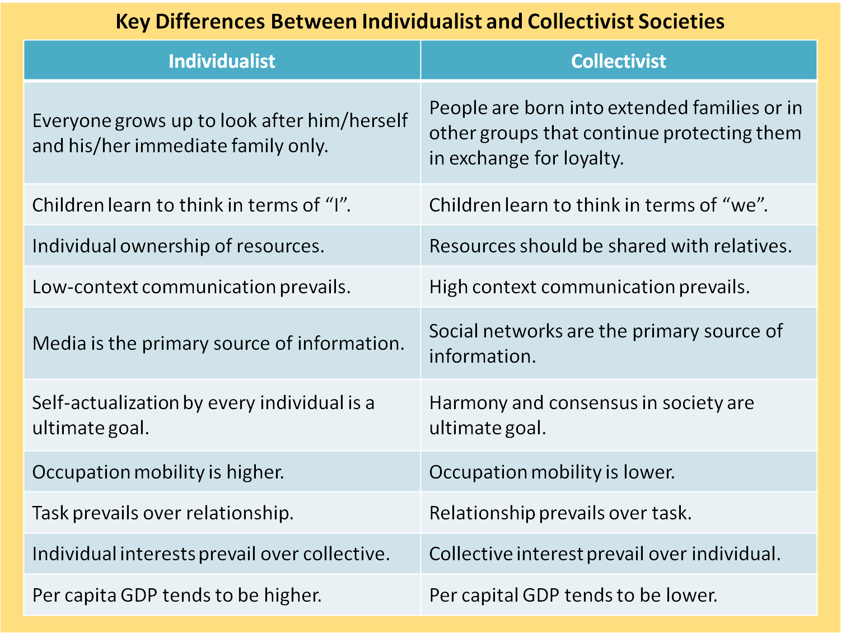
Collectivistic vs. Individualistic
Individualistic societies tend to view motives as dispositional…it’s the person’s fault.
Collectivistic societies view events as situational…there’s a good reason for the behavior.

Slide 9
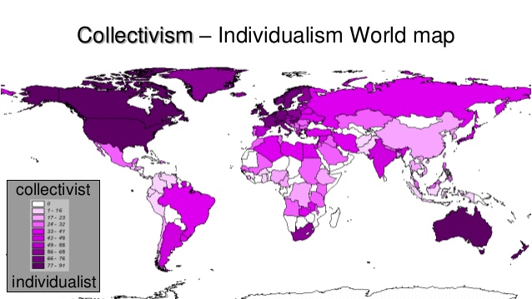

Slide 10
Questions
The common tendency to assume that the beliefs, values, attitudes, or actions of one’s own group are superior to those of other groups is called
(A) Deindividuation
(B) Groupthink
(C) Observer bias
(D) Ethnocentrism
(E) Reactance

Slide 11
Questions
61. Jessie and a friend are driving in rush-hour highway traffic when a car suddenly cuts in front of them in order to reach an unmarked exit ramp. Jessie’s passenger points out that the circumstances may have required the other driver to do so, while Jessie loudly criticizes the personal qualities of the other driver. Jessie’s response is best explained by
(A) cognitive dissonance theory
(B) the fundamental attribution error
(C) a self-fulfilling prophecy
(D) the mere exposure effect
(E) social inhibition theory
78. Which of the following is true regarding cross- cultural studies on attributional tendencies?
(A) The actor-observer bias is universal.
(B) People in collectivist cultures are more likely to commit the fundamental attribution error than people in individualistic cultures.
(C) People in individualistic cultures are more likely to commit the fundamental attribution error than people in collectivist cultures.
(D) People in collectivist cultures are more likely to base their attributions about people on their appearance than are people in individualistic cultures.
(E) It is almost impossible to determine cultural differences in attributional biases with an experimental design.

Slide 12
Questions
Two friends attribute their high math scores to their high level of effort and ability in math and their low Spanish scores to their teacher’s subjective grading and favoritism. In this situation these students are exhibiting
(A) the actor-observer effect
(B) the hindsight bias
(C) scapegoating
(D) equity
(E) the self-serving bias

Slide 13
Questions
According to the theory of fundamental attribution error, when explaining the failures of others, we usually underestimate the significance of
(A) situational factors
(B) dispositional factors
(C) motivational factors
(D) support systems
(E) inherited traits

