Slide 1
Cognitive Dissonance Theory
(Leon Festinger 1957)
Occurs whenever a person has two contradictory thoughts or beliefs at the same time. They are dissonant because each one implies the opposite of the other. Examples: smoking, global warming, end of the world adherents.
It creates an unpleasant cognitive tension. We like to be consistent.
So, we change our attitude or justify our beliefs in other ways.

Slide 2
Experiment
You sit at a table and are asked to undertake a series of dull, meaningless tasks for approximately an hour.
Afterward, the experimenter wants you to convince (lie to) another participant that the task is highly worthwhile, interesting, and educational.
You were paid either $1 or $20 to do this.
You are then asked to privately rate your enjoyment of the dull task on a questionnaire.
Who had higher enjoyment ratings, those paid $1 or $20? Why?

Slide 3
Cognitive Dissonance Video
Festinger Video
Friends Video

Slide 4
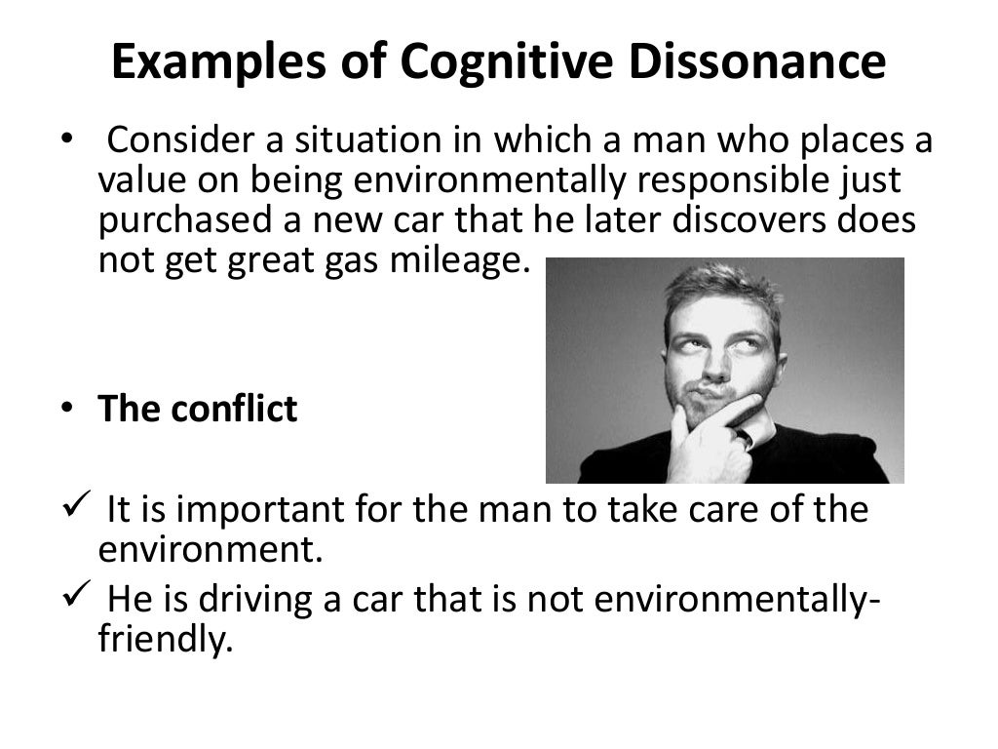

Slide 5
Resolution of Cognitive Dissonance
1. Changing your attitude or belief.
Either, global warming doesn’t bother me, or
2. Adding beliefs that back one side.
3. Reduce the importance of one of the sides
Either, finding new evidence that global warming is not so bad, or
Either, I own this gas guzzler, but I do many other things that help the environment, or
I may have to sell my car
my car has other good environmental features
my other car gets good gas mileage.

Slide 6
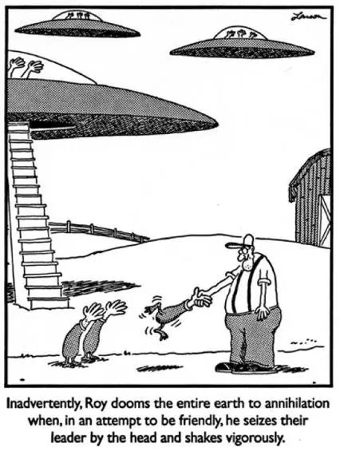

Slide 7
Social Cognition:
How you think about people?
Impression Formation – how you construct your views of others
  Primacy effect
    First impressions of someone matter
  Self-fulfilling prophecy
    A person’s expectations elicits behavior from the other person that confirms the expectations
    Randomly identified “bloomers” made greater gains in school

Slide 8

Stereotypes
  characteristics believed to be shared by all members of a social category
  usually unfair
  Most often applied to sex, race, occupation, physical appearance, place of residence, membership in a group or organization
  Can become the basis for self-fulfilling prophecies

Slide 9
Attitudes
Relatively stable – can be used to predict behavior
    Beliefs – facts and general knowledge
    Feelings – love, hate, like, dislike

Slide 10


Attitude Change
Process of Persuasion
  Must get and maintain the person’s attention
  Must comprehend the message
  Comprehension leads to acceptance?

Slide 11
Attitude Change
Elaboration Likelihood Model – how much time/investment is spent on the topic. Likelihood of changing minds.
  Source (credibility is key)
  Message itself (more effective when it acknowledges other arguments and then gives novel ones)
  Medium of communication (face-to-face best, writing good for complex)
  Audience’s characteristics

Slide 12

Routes of Persuasion
Central Route (high elaboration)
Changing minds through thoughtful consideration of the message (data, facts, pros-cons).
Peripheral Route (low elaboration)
Using cues associated with the message (images, sounds, language) .

Slide 13
Audience Characteristics
Most difficult to change if
  Strong commitment to present attitude
  Attitude is shared by others
  The attitude has been held since early childhood

Slide 14
Questions
Tension from an inconsistency between an individual’s attitudes and behavior is
(A) Cognitive Dissonance
(B) Altruism
(C) Deindividuation
(D) Information Propinquity
(E) Constancy

Slide 15
Questions
According to cognitive dissonance theory, human beings are motivated to
(A) respond to an inborn need to pass their genes to the next generation
(B) maintain an optimal ]evel of arousal
(C) satisfy basic needs such as hunger before proceeding to higher needs such as self- actualization
(D) reduce tensions produced by inconsistent thoughts satisfy needs resulting from tissue deficits

Slide 16
Questions
A teacher who is mistakenly informed that a student is learning disabled begins to treat that student differently from others. The teacher does not call on the student in class or help her with challenging material. The student’s grades gradually decline. This result is an example of which of the following?
(A) Reactance
(B) Social loafing
(C) Actor-observer bias
(D) Self-fulfilling prophecy
(E) Fundamental attribution error

