Slide 1
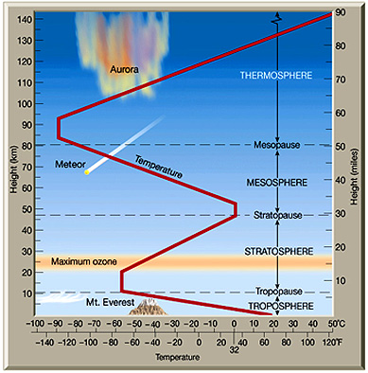
The Atmosphere
Atmosphere is layered by temperature.

Slide 2
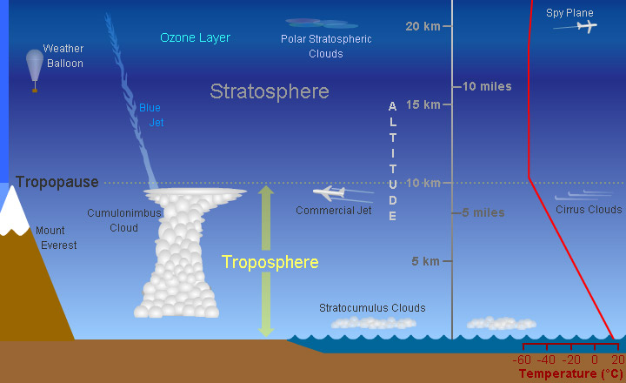
Troposphere
Troposphere
Layer closest to Earth (0-12 km)
- gets colder as you go up.
- all water occurs here.
- all weather occurs here.

Slide 3
Stratosphere
Stratosphere -
from 12-50 km
- gets warmer here.
- ozone layer here.
- ozone absorbs ultraviolet radiation.

Slide 4
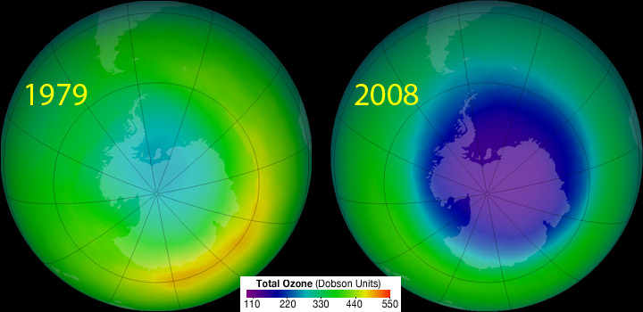
Ozone Hole

Slide 5
Montreal Protocol
In 1987, the world agrees to ban CFC’s to protect ozone.
The ozone layer has improved, but will take until 2075 to recover to 1979 levels.
There is hope! The world can act together. Ozone is proof.

Slide 6
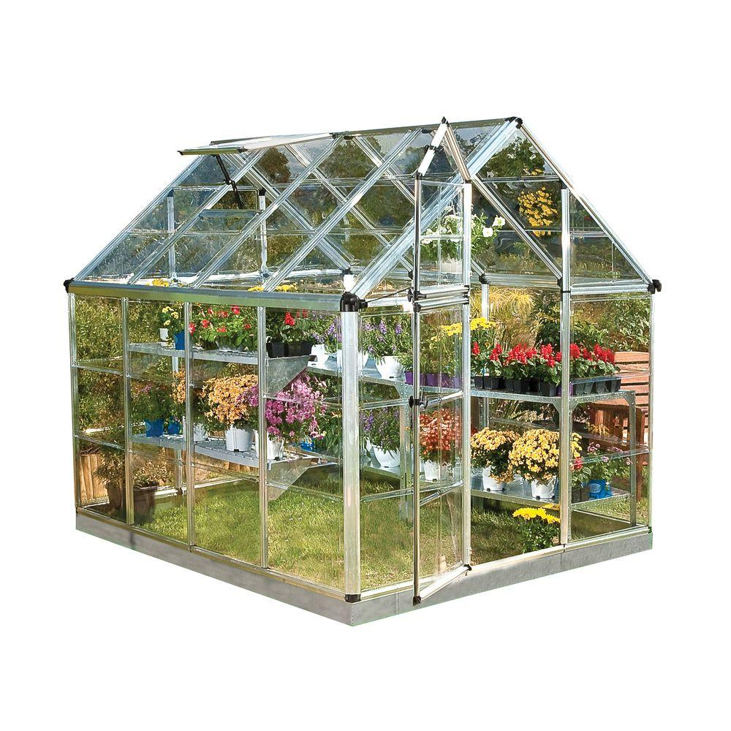
Greenhouse Effect
Greenhouse Gas -
stops Earth’s heat (infrared) from radiating out into space.
- keeps Earth warm…. too cold to live otherwise.

Slide 7
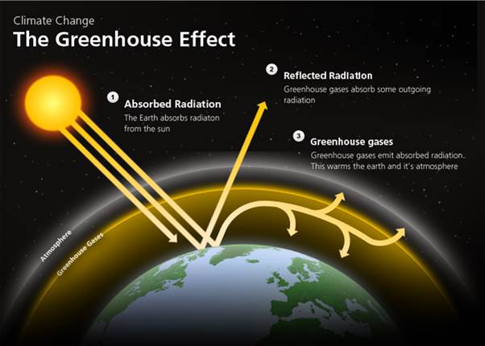

Slide 8
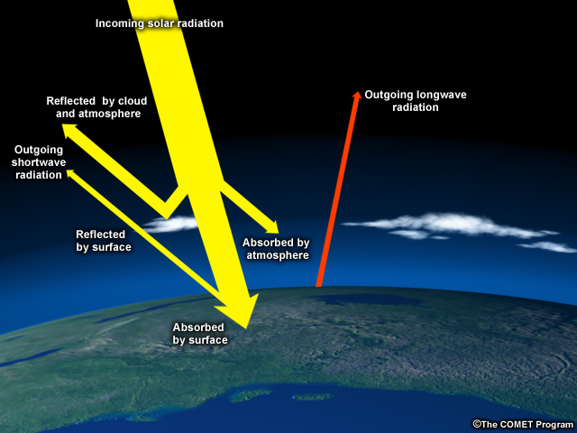
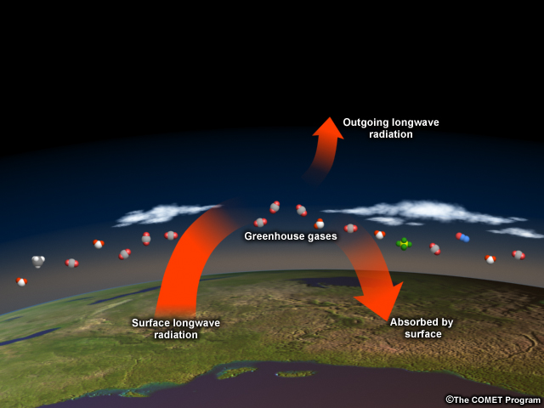
“Greenhouse effect”
Increasing greenhouse gases trap more heat
Notes:
[Image 1] Earth’s surface absorbs heat from the sun and then re-radiates it back into the atmosphere and to space.
[click, Image 2] Much of this heat is absorbed by greenhouse gases, which then send the heat back to the surface, to other greenhouse gas molecules, or out to space. Though only 1% of atmospheric gases are greenhouse gases, they are extremely powerful heat trappers. By burning fossil fuels faster and faster, humans are effectively piling on more blankets, heating the planet so much and so quickly that it’s hard for Mother Nature and human societies to adapt.
8

Slide 9
Greenhouse Gases
Water vapor - largest amount, but steady levels
Carbon dioxide (CO₂) - from burning fossil fuels (oil and gas).
Methane (best absorber),
CFCs (aerosol sprays…stay 100 years in atmosphere).

Slide 10
Carbon Dioxide (CO₂)
When CO₂ levels increase, temperatures increase.
How do we know?
Ice cores from Antarctica show past CO₂ levels.

Slide 11
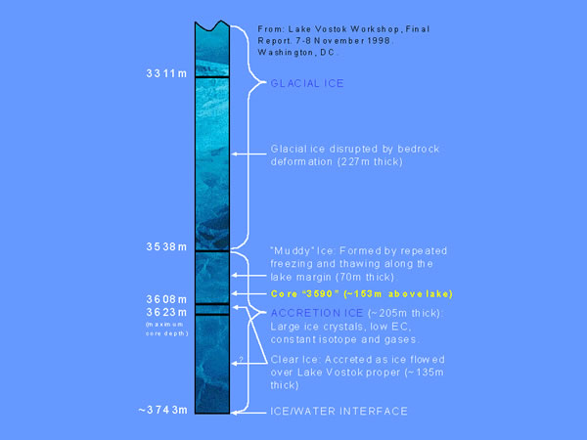

Slide 12
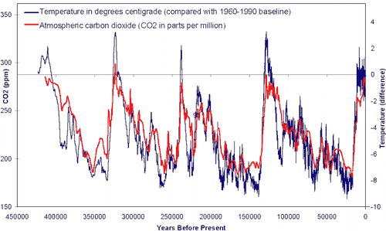
Natural CO₂ Range

Slide 13
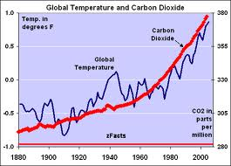

Slide 14
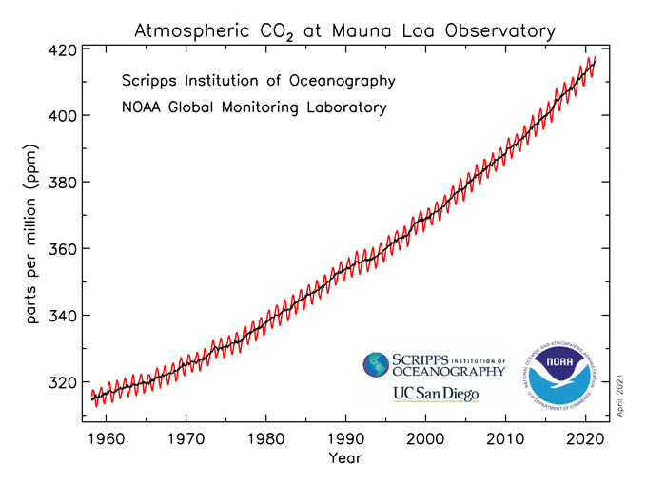

Slide 15
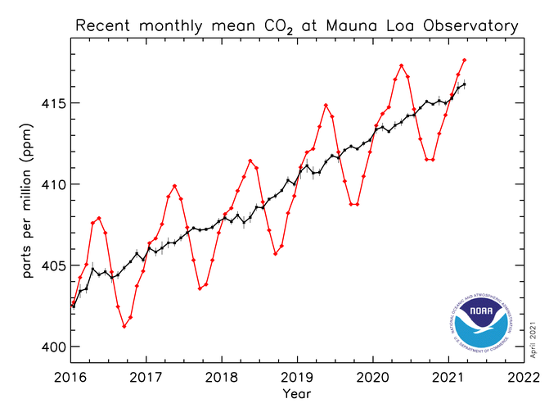

Slide 16
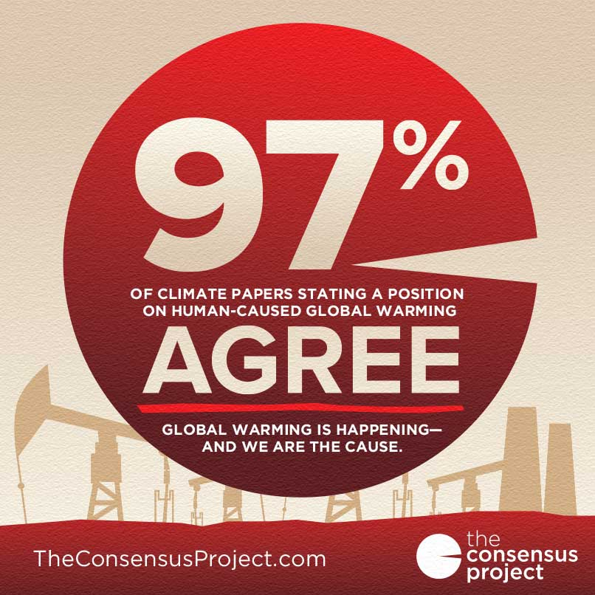

Slide 17
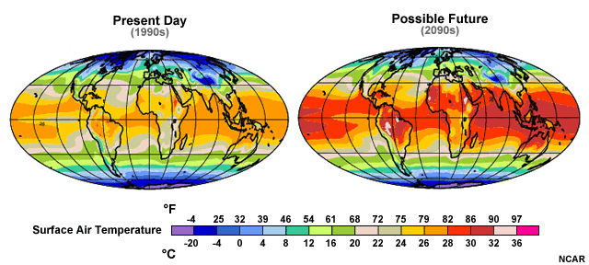
Why Should We Care?
Notes:
Global average temperatures are expected to increase by about 2-13°F (1-7°C) by the end of the century. That may not sound like a lot, so what’s the big deal? The problem is that small changes in global average temperature can lead to really large changes in the environment. Let’s look at some of the expected changes.
17

Slide 18
Problems
Climate change = warmer, drier, more extreme weather.
3 to 7 feet rise in sea levels by end of century.
Arctic temperature rising faster than others.

Slide 19
