Slide 1
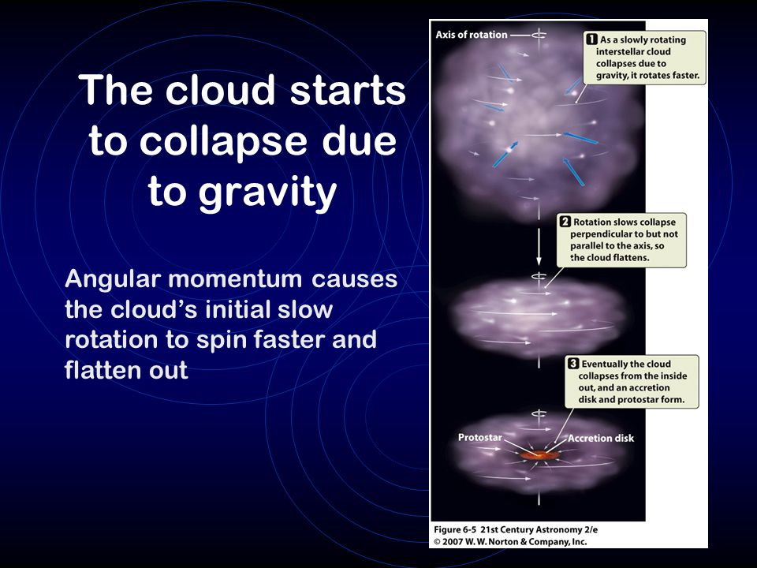
Solar Nebula Theory
How To Make A Star
(and Planets):
nebula = a large cloud of dust and gas.
2. GRAVITY makes the nebula spin and flatten….like making pizza

Slide 2
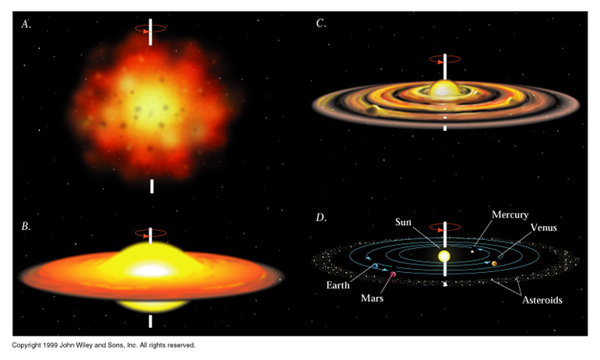
Solar Nebula Theory
3. The center reaches 15 million and ignites!
4. Nuclear Fusion when lighter elements combine to make heavier elements.
5. Voila… a star and planets are formed.

Slide 4
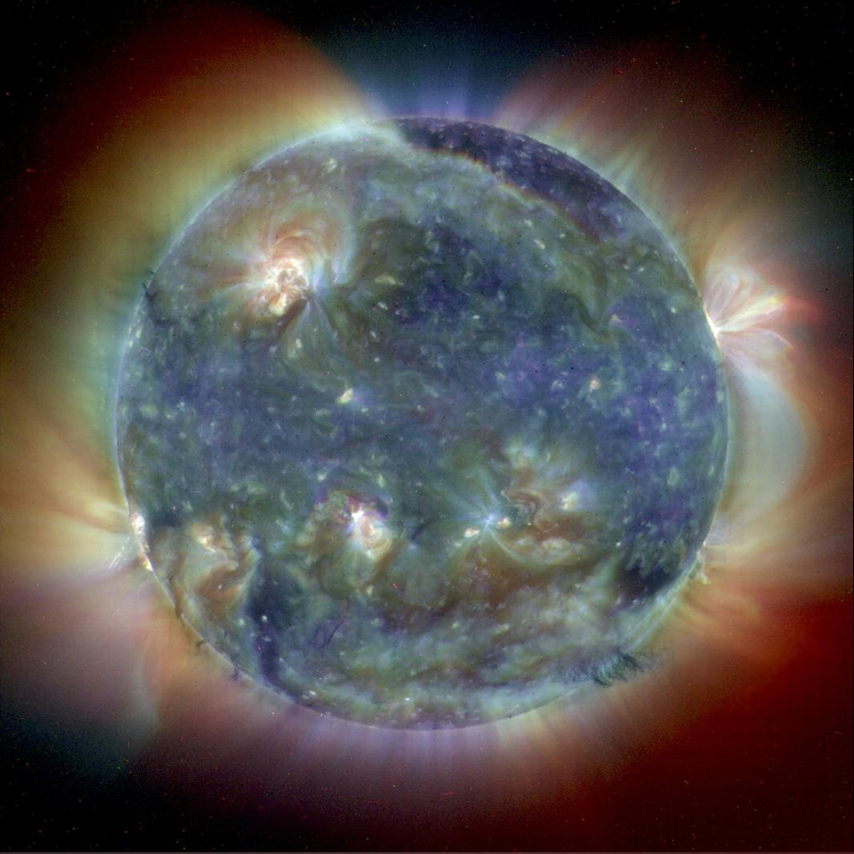

Slide 5
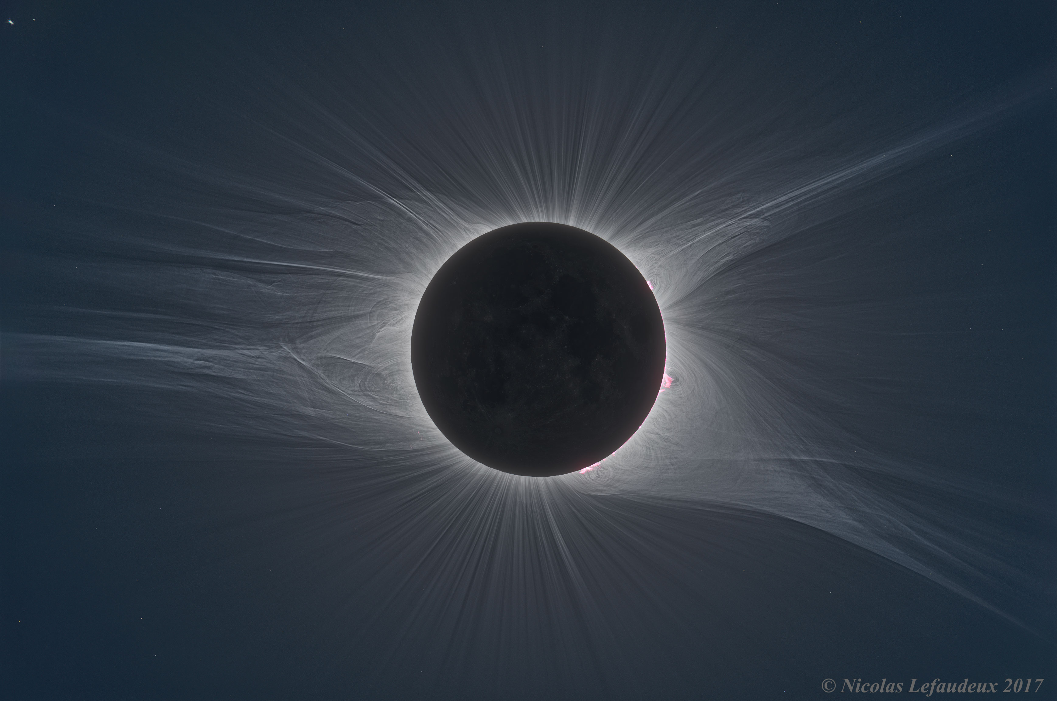

Slide 6
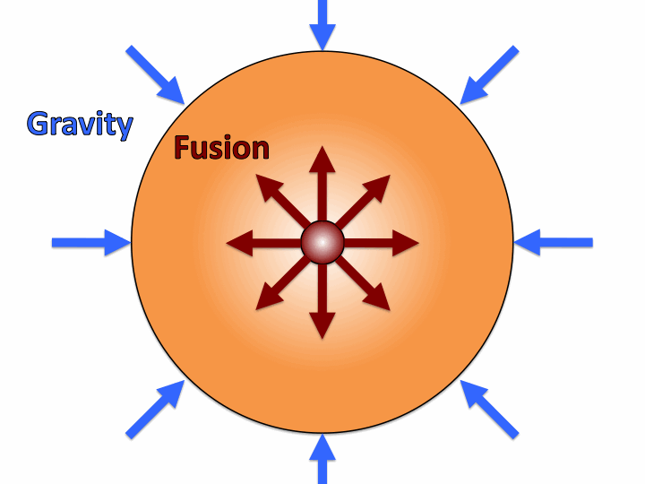
The Sun
The Sun is a star
Huge ball of plasma (electrically charged gas).
Hydrostatic Equilibrium
(Gravity vs. Fusion)
Gravity wants to crush the star
Nuclear Fusion wants to explode the star

Slide 7
How a star lives and dies
depends on its MASS!

Slide 8
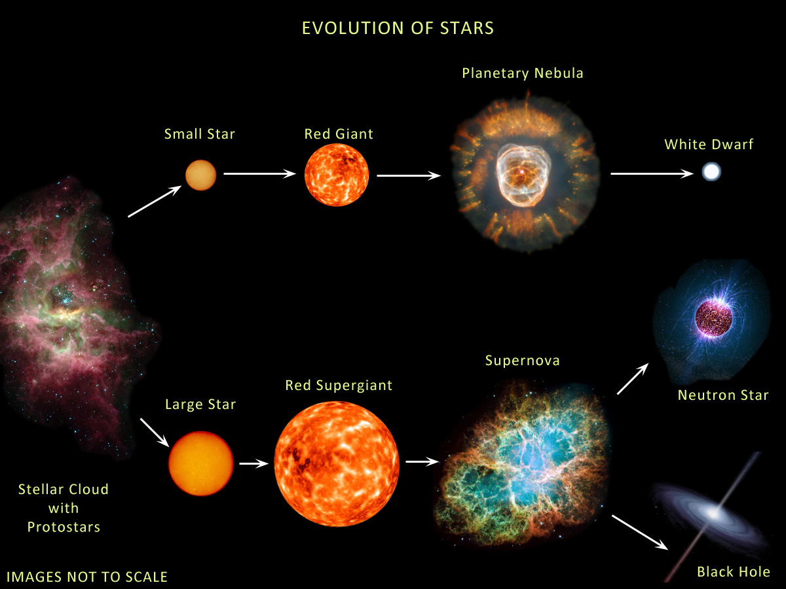

Slide 9
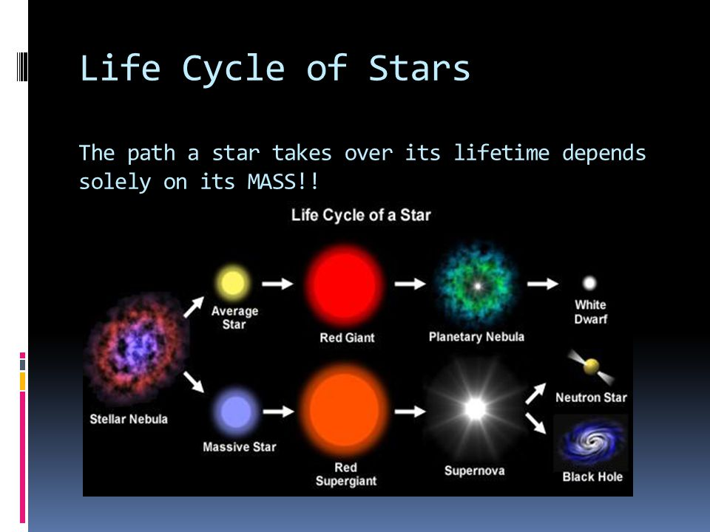

Slide 10
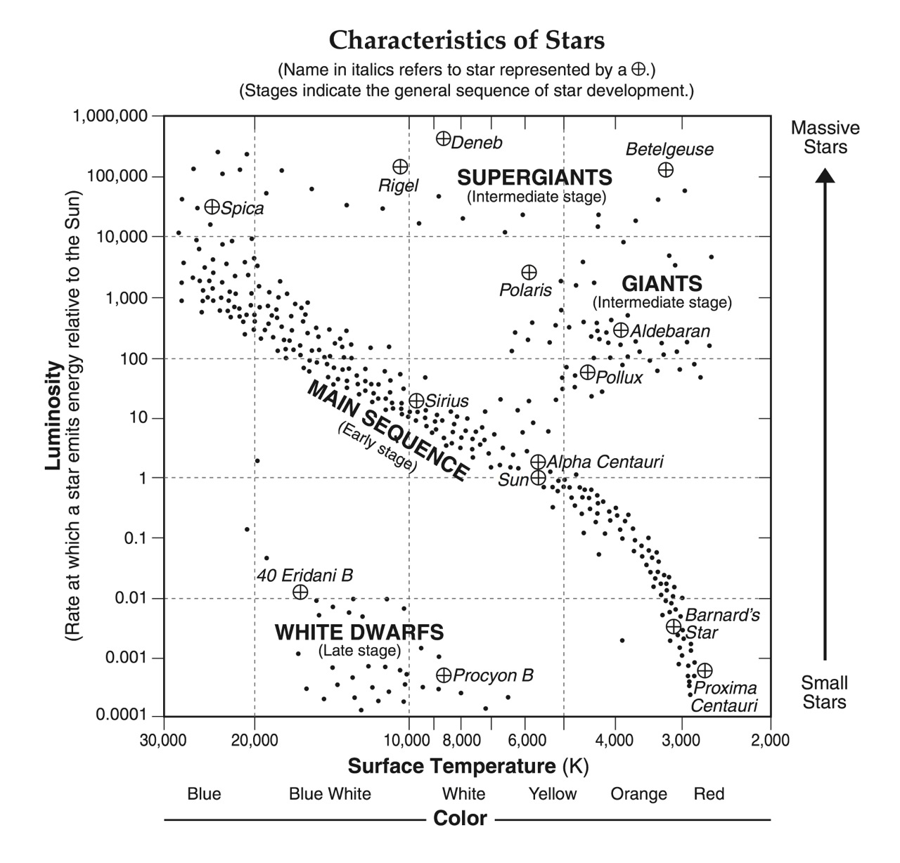
HR Diagram
(Hertzprung-Russell) brightest stars = large and hot dimmest stars = small and cool
Temp = color
Blue = hottest
Red = coolest

Slide 11
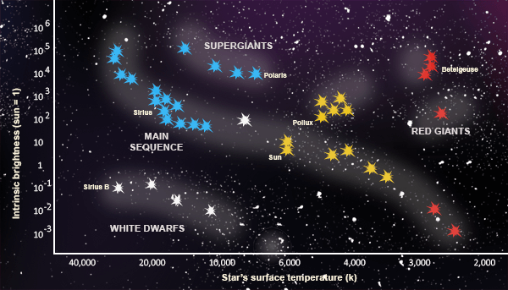
Star Types
Main Sequence Stars
Young to middle age stars
90% of all stars are main sequence.

Slide 12
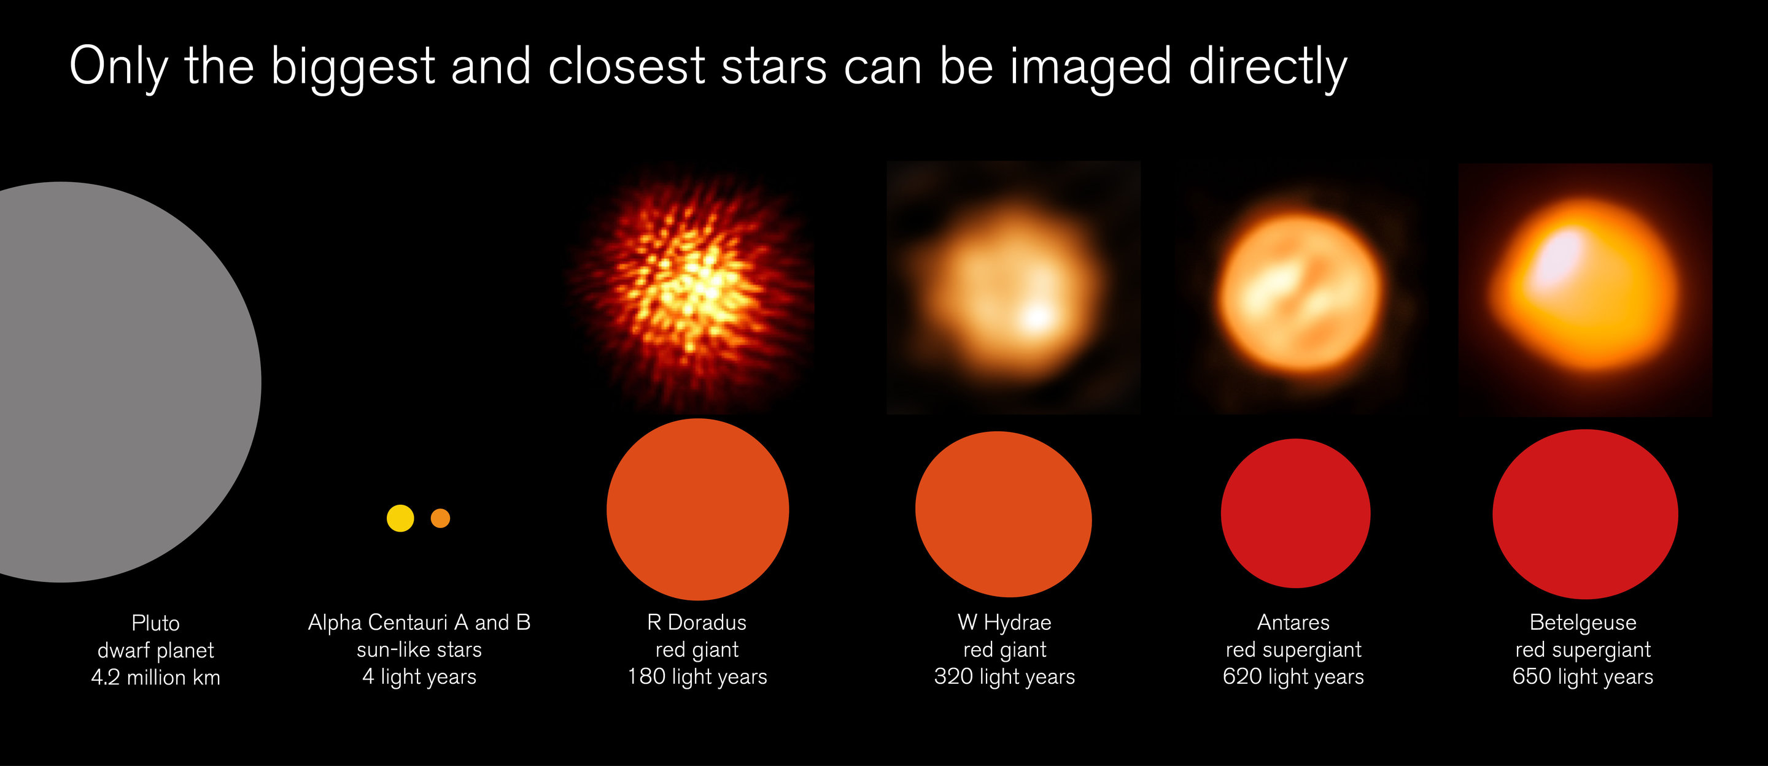
Star Types
(Giants)
Giants - older stars. Large and cooler.
…our Sun will expand into a Red Giant before it dies and becomes a White Dwarf.
Super Giants (red to blue) = These explode!
After supernova, either neutron star or black hole.

Slide 13
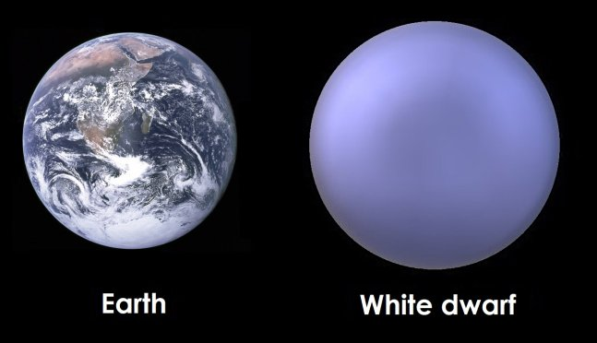
Star Types
(Dwarfs)
White Dwarfs = small and hot
…final stage for small to medium star
…no more nuclear fusion
Black Dwarfs = when white dwarf cools…25 billion yrs.
Red Dwarfs = Cool, dim and small. Most stars are red dwarfs.

Slide 14
Planetary Nebula
Planetary Nebula = shell of gas evaporating away from dead or dying star.
Has nothing to do with planets.

Slide 15
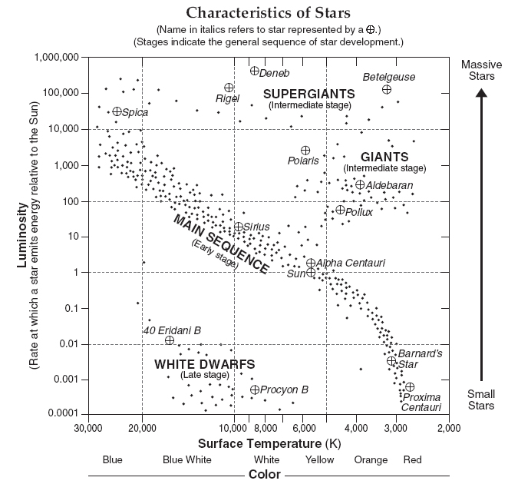

Slide 16
