Slide 1
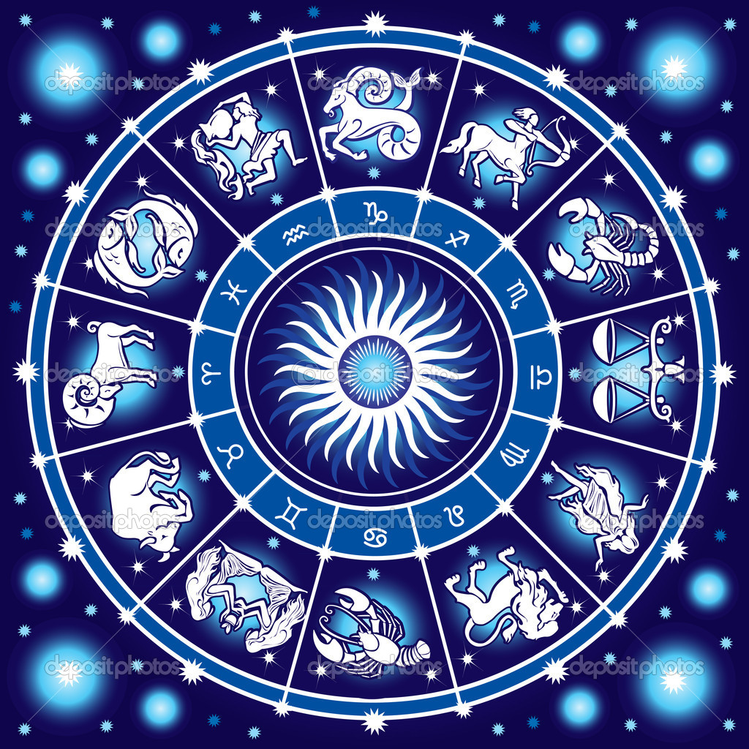
Introduction - History
Aim: What was the study of astronomy like long ago?
First there was astrology.
Astrology – Using stars to tell us about our daily affairs
Notes:
What is a constellation?

Slide 2
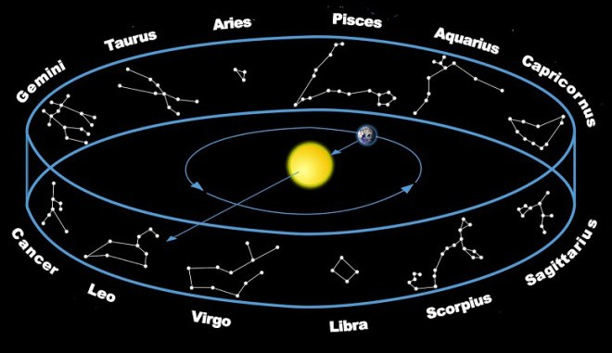
Constellations
(grouping of stars that humans see as a picture)

Slide 3
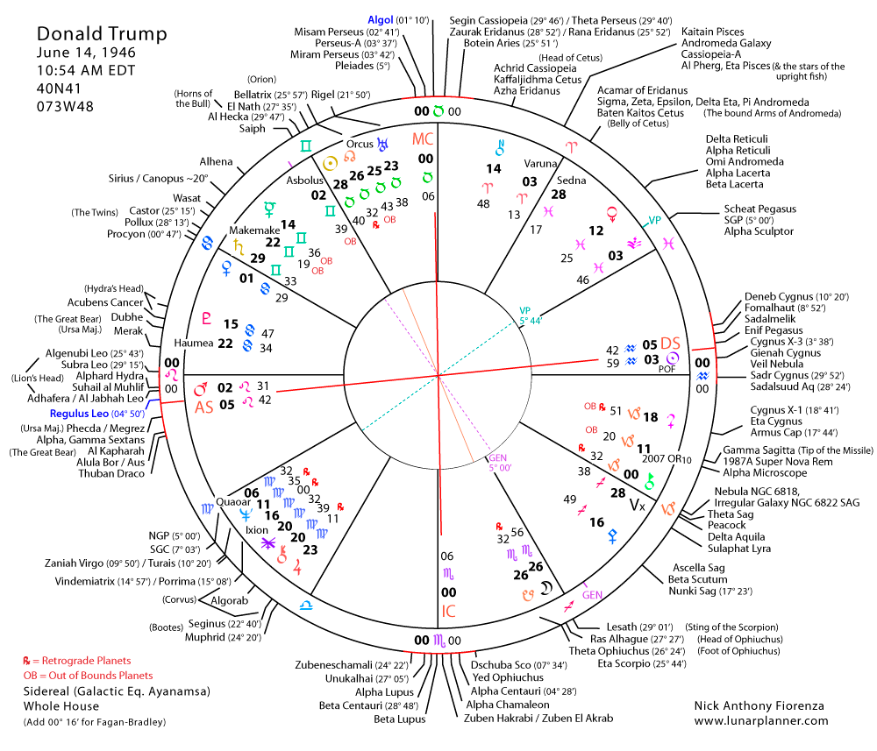

Slide 4
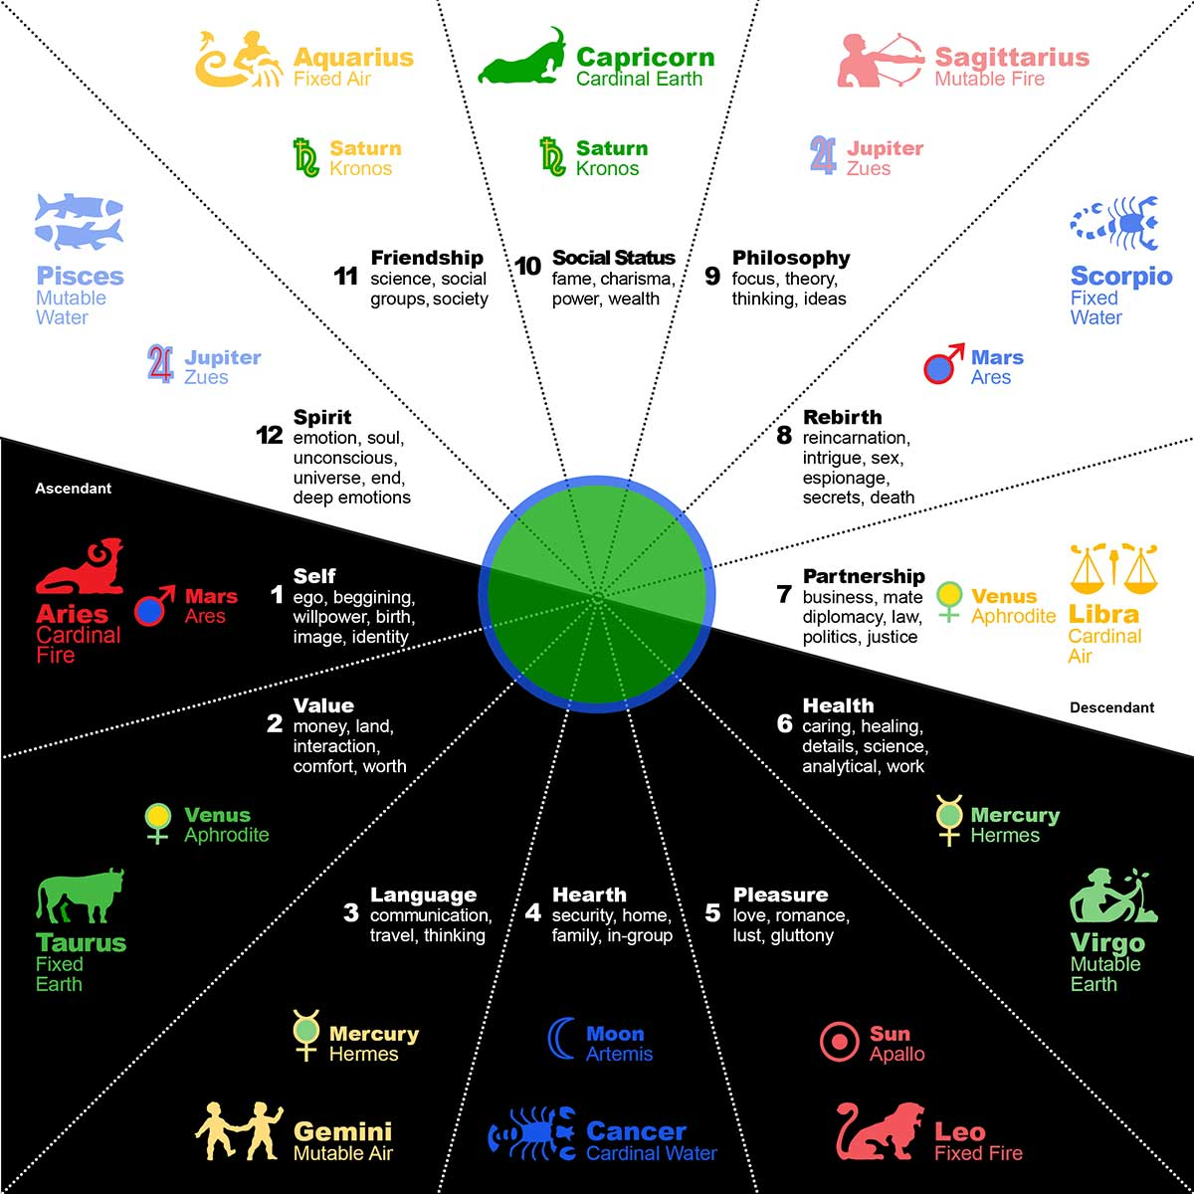

Slide 5
Why Astronomy
Why did humans first study Astronomy?
Galileo and scientific method starts astronomy
Mark time and cycles
Predict season change for planting crops
Navigation
Curiosity…desire to explain phenomena

Slide 6
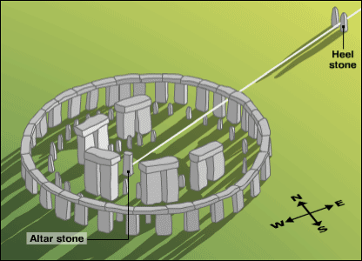
Early Astronomy
- Earliest known records show astronomical interest.
- Many ancient cultures built sites and kept records on
astronomical data.
- 3,000 BC - Stonehenge built (aligned with solstice and lunar eclipses).

Slide 7
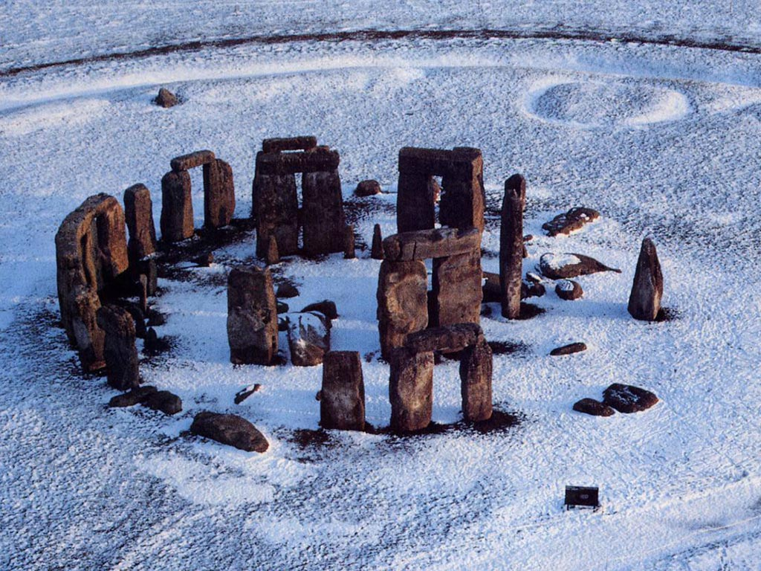

Slide 8
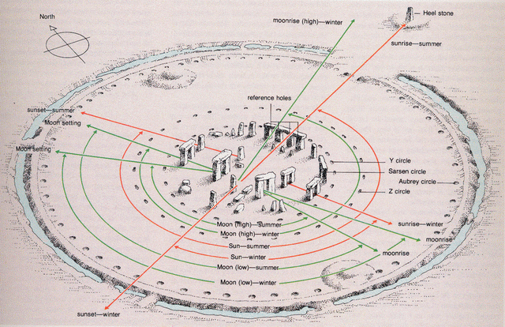
Stonehenge

Slide 9
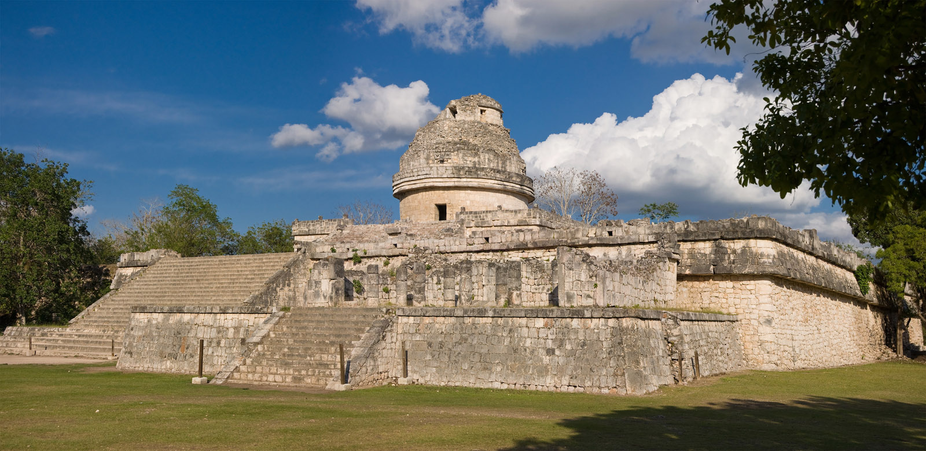
Caracol Observatory - Mayans
Notes:
El Caracol - Mayans

Slide 10
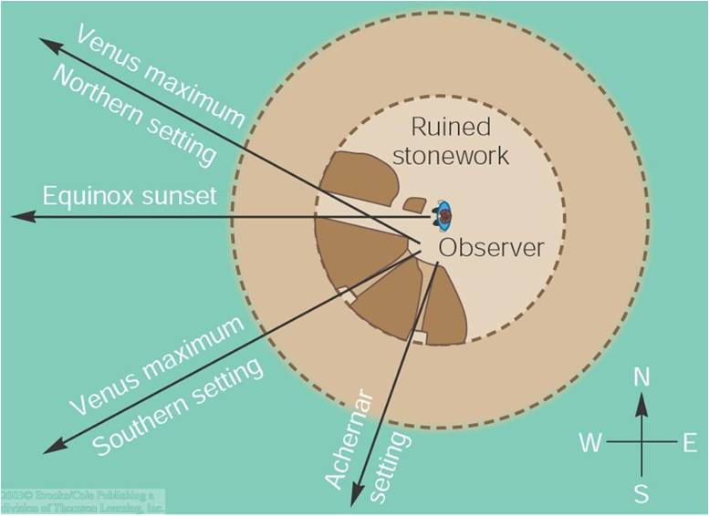

Slide 11
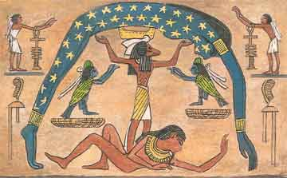
Egypt

Slide 12
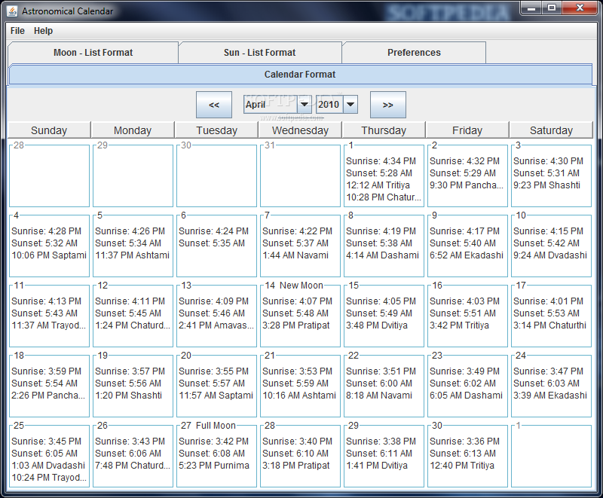
Calendars
Our calendar marks
astronomical events.
Year - one Earth revolution
around Sun.
Month - one Moon revolution around Earth
Day - one Earth rotation

Slide 13
Astronomy
Astronomy = study of celestial objects and phenomena outside Earth’s atmosphere
Includes galaxies, stars, planets, moons, cosmic radiation, etc.
Celestial object = Every object outside of Earth’s atmosphere

Slide 14
Space
Universe = includes everything in existence.
~13.8 billion years old.
Galaxies = collections of billions of stars.
Our galaxy is the Milky Way.
Solar System = Stars and whatever revolves around them;
Includes planets, dwarf planets, comets, and asteroids.

Slide 15
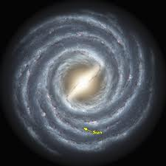
Milky Way

Slide 16
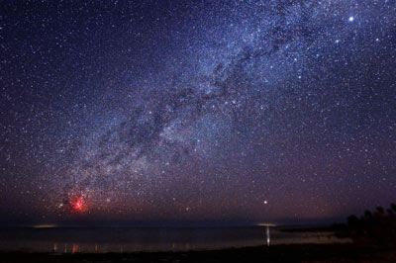
Milky Way

Slide 17
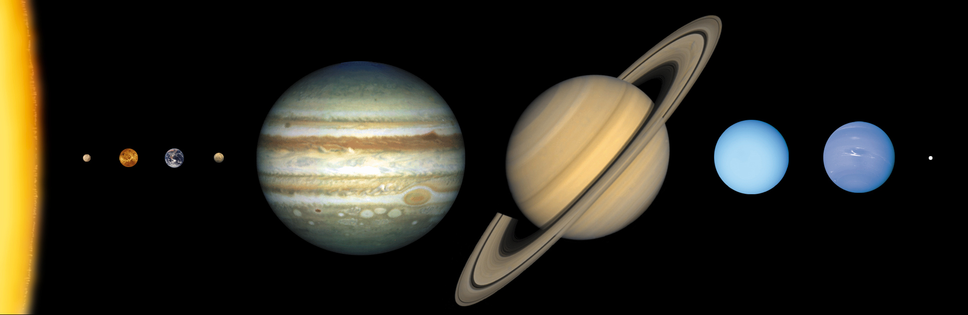
Solar System

Slide 18
Describe and explain your current beliefs and ideas about astrology and astronomy. At least 2 paragraphs.
  Which are you most familiar with?
  What are your beliefs and thoughts for each one?
  Which one, or both, do you think will be helpful in your life?

Slide 19
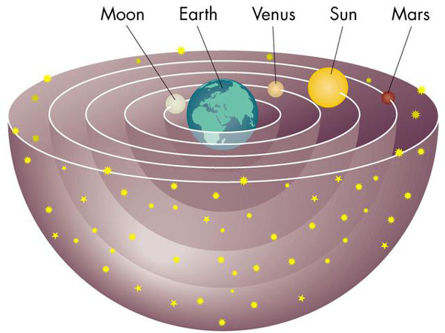
Geocentric Model
Aristotle (350 BC) - Geocentric model.
Why?
It explains the sun’s motion during the day.
Geocentric Model:
Earth at the center of universe.

Slide 20
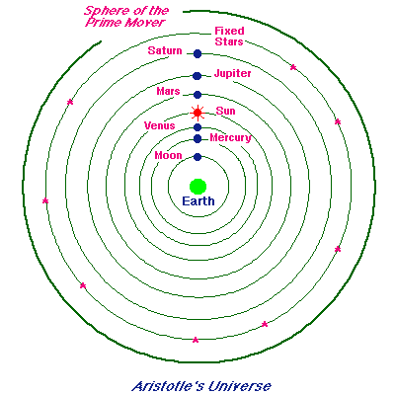
Aristotle’s Universe

Slide 21
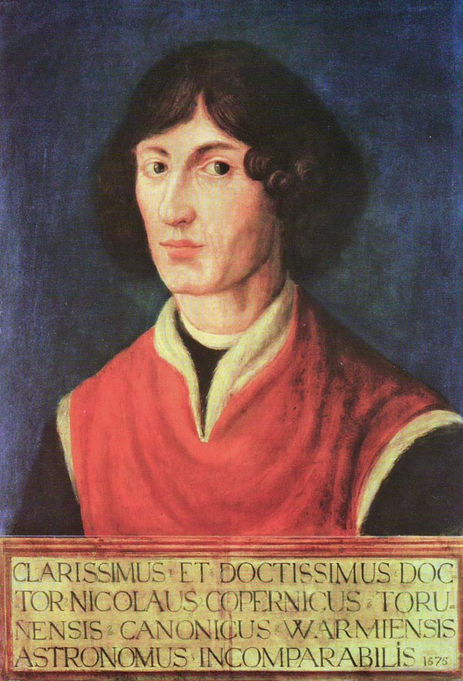
Copernicus

Slide 22
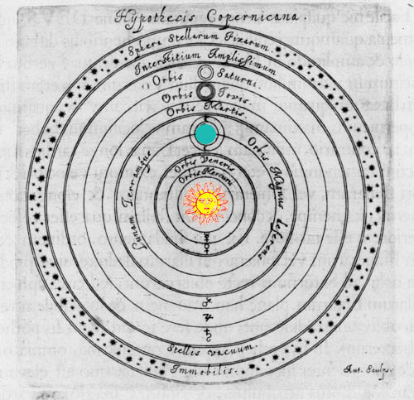
Heliocentric Model
Nicolaus Copernicus (1473 – 1543)
Heliocentric Model: Sun is at the center of universe.
Not accepted until Galileo 100 years later

Slide 23
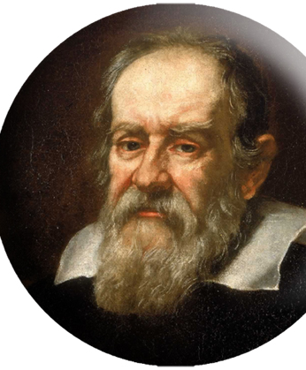
Galileo
Galileo Galilei (1564 – 1642)
-- finally disproved the geocentric theory.
-- the first to turn the telescope to the sky (he did not invent the telescope).
-- first scientist…tested ideas with experiments.

Slide 24
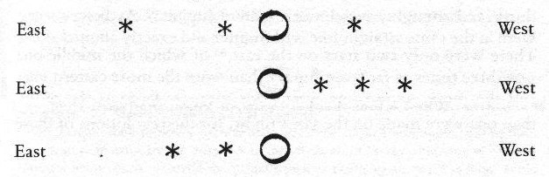
Jupiter’s Moons
Notes:
What do you think this represents? Can you tell these are moons?

Slide 25
Galileo Firsts
First to see 4 moons of Jupiter.
This ended the geocentric theory… not all objects orbit Earth.

Slide 26
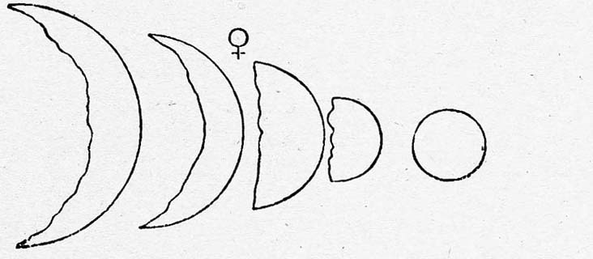
Galileo
First to see Venus’ phases; explained its brightness.

Slide 27
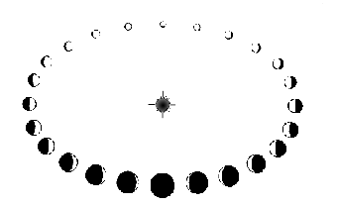

Slide 28
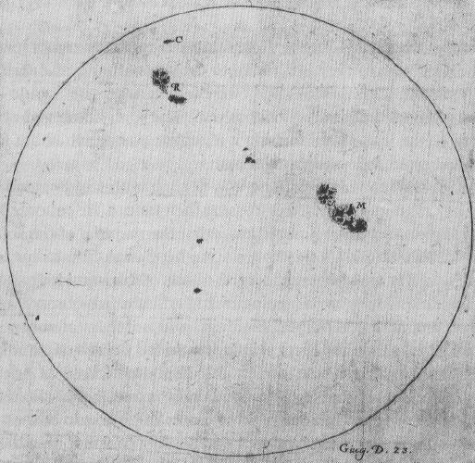
Sunspots
First to see sunspots and moon craters
universe not perfect

