Slide 1
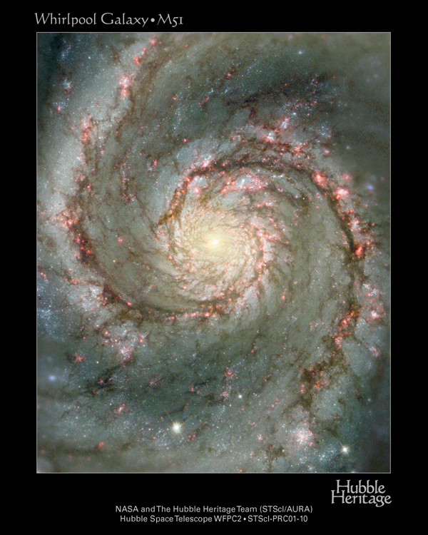

Slide 2
Galaxies
Large collection of stars held together by gravity… there are hundreds of billions of galaxies.
Dark matter makes up 90% of galaxy mass… doesn’t emit or absorb EMR, so cannot be seen.
Supermassive black holes likely found at center of all galaxies.

Slide 3
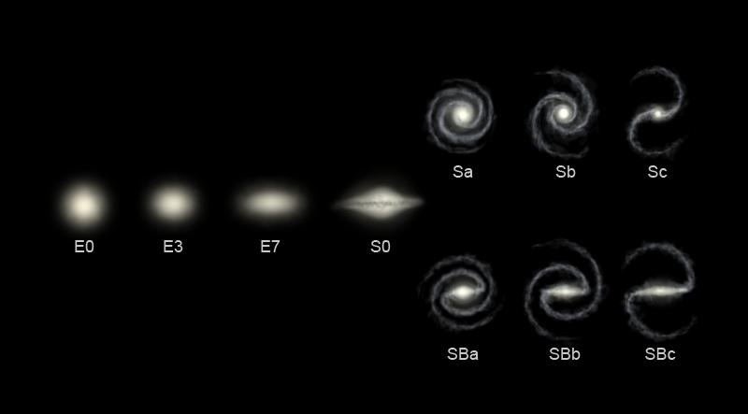
Types

Slide 4
Types
Elliptical = The largest type… likely formed by collision with other galaxies.
Spiral = rotating disk of extended arms.
Irregular = all the others

Slide 5
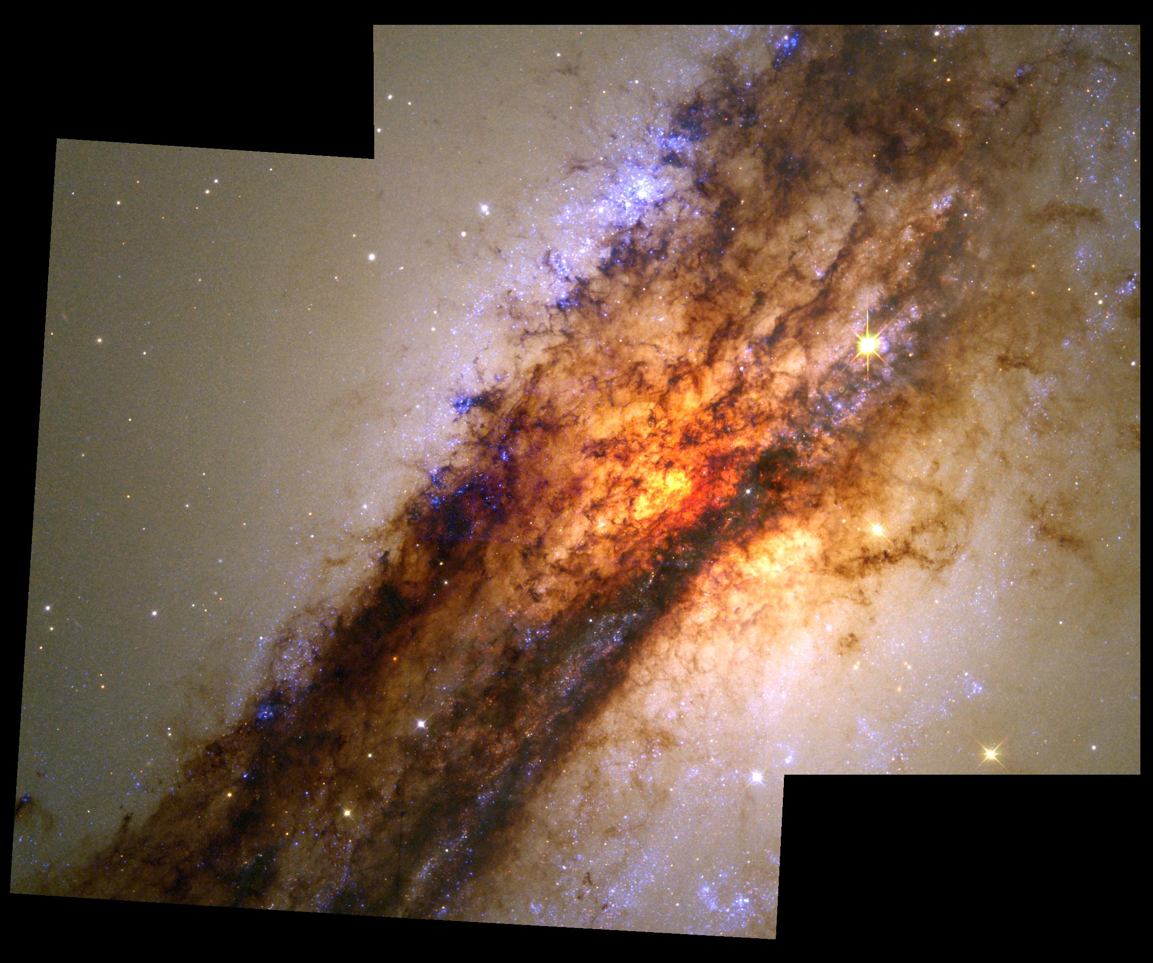

Slide 6
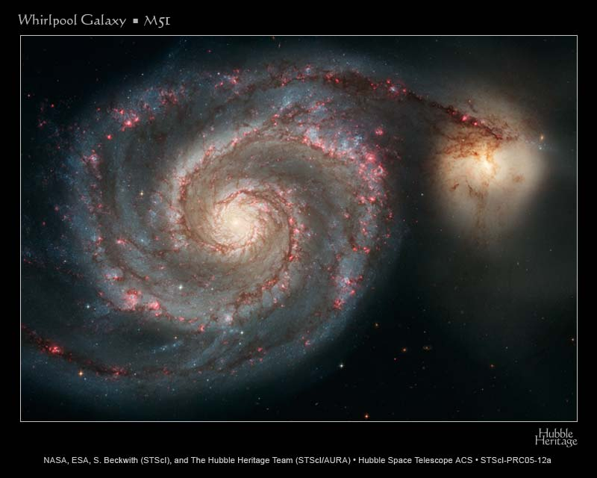

Slide 7
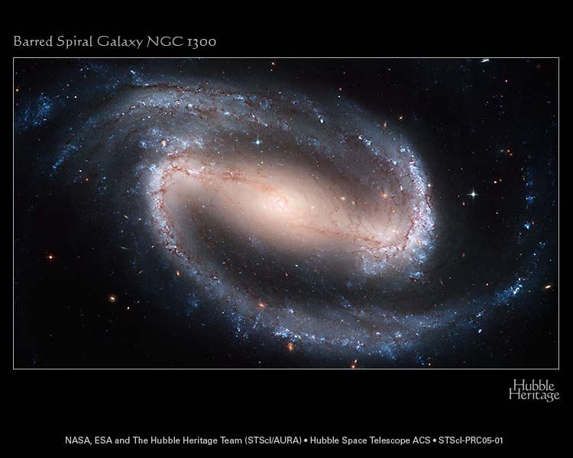

Slide 8
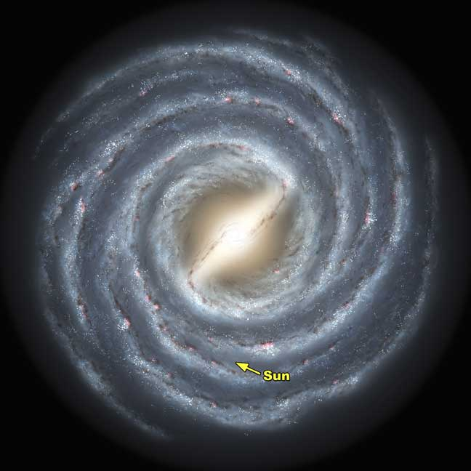

Slide 9
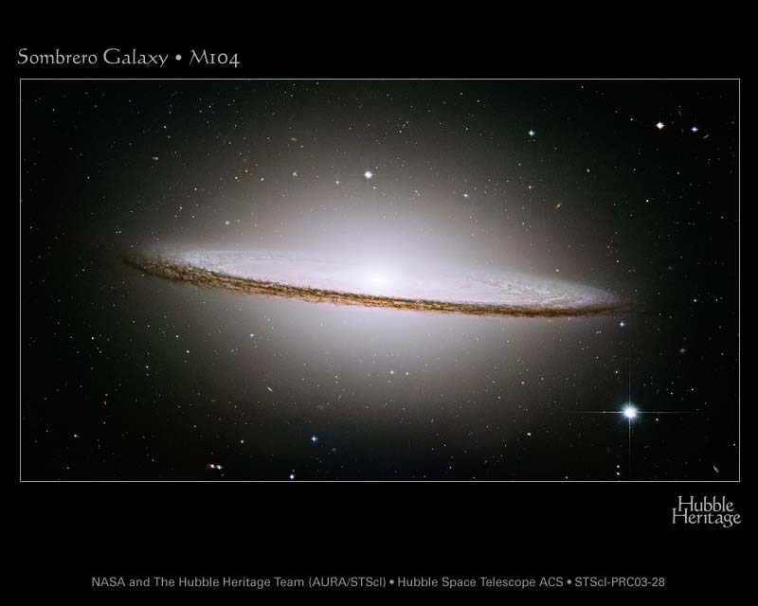

Slide 10
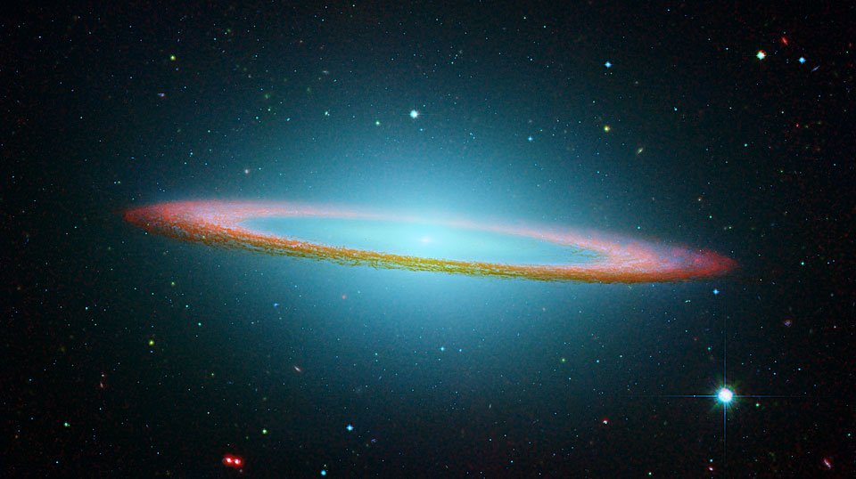

Slide 11
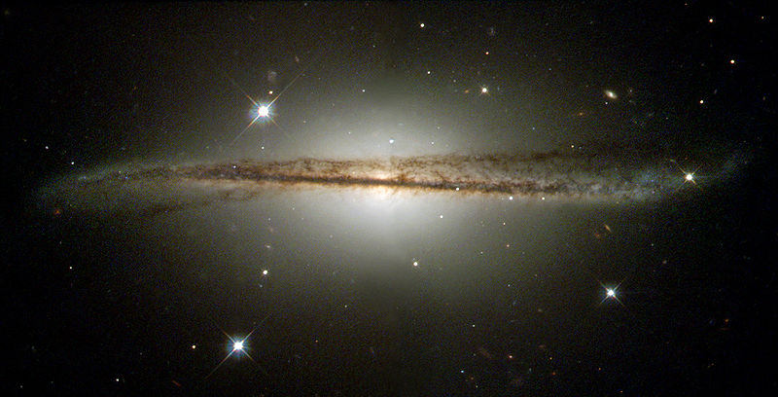
Warped Disk Galaxy

Slide 12
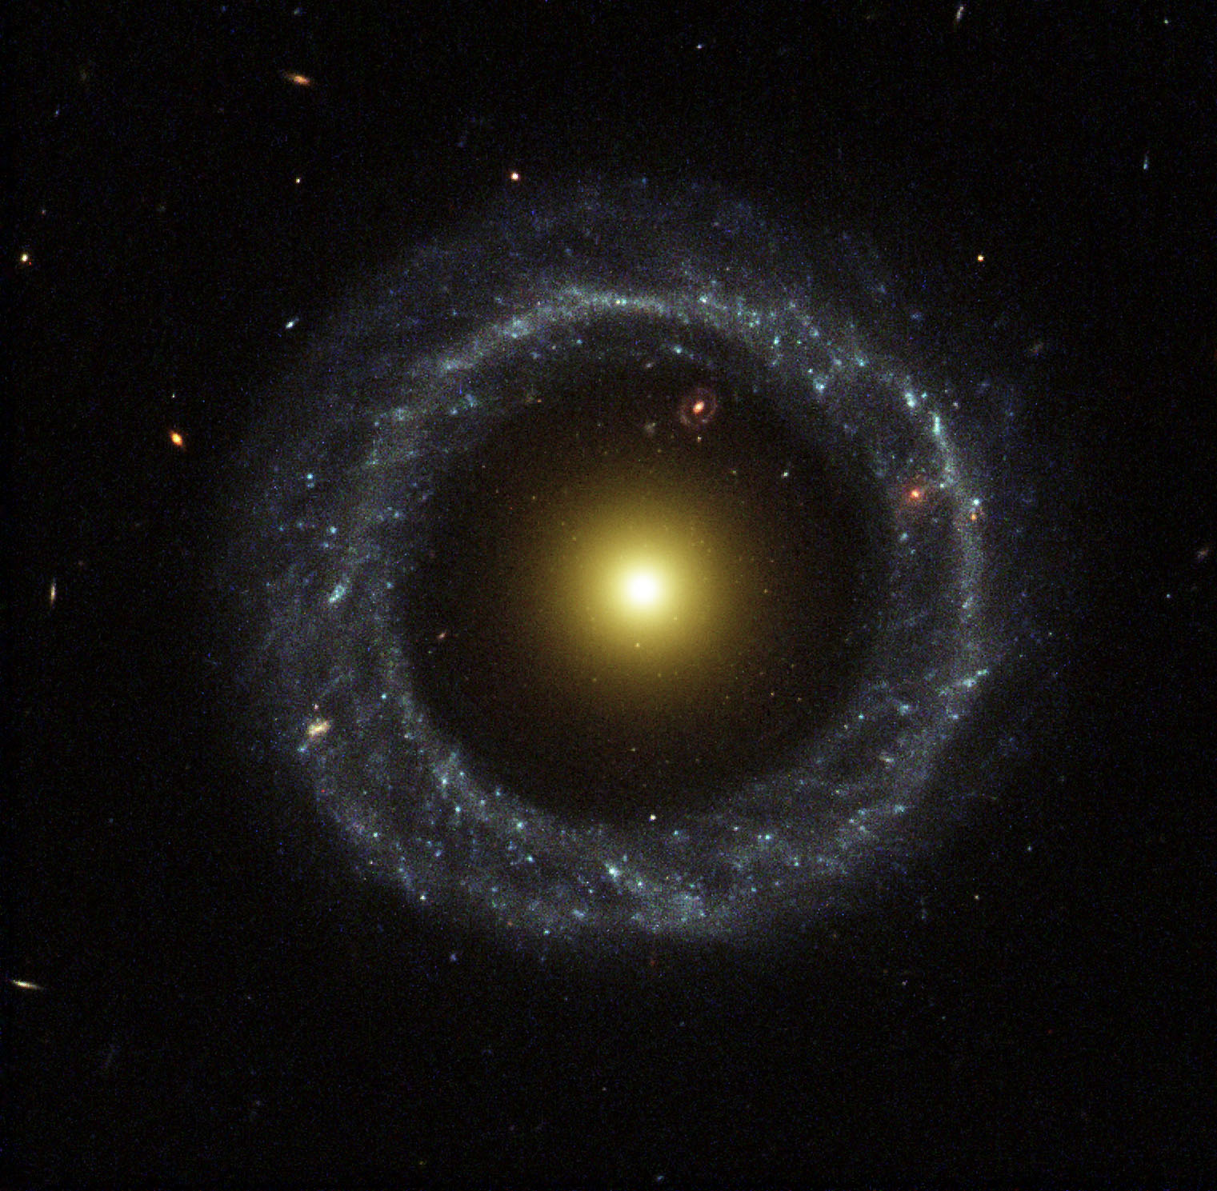

Slide 13
Galaxy Zoo Extra Credit
Now that you have learned how to classify galaxies go to the Galaxy Zoo website at: www.galaxyzoo.org.
Register on the main page and classify at least 20 galaxies.
Then print out your report and turn it in.
Make sure you are registered when you classify galaxies or Galaxy Zoo will NOT record your work!

Slide 14
Collisions
Common way for galaxies to grow larger.
During merge, stars do not collide... too much empty space.
Andromeda is heading toward Milky Way.
Milkomeda anyone?

Slide 15
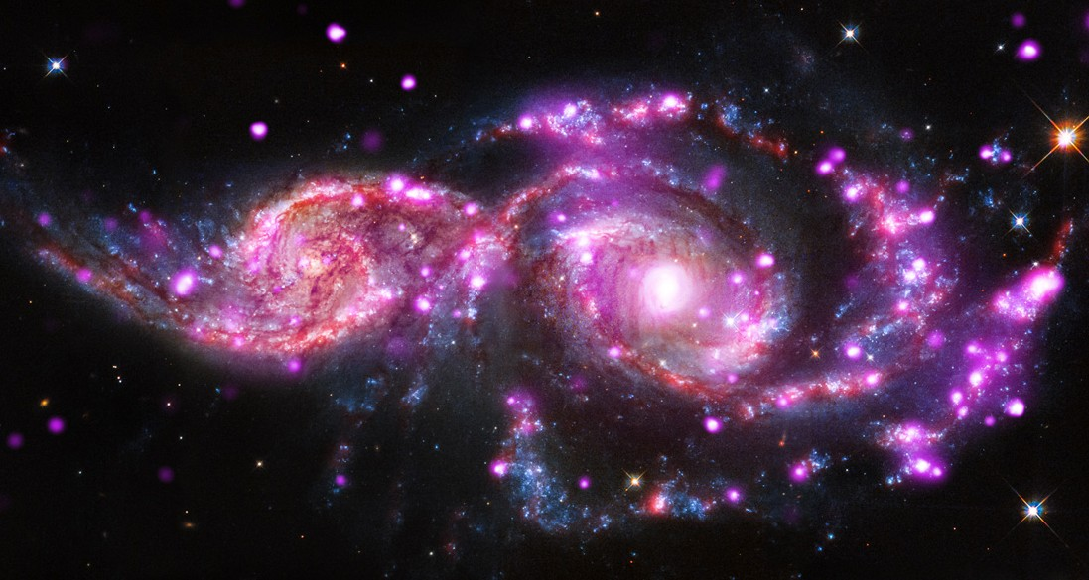

Slide 16
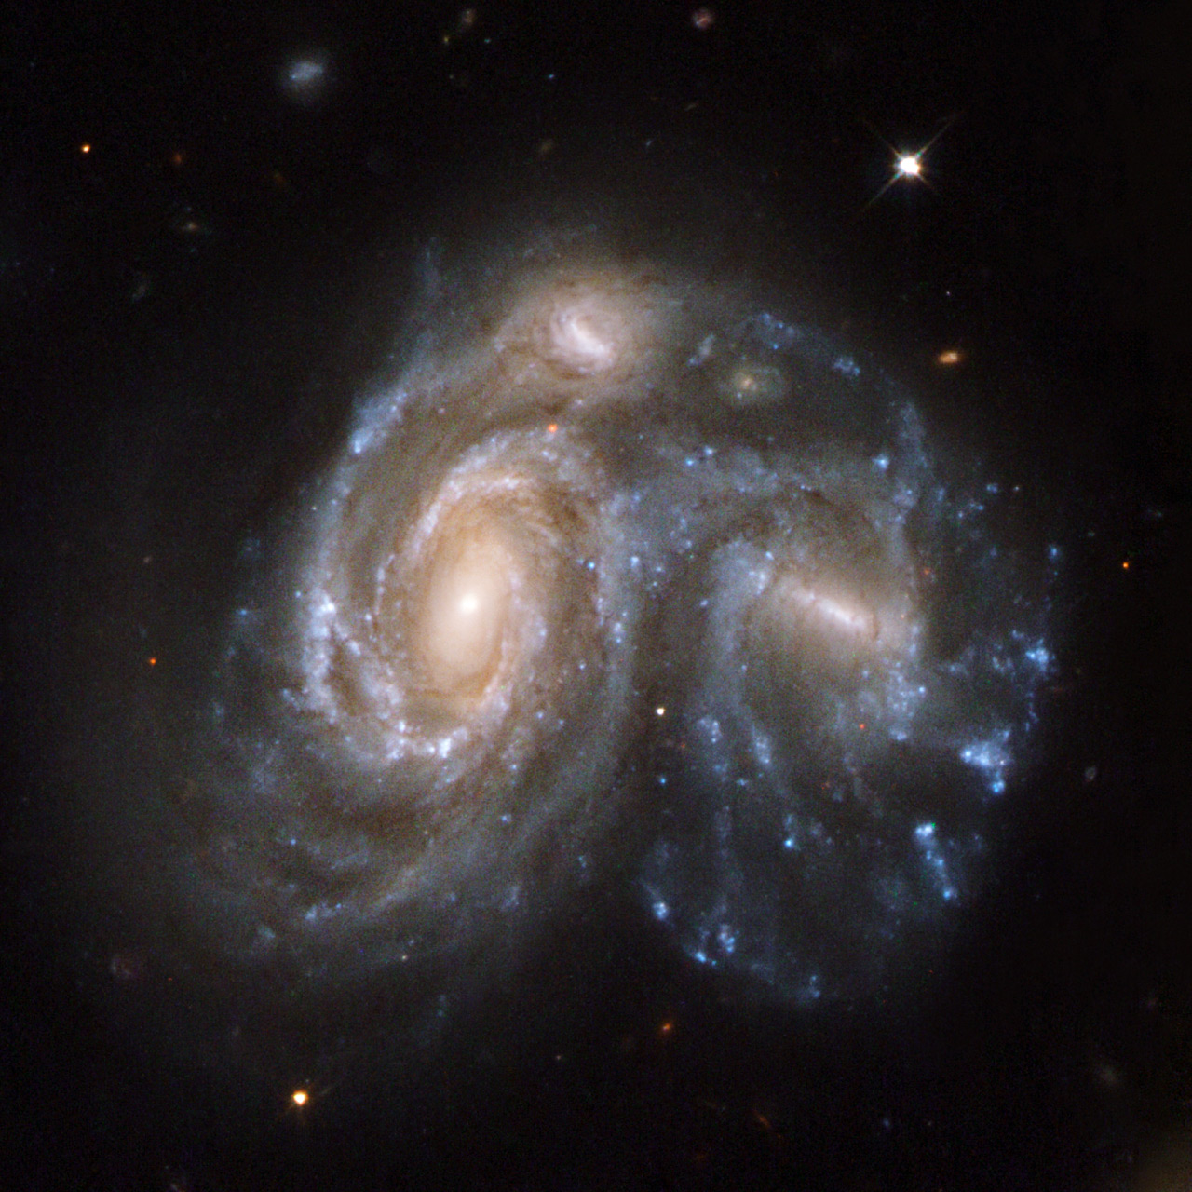

Slide 17
