Slide 1
Asteroids
Asteroid (“star-like”) = rocky or metallic bodies orbiting the sun.
Most located in orbit between Mars and Jupiter
Size ranges from a few meters to 1,000 km.
Formed 4.5 by ago.

Slide 2
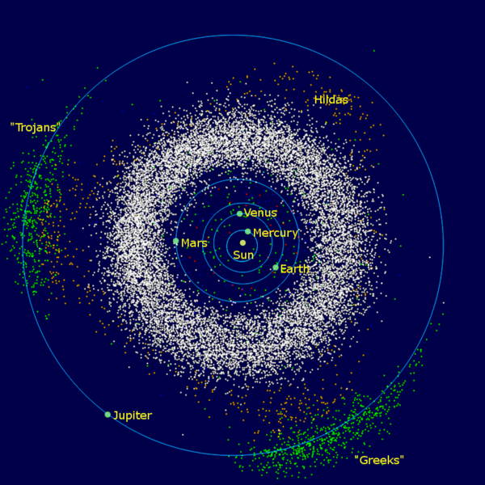

Slide 3
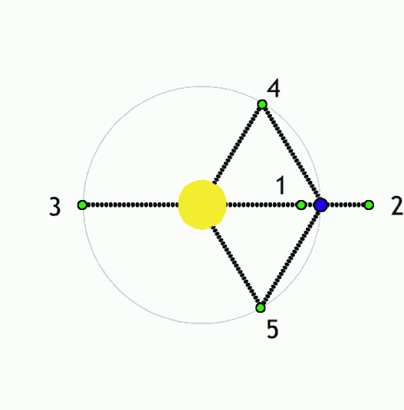
Lagrangian Points

Slide 4
What Happened?
Possible remnant of proto-planet.
Mass of all asteroids together equals only 4% of mass of Moon.
So, possible that Jupiter’s large mass/gravity ejected planetesimals… now not enough to form planet.

Slide 5
Types
C-Type = carbon-rich (oldest)
S-Type = stony
M-Type = metallic
Irregularly shaped (potato-like) because small in size… not enough mass to be sphere.

Slide 6
Ceres
Largest object in asteroid belt at 951 km (591 miles).
Now considered a “dwarf planet,” like Pluto.
Only spherical object in belt.
Dawn spacecraft will visit in 2015

Slide 7
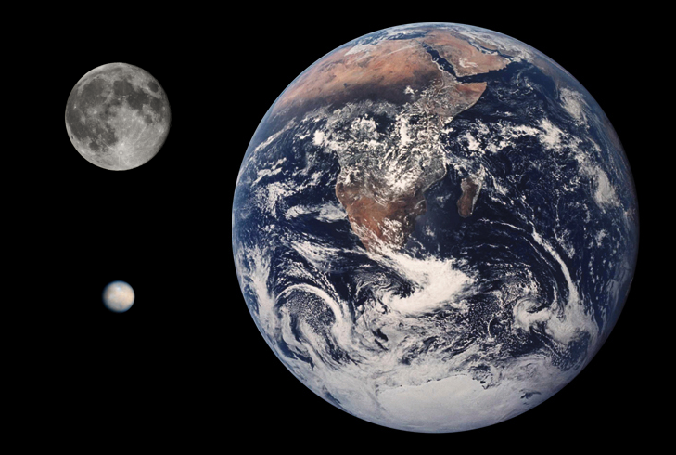

Slide 8
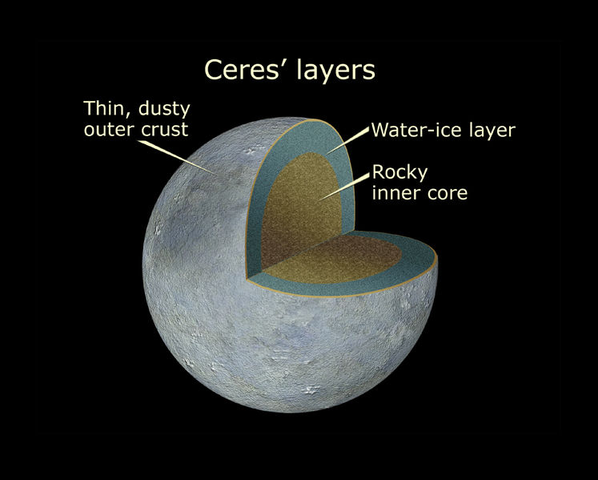

Slide 9
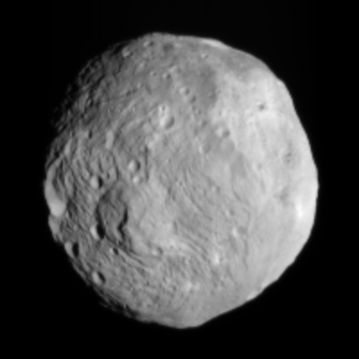
Vesta
2nd largest asteroid – (dwarf planet?)

Slide 10
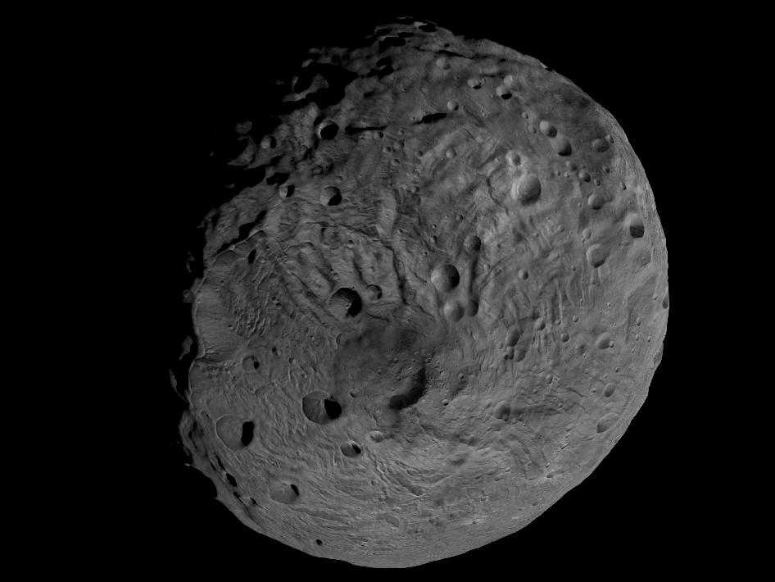
Vesta South Pole
(should be a sphere)

Slide 11
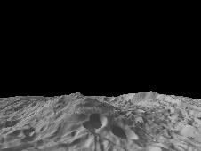
Vesta
(13-mile high Mtn)

Slide 12
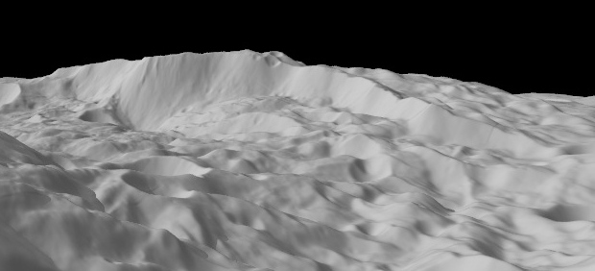
Vesta Landslides

Slide 13
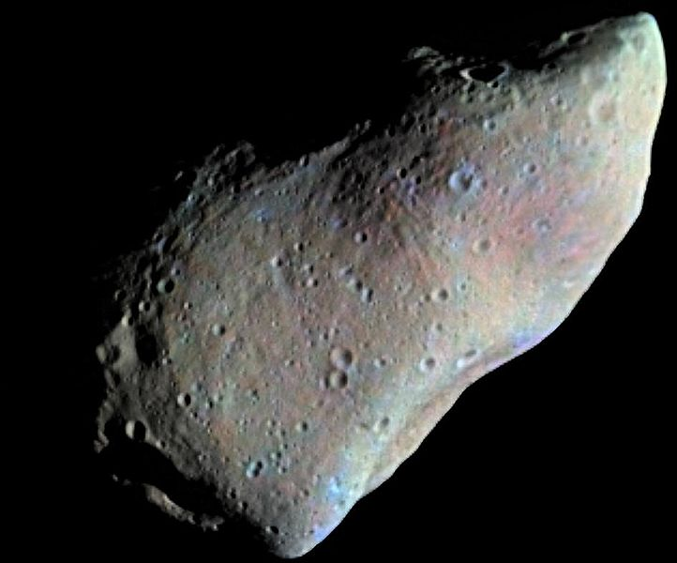
Gaspra

Slide 14
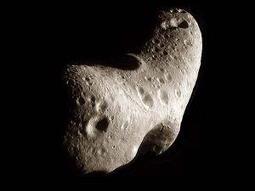
Eros (NASA soft-landed)

Slide 15
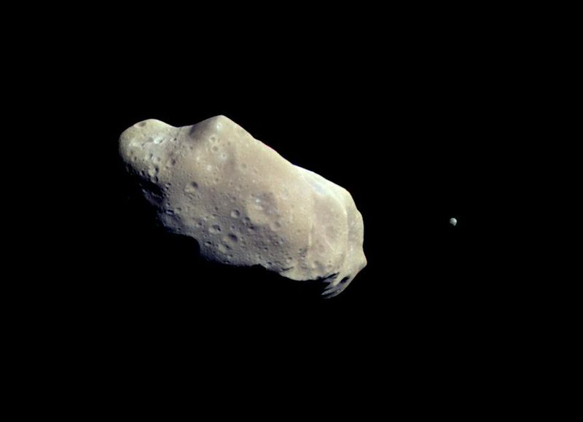
Asteroid Moons (Ida + Dactyl)

Slide 16
Meteoroids
Meteoroid = small piece of asteroid on collision course with Earth.
Meteor = when meteoroid hits Earth’s atmosphere… usually burns up (shooting star).
Meteorite = if meteor hits Earth. Over 100 meteorites fall annually…most very small.

Slide 17
Threat to Planet
NASA gets <1% of federal budget… very little of this goes to asteroid detection/prevention.
NEO (Near Earth Object) program searches for potential problem asteroids.
1-2 km wide can cause worldwide damage.

Slide 18
Earth’s Oceans and Life
Earth’s oceans may have largely come from asteroids bombarding early Earth.
Unlikely that comets contributed.
Some asteroids (C-type) contain hydrates (water) and organics (amino acids).

Slide 19
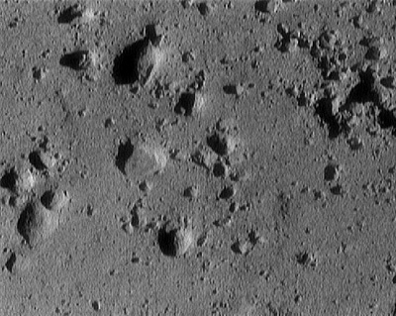
Eros Regolith

Slide 20
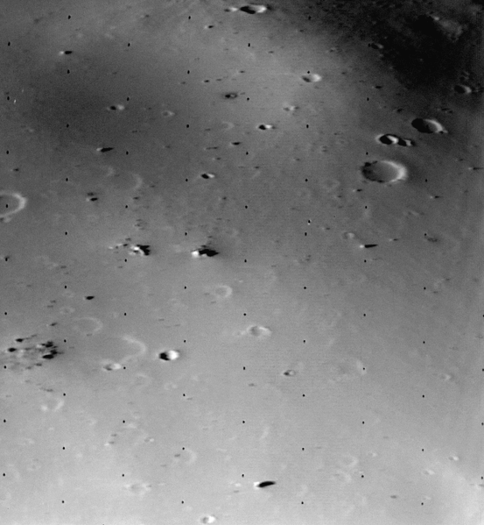
Deimos Regolith

