Slide 1
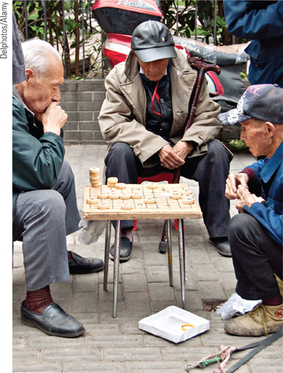
Aging - Physical Development

Slide 2
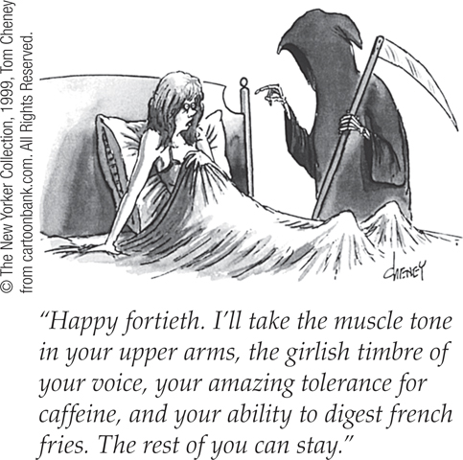
Middle Adulthood
Menopause –
the natural cessation of menstruation; also refers to the biological changes a woman experiences as her ability to reproduce declines.

Slide 3
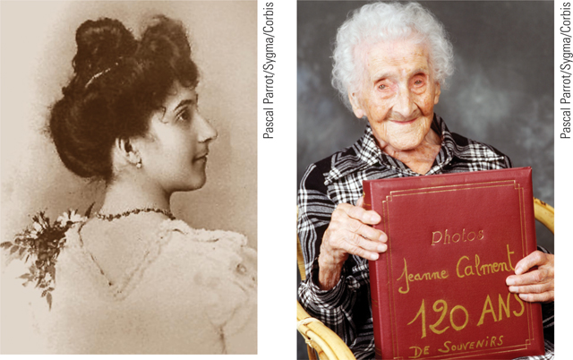
Physical Changes in Later Life
Physical changes in later life
  Strength and stamina
  Sensory abilities
  Health
  The aging bran:
    Neurocognitive disorders:
    (Alzheimers, Parkinsons, dementia)

Slide 4
Cognitive Development

Slide 5
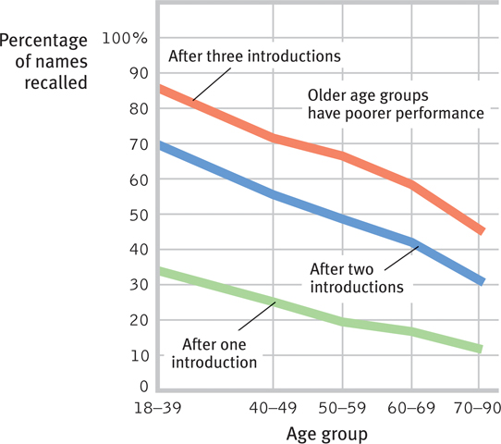
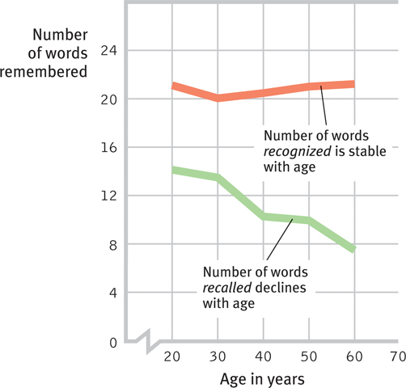
Cognitive Development
Recall versus Recognition

Slide 6
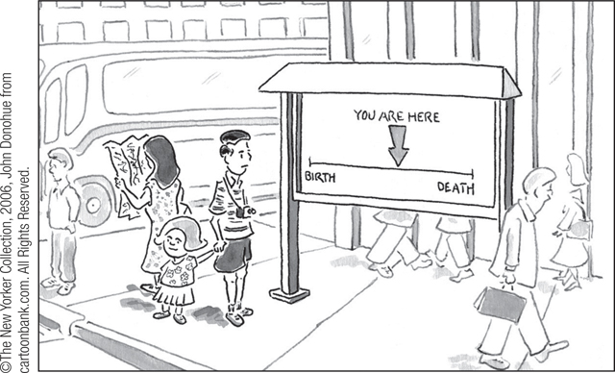
Cognitive Development
Cross-Sectional Evidence
  Cross-sectional study
Longitudinal Evidence
  Longitudinal study
Terminal decline

Slide 7
Social Development

Slide 8
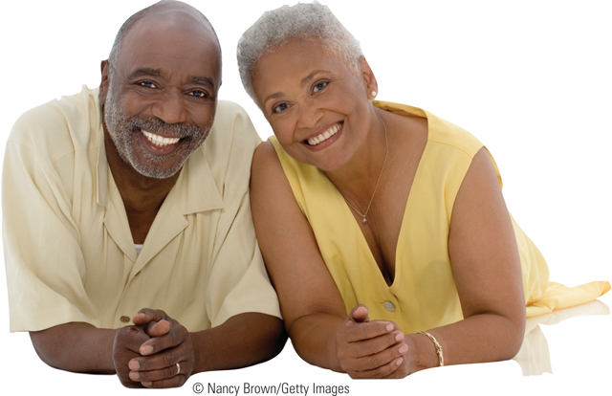
Adulthood’s Ages and Stages
Midlife transition
Social clock - the culturally preferred timing of social events such as marriage, parenthood, and retirement.

Slide 9
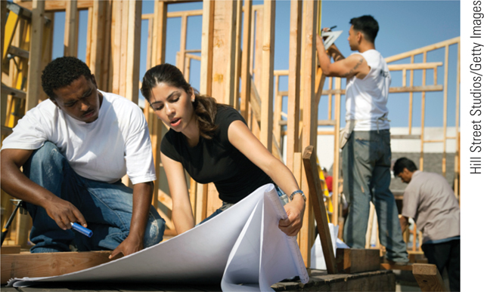
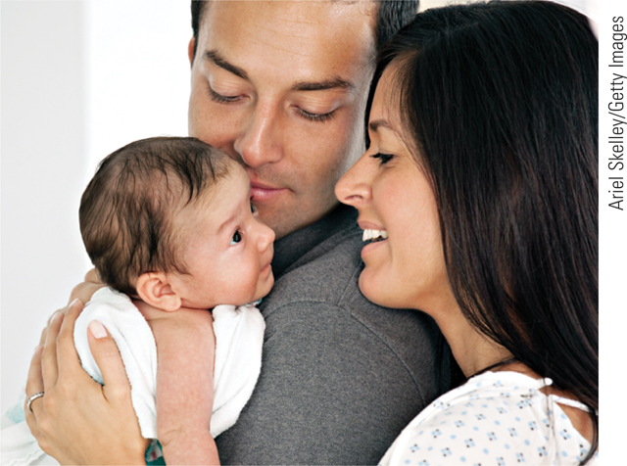
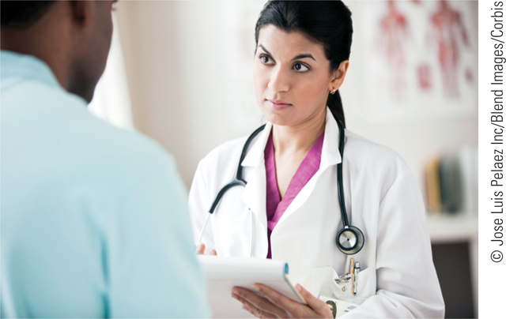
Adulthood’s Commitments
- Love
- Work

Slide 10
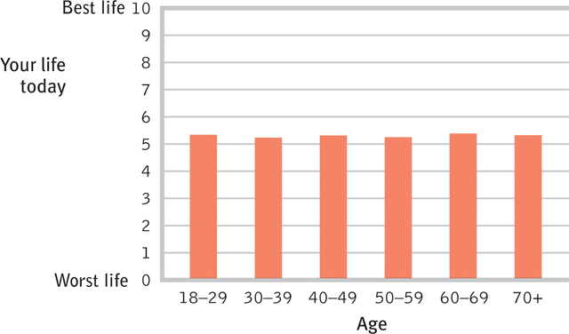
Well-Being Across the Life Span
- Well-being across the life span
- Death and dying

