Slide 1

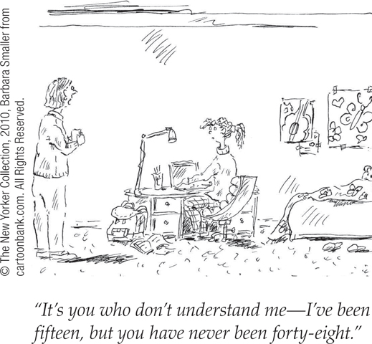
Parent and Peer Relationships

Slide 2

Forming an Identity

Slide 3
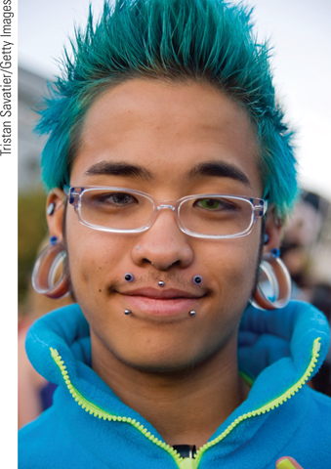
Forming an Identity
Forming an identity
  Identity – sense of self
  Social identity – what group
  Intimacy – ability to form close
  relationships

Slide 4
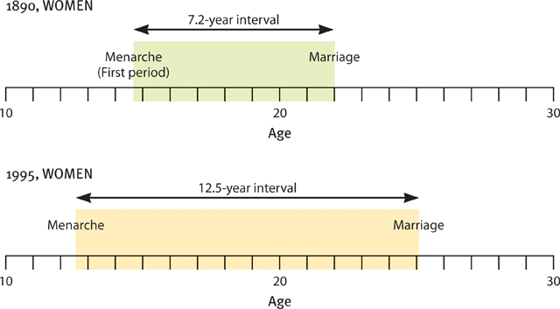
Emerging Adulthood

Slide 5
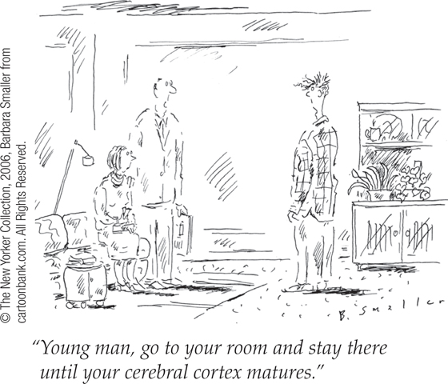
Physical Development
Puberty
Brain development
  Myelin growth

Slide 6
Adolescent Sexual Development
Puberty
  Primary sexual characteristics - the body structures (ovaries, testes, and external genitalia) that makes sexual reproduction possible.
    Menarche – menstruation
  Secondary sexual characteristics - non-reproductive changes:
  such as female breasts and hips, male voice quality, and body hair.

Slide 7
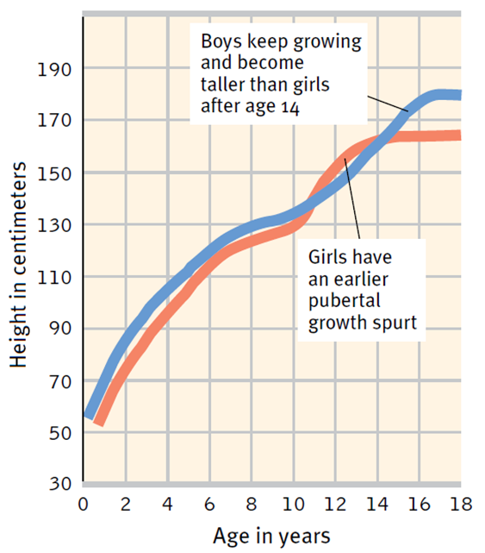

Adolescent Sexual Development

Slide 8
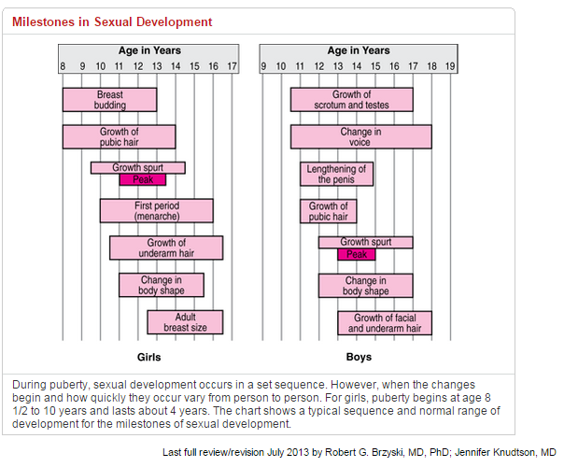
Puberty

Slide 9
Teen Anxiety and Mood Swings
Mood swings and anxiety, often caused by stress, are well known characteristics of puberty.
Anxiety is regulated by the brain's principal inhibitory neurotransmitter, GABA (gamma-amino-butyric-acid) which counteracts the effect of glutamate, an excitatory neurotransmitter in the brain's limbic system.

Slide 10
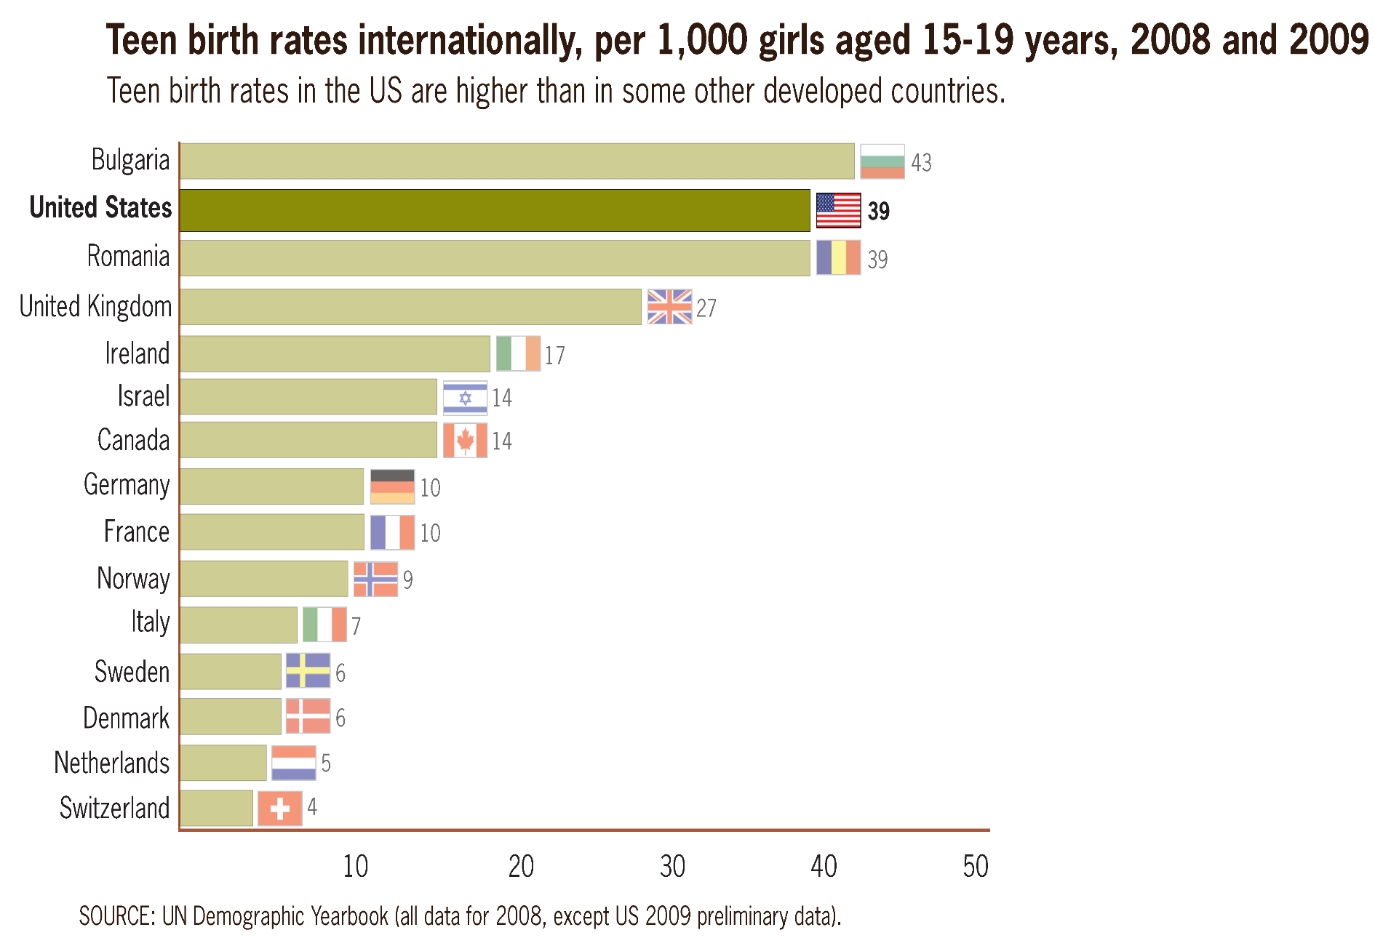
Teen Birth Rates

Slide 11
