Slide 1
Abnormal Psychology
The scientific study of abnormal behavior in order to describe, predict, explain, and change abnormal patterns of functioning.
About one in four adults suffer from a diagnosable mental disorder in a given year. Or ~58 million people.
About 6 percent suffer from a serious mental illness.
In addition, mental disorders are the leading cause of disability in the U.S. and Canada for ages 15-44.
Most common disorders are anxiety, phobias, and mood disorders

Slide 2
What Makes a Behavior a Mental Illness?
Many definitions have been proposed, yet none are universally accepted
Most definitions, however, share some common features…
“The Four Ds”
  Deviance – Different, extreme, unusual
  Distress – Unpleasant & upsetting
  Dysfunction – Causes interference with life
  Danger – Poses risk of harm
Notes:
OBJECTIVE 1| Identify criteria for judging whether behavior is psychologically disordered.

Slide 3
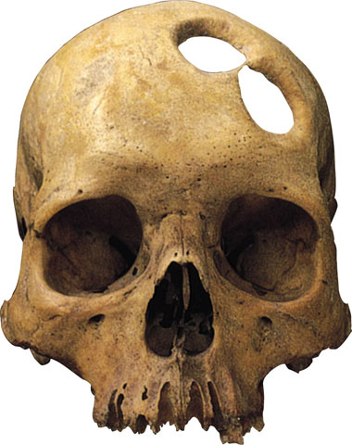
Understanding Psychological Disorders
Ancient Treatments of psychological disorders include trephination, exorcism, being caged like animals, being beaten, burned, castrated, mutilated, or transfused with animal’s blood.
Trephination - boring holes in the skull to
remove evil forces
Notes:
OBJECTIVE 2| Contrast the medical model of psychological disorders with the biopsychosocial perspective on disordered behavior.

Slide 4
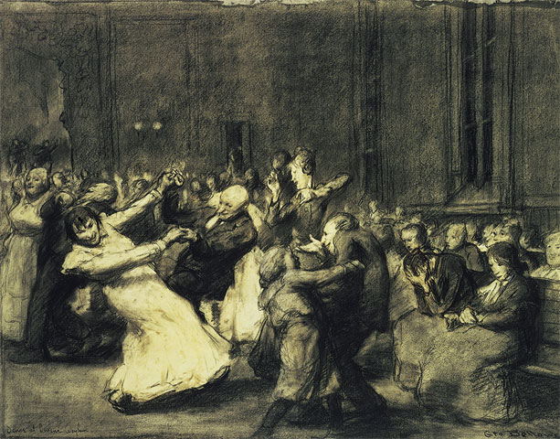
Medical Perspective
Philippe Pinel (1745-1826) from France, insisted that madness was not due to demonic possession, but an ailment of the mind.
George Wesley Bellows, Dancer in a Madhouse, 1907. © 1997 The Art Institute of Chicago
Dance in the madhouse.

Slide 5
Medical Approach
When physicians discovered that syphilis led to mental disorders, they started using medical models to review the physical causes of these disorders.
Etiology: Cause and development of the disorder.
Diagnosis: Identifying (symptoms) and distinguishing one disease from another.
Treatment: Treating a disorder in a psychiatric hospital.
Prognosis: Forecast about the disorder.

Slide 6
Models of the Causes of Psychological Disorders
Biological model
  Physiological or biochemical basis
Psychoanalytic model
  Disorders are the result of unconscious conflicts
Cognitive-Behavioral model
  Disorders are the result of learning maladaptive ways of behaving and thinking
Diathesis-Stress model
  Biological predisposition to disorder which is triggered by stress

Slide 7
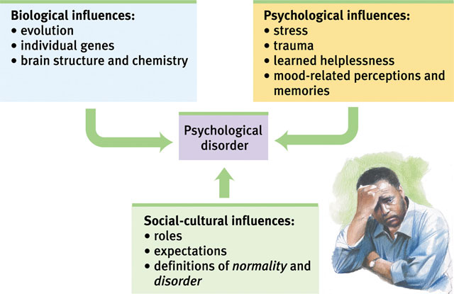
Biopsychosocial Model
Assumes that biological, socio-cultural, and psychological factors combine and interact to produce psychological disorders.

Slide 8
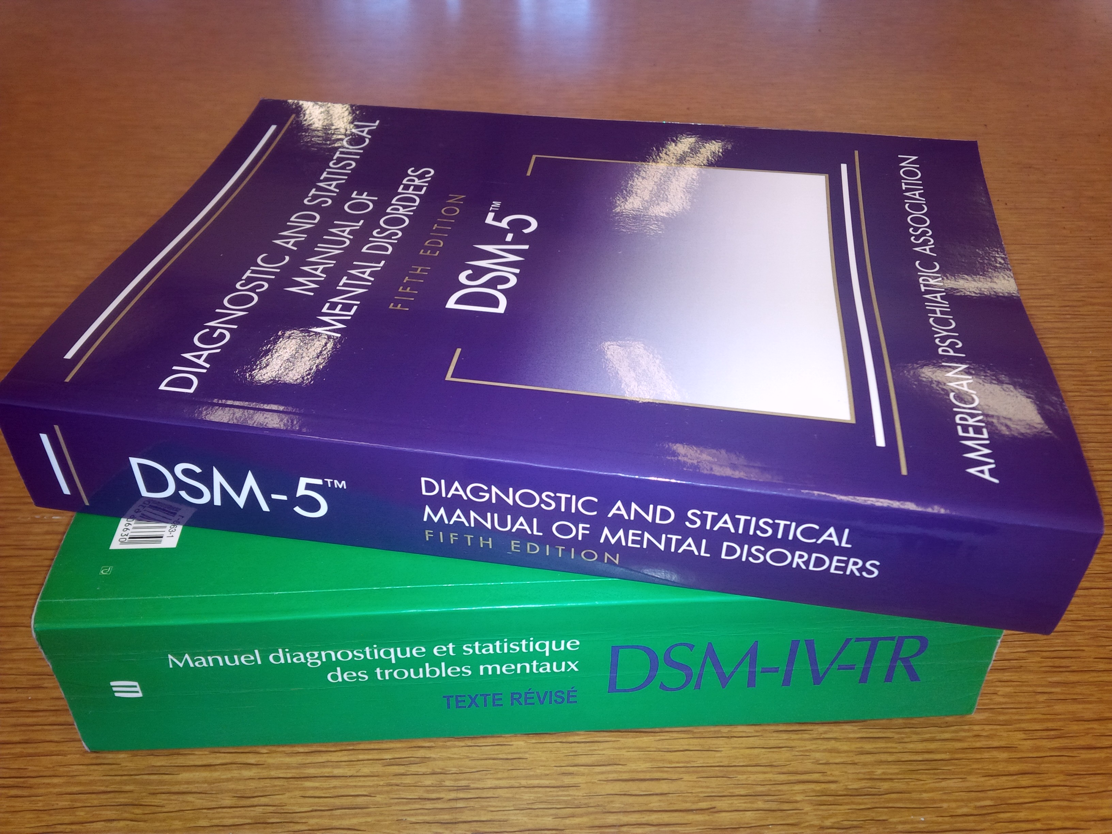
Classifying Psychological Disorders
The Diagnostic and Statistical Manual of Mental Disorders (DSM) describes psychological disorders.
The most recent edition, DSM-5 (2013), describes over 150 psychological disorders compared to 60 in the 1950s.
- Standardizes the classification of disorders enhancing the reliability of a diagnosis.
Notes:
OBJECTIVE 3| Describe the goals and content of the DSM-IV.

Slide 9
The DSM lists the specific diagnostic criteria
- An example of this can be seen in the diagnosis of a major depressive episode.
- A person must exhibit at least five or more of the listed nine characteristics and the symptoms must be evident for at least the last two weeks for that person to be diagnosed with this disorder.
- When diagnosing a client, the American Psychological Association recommends that the clinician use a Multiaxial Assessment System.

Slide 10
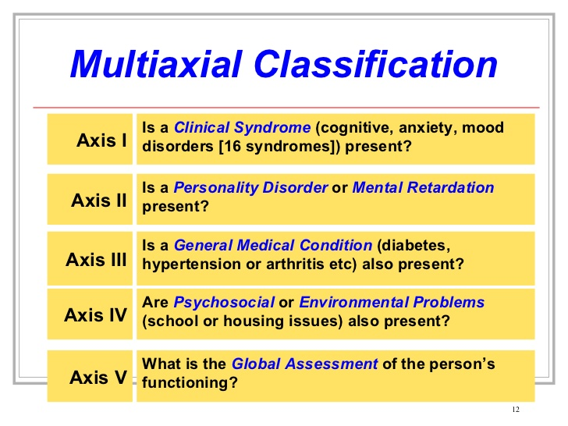

Slide 11
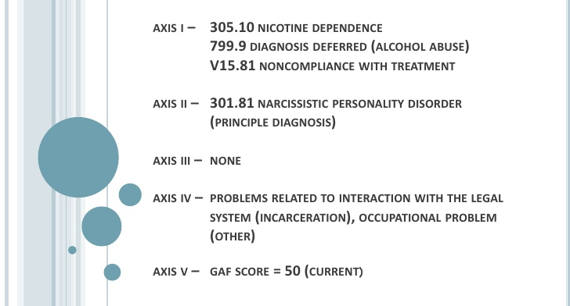

Slide 12
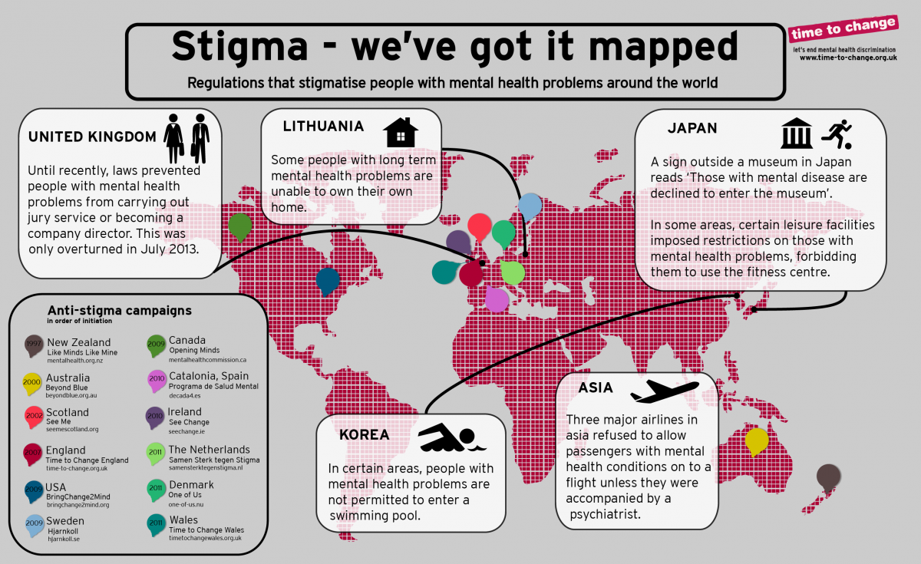
DSM Pros and Cons
Pros – helps define the problem; shows how behavior is related
Cons - labels stigmatize individuals. Create self-fulfilling prophesy.
Notes:
OBJECTIVE 4| Discuss the potential dangers and benefits of using diagnostic labels.

Slide 13
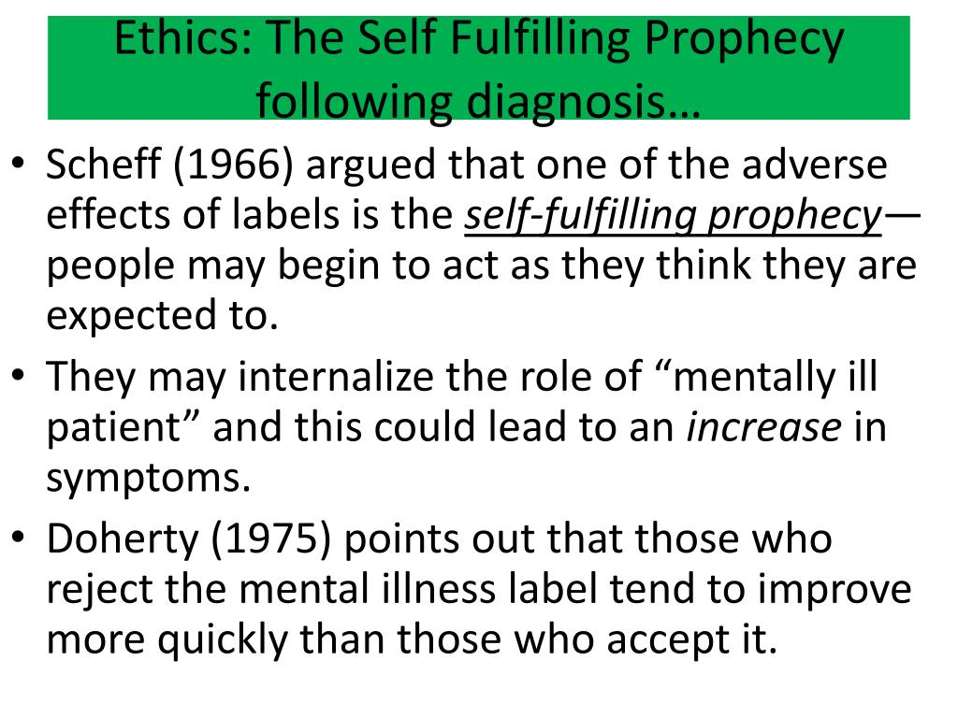

Slide 14
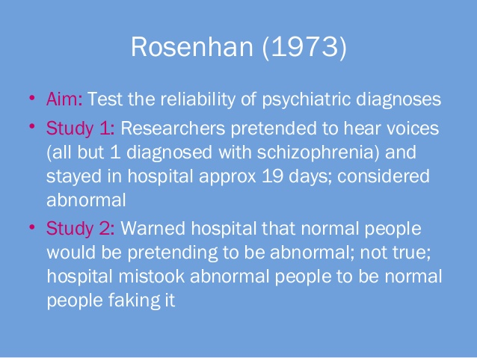

Slide 15
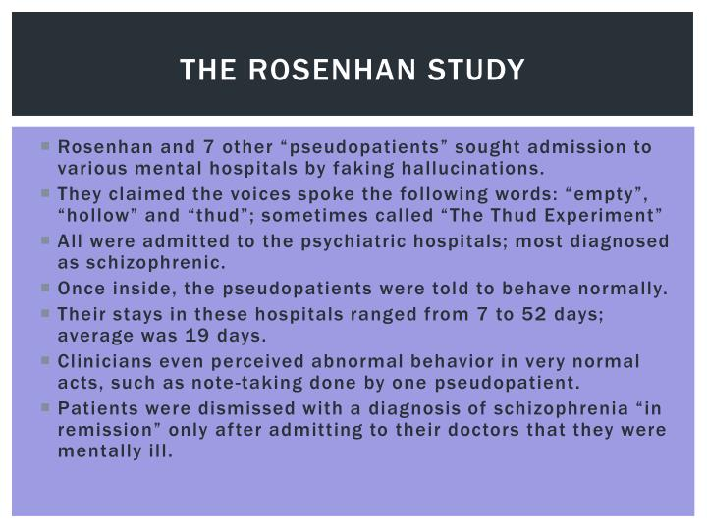

Slide 16
Criminal Justice?
“Insanity” is a legal term…not psychiatric. Does the person know right from wrong.
Can we blame persons for crimes if causes are psychological or biological?
Ex. Charles Whitman went to 5 doctors and a psychiatrist in 1966, saying he was having violent impulses. No
treatment was given other than valium. The psychiatrist noted “He readily admits having overwhelming periods of
hostility with a very minimum of provocation. Repeated inquiries attempting to analyze his exact experiences were not
too successful, with the exception of his vivid reference to 'thinking about going up on the tower with a deer rifle and
start shooting people.”
A few months later, he first killed his wife and mother, then went to the University of Texas and
from a tower terrorized the campus for an hour and a half, shooting and killing 14 and
wounding 31. An autopsy later showed a he had a brain tumor.

